Slide 1
JUNIOR PARENT NIGHT

Slide 2
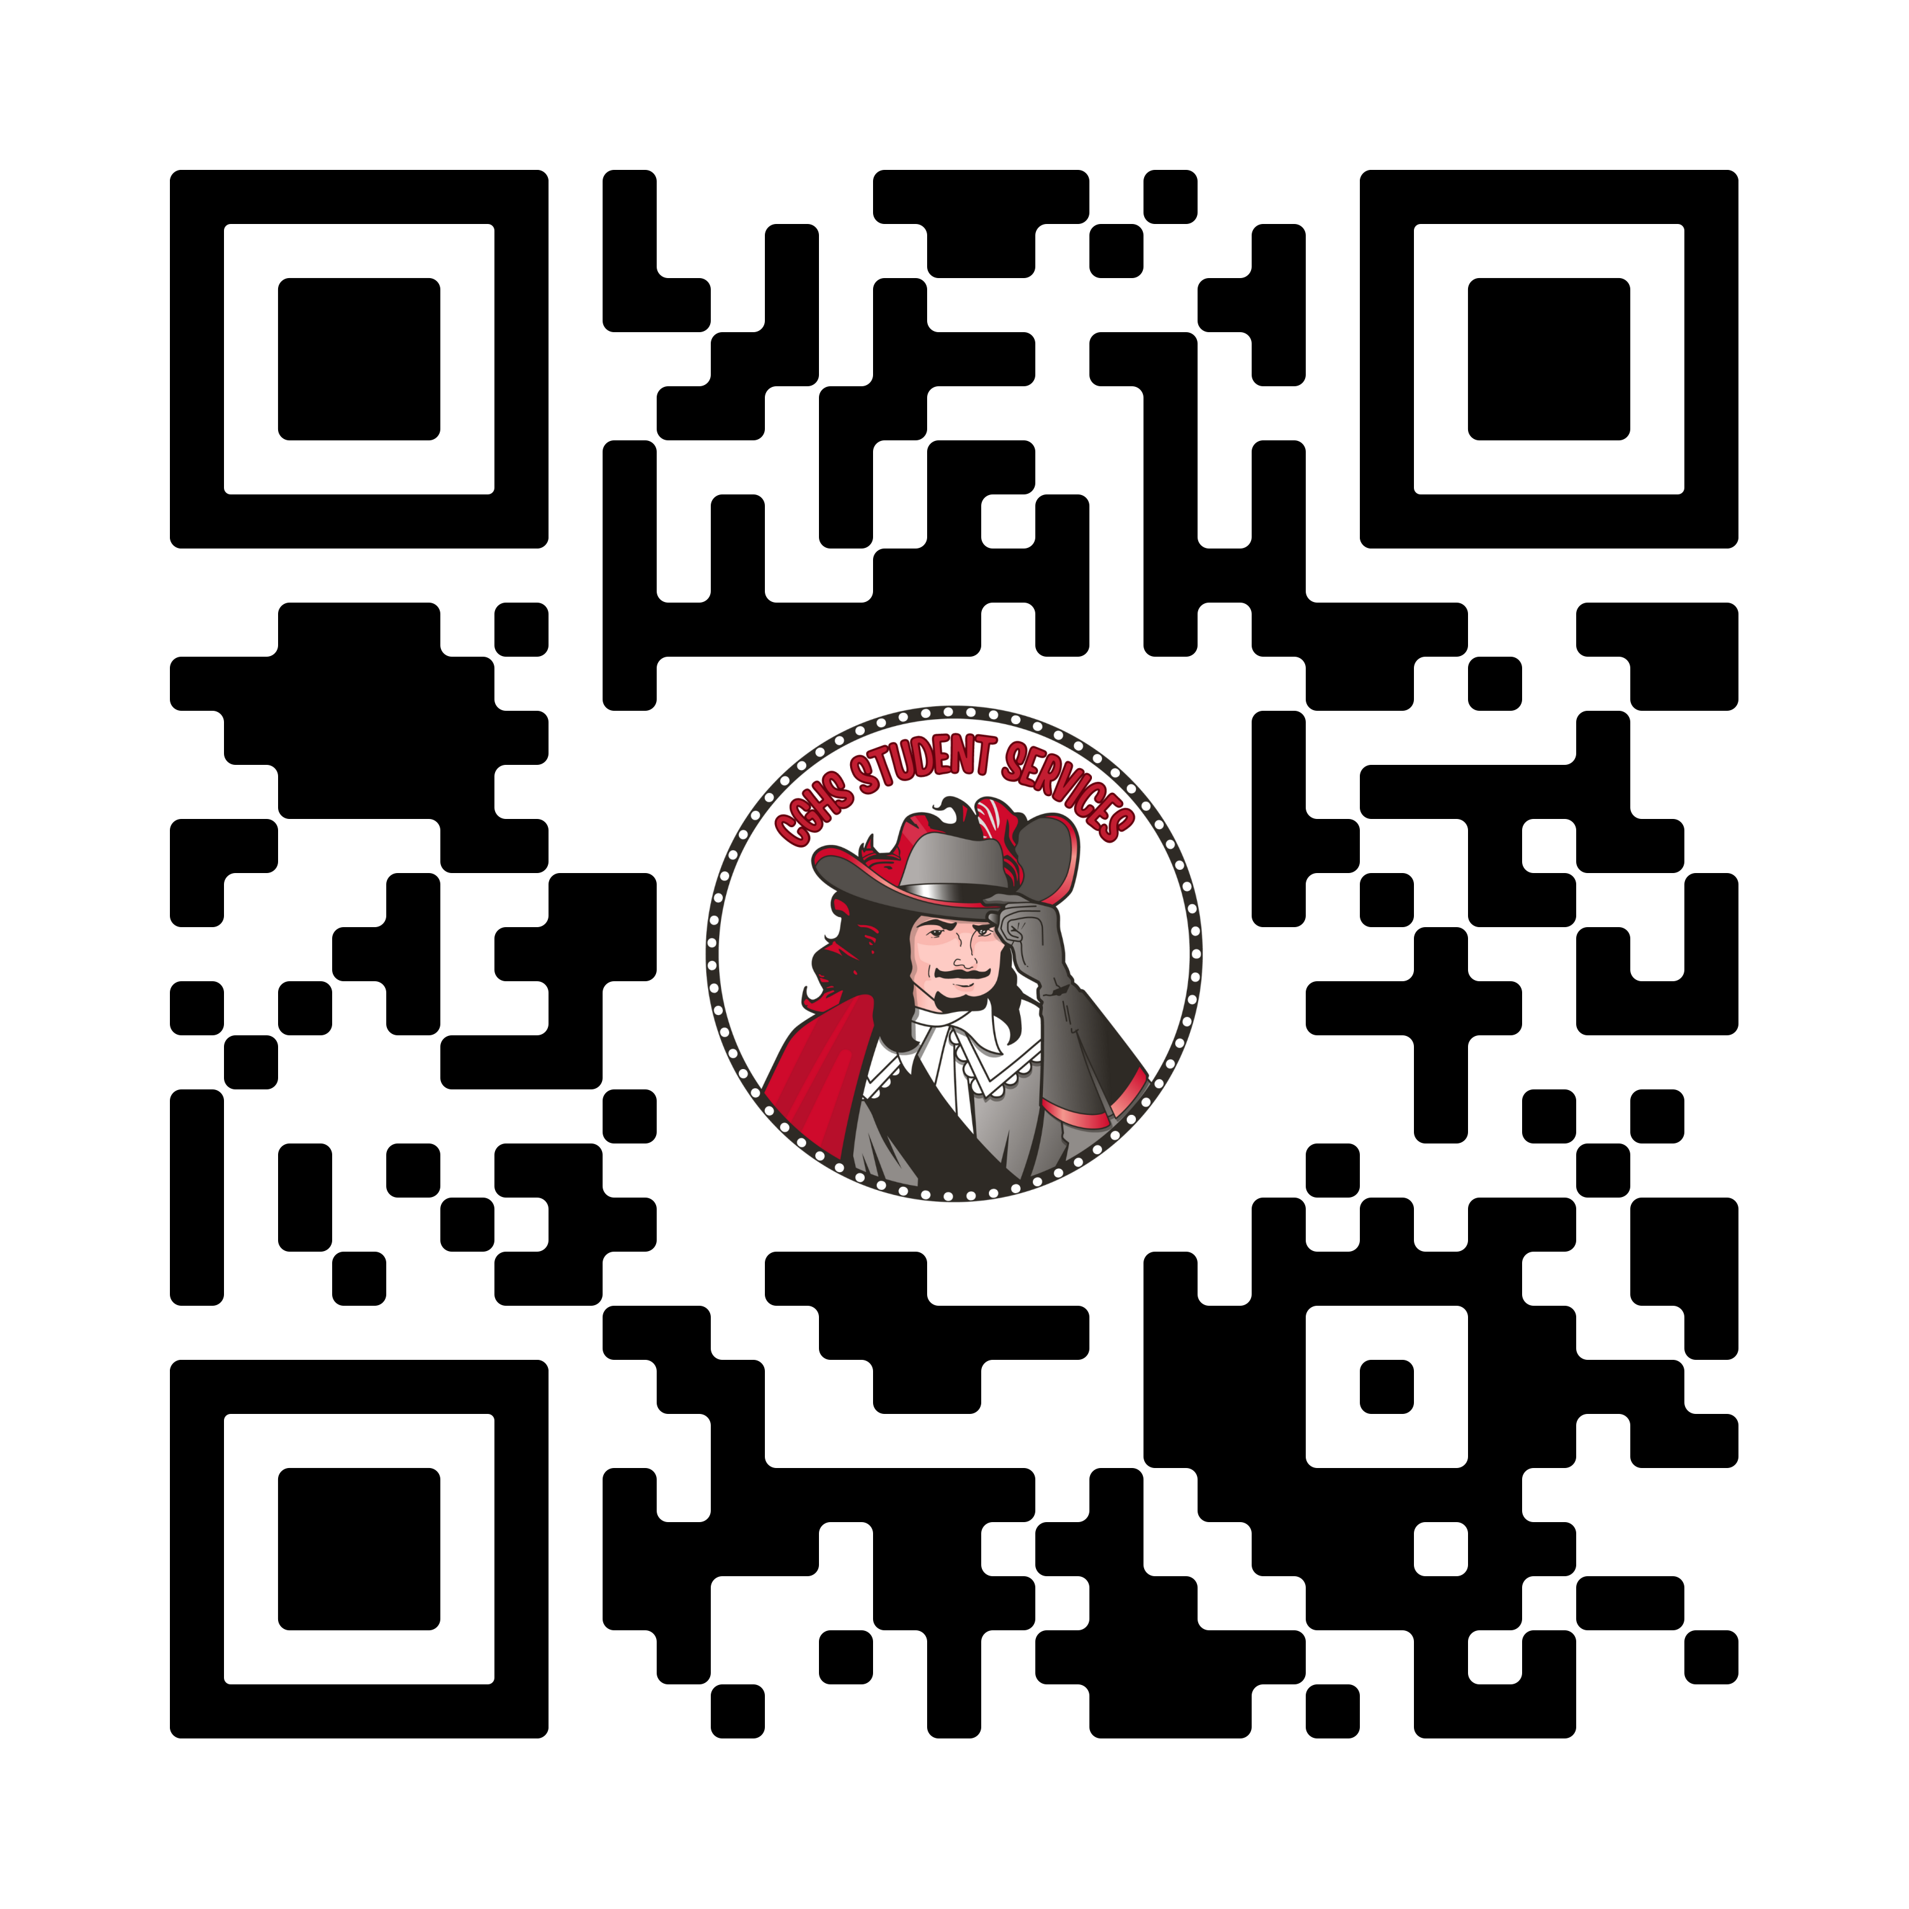
COUNSELOR ASSIGNMENTS
COUNSELOR | ASSIGNMENT | HOW TO MAKE AN APPOINTMENT | EMAIL
MR. SEPULVEDA | A-Dn |  | Ksepulveda@dadeschools.net
MS. COLLADO | Do - L |  | 339573@dadeschools.net
MS. PEDROSO | M - Ri |  | bpedroso@dadeschools.net
MS. BERGOUIGNAN | AOF/ Rj - Sam |  | mebergouignan@dadeschools.net
MS. SANZ | College Assistance | appointments /walk-ins welcome | ssanz@dadeschools.net
MR. FINORA | San - Z | email/ walk-ins welcome | dfinora@dadeschools.net
MS. LEZCANO | IB: A - K | email/ walk-ins welcome | nlezcano@dadeschools.net
MS. KURZNER | IB: L - Z | email/ walk-ins welcome | lkurzner@dadeschools.net
MS. COSGROVE | Graduation Assistance | email/ walk-ins welcome | francosgrove@dadeschools.net

Slide 3
CAP COMMUNICATIONS
Email: ssanz@dadeschools.net
Instagram: @Gables_CAP
Schoology: Class of 2024, students only
Room 6111
CAVSCONNECT.COM
CAP CORNER- JUNIOR

Slide 4
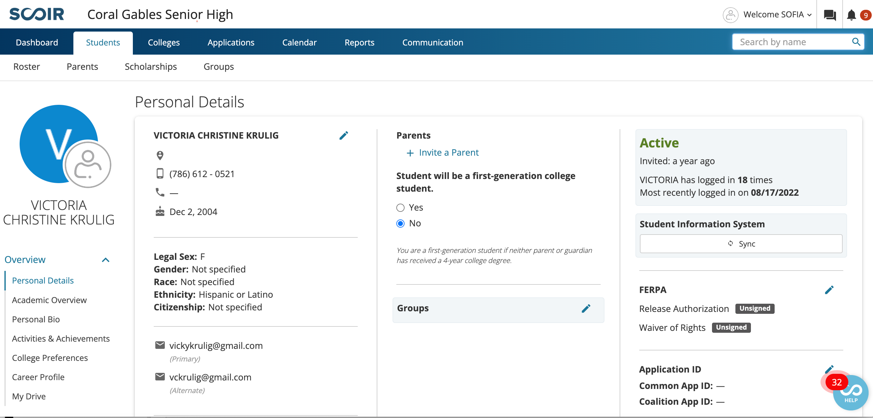
SCOIR
A college planning tool that assists parents and students in making informed decisions about college opportunities. All students must have a registered Scoir account. Only your student can invite you to join.

Slide 5
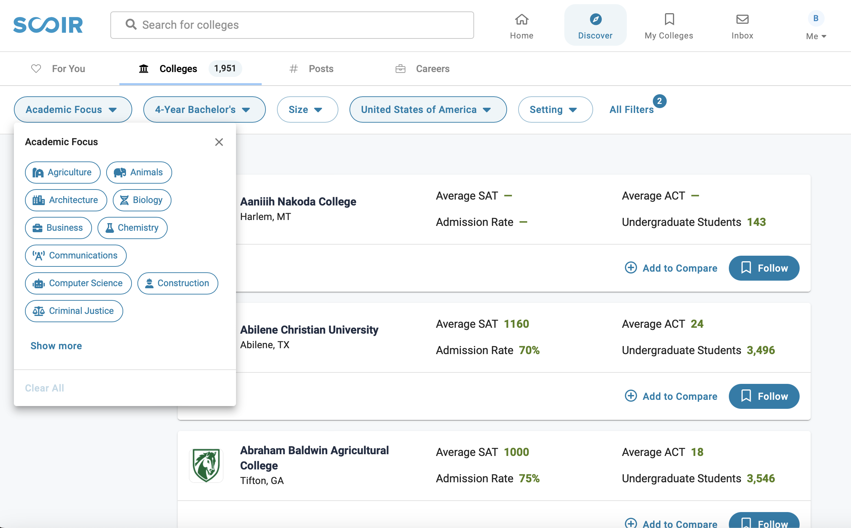
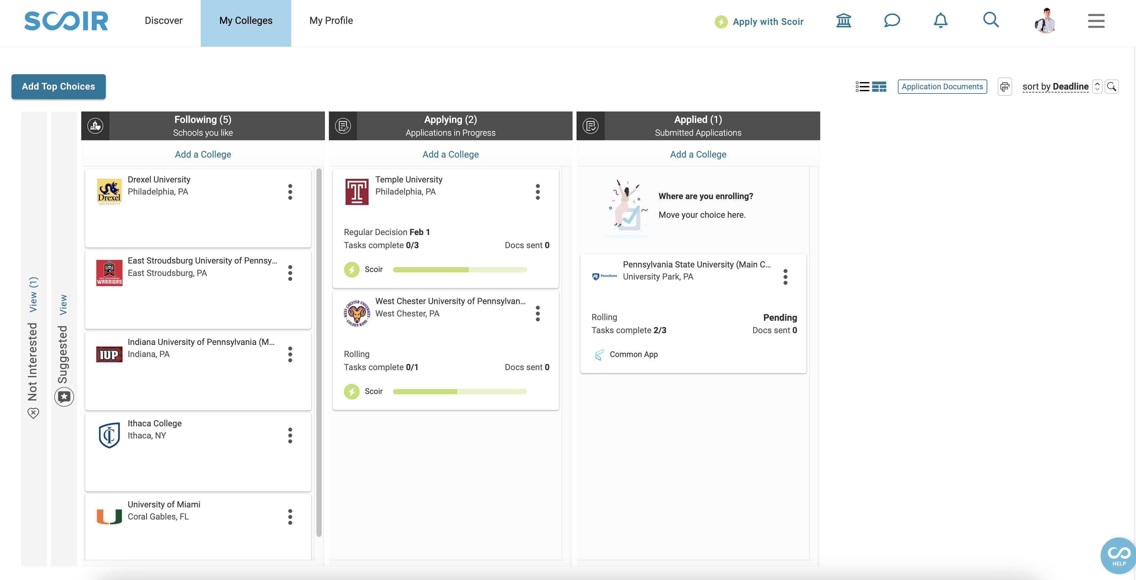
SCOIR FEATURES
UPDATE YOUR PROFILE
Add college preferences for personalized suggestions
Update personal bio
Add activities and achievements
RESEARCH COLLEGES
Search schools by preferences
Look at information such as: virtual tours, location, athletics/clubs available, academic programs offered, admission rates, application requirements, cost & aid, student life, and more
ORGANIZE THE COLLEGE LIST
Start “following” colleges that you plan to apply to next year
Parents can “suggest” colleges

Slide 6
PICKING A COLLEGE OR UNIVERSITY
FACTORS TO CONSIDER:
Four-year, two-year, or vocational?
Location: close to home or far away? City life or college town?
Size: Under 3,000 students or over 30,000 students?
Coed or single sex?
Private or public institutions?
What programs are offered?
What sports or extracurricular activities are available?
Cost? Do not exclude any choices because of high cost (Expensive schools often offer more aid) ALWAYS CHECK THE NET PRICE CALCULATOR

Slide 7
HOLISTIC REVIEW OF APPLICATIONS
IMPORTANT FACTORS:
Strength of curriculum (IB, AP, Honors)
Grade Point Average (GPA) and class rank (percentile)
College Entrance Examination Scores (ACT or SAT)
Activities student is involved in
College essay
Supplemental questions
Letters of recommendation
Community service
Strength of resume
Demonstrated interest
Personal interview

Slide 8
SELECTIVITY OF COLLEGES
OPEN ADMISSIONS: 100% acceptance rate
Community Colleges: application, high school degree- automatic acceptance
SELECTIVE: < 70% acceptance rate
Clemson, UCF, Syracuse, Penn State
VERY SELECTIVE: < 40% acceptance rate
UF, FSU, Villanova, Wake Forest, Smith College
MOST SELECTIVE: < 20% acceptance rate
Ivy League, Duke University, NYU, UChicago, UC Berkeley

Slide 9
TYPES OF APPLICATIONS
EARLY DECISION: binding, regardless of financial aid status. You can only apply to only one ED school and must sign a contract, along with your parents & myself.
EARLY ACTION: nonbinding. Students can apply to multiple schools as EA. Apply early (October-November) and receive notice by December.
REGULAR DECISION: varies per college/university. most deadlines are around January and decisions are made by mid-March-April.​
ROLLING ADMISSION: accepts students as applications come in, and until they run out of spots, so apply early!​

Slide 10
THE COLLEGE LIST
AT LEAST 2 REACH SCHOOLS
AT LEAST 4 MATCH SCHOOLS
AT LEAST 2 REAL SAFETY SCHOOLS
RESEARCH THE COLLEGE’S ADMISSION DATA ON SCOIR OR LOOK AT THE COLLEGE’S WEBSITE FOR THE COMMON DATA SET:
most important facts and figures about a college that allows you to easily look up certain pieces of information, helps you compare colleges, and even provides demographic breakdowns of admissions and enrollment statistics

Slide 11
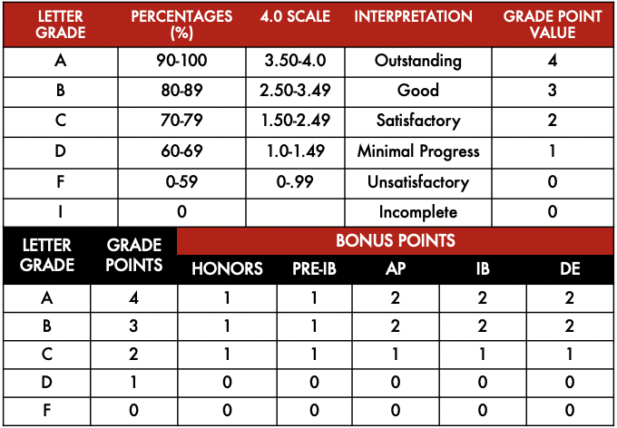
WHY IS JUNIOR YEAR SO IMPORTANT?
Students apply to college with their grades and GPA from freshman year to the end of Junior year. This is their last chance to raise their GPA in time for college applications!

Slide 12
POST SECONDARY EDUCATION
COMMUNITY COLLEGE: Better financially, MDC Honors
VOCATIONAL/TECHNICAL: quick path into the work force
MILITARY: scholarship opportunities

Slide 13
COMMUNITY COLLEGES AND STATE UNIVERISTIES
Programs of 6 months to full Bachelor’s degrees
OPEN ADMISSIONS: anyone with a high school diploma or GED is admitted.
Applications are simple, transcript is the only entry requirement.
Vast selection of programs including Graphic Design, Music Production & Management, Fire Science Technology, Nursing and much more.
Programs to consider:
MDC Honors
MDC Pathway Program

Slide 14
COLLEGE ENTRANCE EXAMS
ACT
ACT scores range from 1 to 36.
English
Math
Science
Reading
SAT
SAT scores range from 400 to 1600.
Reading/Writing
Math
SAT IS GOING DIGITAL IN JANUARY

Slide 15
COLLEGE ENTRANCE EXAMS
More and more schools are becoming test optional: Truly test optional!
ALL PUBLIC STATE SCHOOLS REQUIRE EXAMS
SAT or ACT: There is no difference in judgement
Test Prep:
Khan Academy in Student/Parent portals
If you have a fee waiver, ACT includes free test prep
Free math section tutoring offered through the Coral Gables Foundation, email me for more information

Slide 16
UPCOMING EXAM DATES
ACT
SAT
REGISTER AT MYACT.ORG
REGISTER AT SAT.SUITE.COLLEGEBOARD.ORG
REGISTER AT MYACT.ORG
EXAM DATE | REGISTRATION DEADLINE
October 28th | September 22nd
December 9th | November 3rd
February 10th | January 5th
April 13th | March 8th
June 8th | May 3rd
EXAM DATE | REGISTRATION DEADLINE
December 2nd | November 2nd
March 9th | February 27th
May 4th | April 19th
May 4th | April 19th
June 1st | May 16th

Slide 17
FEE WAIVERS
You must complete this form: incomesurvey.dadeschools.net
If you qualify for free or reduced lunch, you may qualify for testing and application fee waivers.
4 ACT Waivers (4 different codes)
2 SAT Waivers (1 code)
Unlimited Scoir Application Fee Waivers
TO REQUEST AN ACT/SAT FEE WAIVER: see me in room 6111 or send me an email at ssanz@dadeschools.net

Slide 18
THE TIMELINE
Keep grades up, especially in core classes
Stay involved, gain leadership roles, build your resume
STUDY and take the SAT or ACT
Should be taking these exams more than once
Research colleges and build your college list
Show demonstrated interest: subscribe to email lists, go to events in your area, tour schools if possible
Research scholarship programs: Questbridge and Posse

Slide 19
THE TIMELINE
Admissions Decisions from Universities
Early Action/Early Decision/Priority Applications Due
SAT/ACT Testing
Regular Decision Applications Due
Decision Day
August September October November December January February March April May
FFAA (Bright Futures) Application Opens
FAFSA Opens
Financial Aid Packages
Housing Applications

Slide 20
APPLYING FOR ADMISSION
APPLICATION: required everywhere
TRANSCRIPT OR SSAR
APPLICATION FEE: (fee waiver(s) can be used, see me for more info.)
SAT/ACT SCORES: required or test optional
LETTERS OF RECOMMENDATION: (if applicable)
ESSAY/PERSONAL STATEMENT: (if applicable…share your voice!)
COPY OF OTHER REQUIRED DOCUMENTATION: (if applicable)

Slide 21
FINANCIAL AID
FAFSA: Federal Student Aid
There are a lot of changes to the FAFSA this year. IT DOES NOT OPEN UNTIL DECEMBER OF SENIOR YEAR. Requires 2023 tax documents.
EVERYONE MUST APPLY Even if you think you won’t receive aid.
This is the first step to receiving ANY kind of scholarship
CSS Profile: only some schools require it, another financial aid application
FFAA: Florida Student Aid, also known as Bright Futures Application
Application opens Sunday, October 1st
SCHOLARSHIPS: Students need to put in the work to search and apply for scholarships.
Check CAP Corner and Schoology for Scholarships posted by the CAP Office

Slide 22
FAFSA UPDATES
ALL students must fill out the FAFSA for any scholarship or grant consideration.
IMPORTANT UPDATES:
FAFSA now opens in December, exact date TBA
BOTH students and parents need to fill out the FAFSA
BOTH parents (even if divorced or separated or never married) need to provide tax information, if remarried, step parents as well.
Student Aid Index: a number that a college's or career school's financial aid office uses to determine how much federal student aid the student would receive if the student attended the school. (Similar to last year’s EFC) It can now be up to -1500.
No longer need to fill in tax information, but you need to grant permission to link with IRS.
https://www.youtube.com/watch?v=F3CxBRT7V8A

Slide 23
SCHOLARSHIPS
THREE MAIN TYPES OF SCHOLARSHIPS
INSTITUTIONAL: Usually are the most generous. Students can qualify by applying early and meeting the school’s requirements for their merit based scholarships. Each school has different requirements, check the scholarship page on their website.
Most cases, you are automatically considered for all of their scholarships, but sometimes there are additional requirements, such as:
Earlier deadlines
Additional essays
Nomination forms
Letters of recommendation

Slide 24
SCHOLARSHIPS
THREE MAIN TYPES OF SCHOLARSHIPS
PRIVATE: Can be very competitive and take a lot of work, but are often the deciding factor against student loans or can fill the financial need gap left over ater financial aid letters are awarded.
Can be awarded as many as possible (depending on the school)
Some take financial need into consideration, some do not
Have various application platforms and different requirements (essay, recommendation letters, service projects, etc)

Slide 25
BRIGHT FUTURES
Full tuition scholarship available at Florida universities
Application opens October 1st
Deadline: June 30th

Slide 26
QUESTBRIDGE
QUALIFYING CRITERIA
Academics | Primarily A's in the most challenging courses available (usually including Honors, AP, and/or IB level courses.)
Class Rank | Top 5-10% of your graduating class.
Test scores | SAT or PSAT scores > 1310 ACT composite score > 28 We also recommend submitting any AP, IB, or SAT Subject Test scores. Review the standardized testing requirements for each college.
Financial Need | Households typically earning less than $65,000 annually. Looks at ALL sources of income and both biological parents.
Additional Criteria | Looks for evidence of strong writing ability, intellectual spark, and determination through essays and teacher/counselor recommendations.

Slide 27
QUESTBRIDGE

Slide 28
POSSE SCHOLARSHIP
A partner full-tuition scholarship based on nominations (nominated towards the end of Junior Year: NOT NEED BASED!
Miami Posse Foundation Partner schools:
Davidson College
Franklin & Marshall
Hamilton College
Mount Holyoke College
Pomona College
Syracuse University

Slide 29
CARS
The College Application Readiness Symposium
3 day workshop for rising seniors to help them get a jumpstart on applications. Includes:
College admissions case study
Organizing the college list
Resume workshop
Scholarship information
College essay workshop
Interview prep
Dates: May 30th- June 3rd (dates subject to change)
Minimum unweighted 3.25 GPA, and follow 10/20 attendance rule. Must sign up to attend.
All resources are shared with all students, even if they cannot attend.

Slide 30
THE COLLEGE VISIT
Virtual or in-person options. Some tips:
Make appointments/schedule your visit two weeks in advance, if possible…most can be done online. Let them know you’re there!
Go while school is in session
Notice the students on campus
No more than two a day
Eat in the dining hall if possible
See a FRESHMAN dorm
Ask about programs you are interested in
Look for anything else that will be important to you

Slide 31
QUESTIONS?
CONTACT ME!
Q & A Google Doc
ssanz@dadeschools.net
CAP Office: 6111
Schedule a meeting:

