Slide 1
SENIOR YEAR

Slide 2
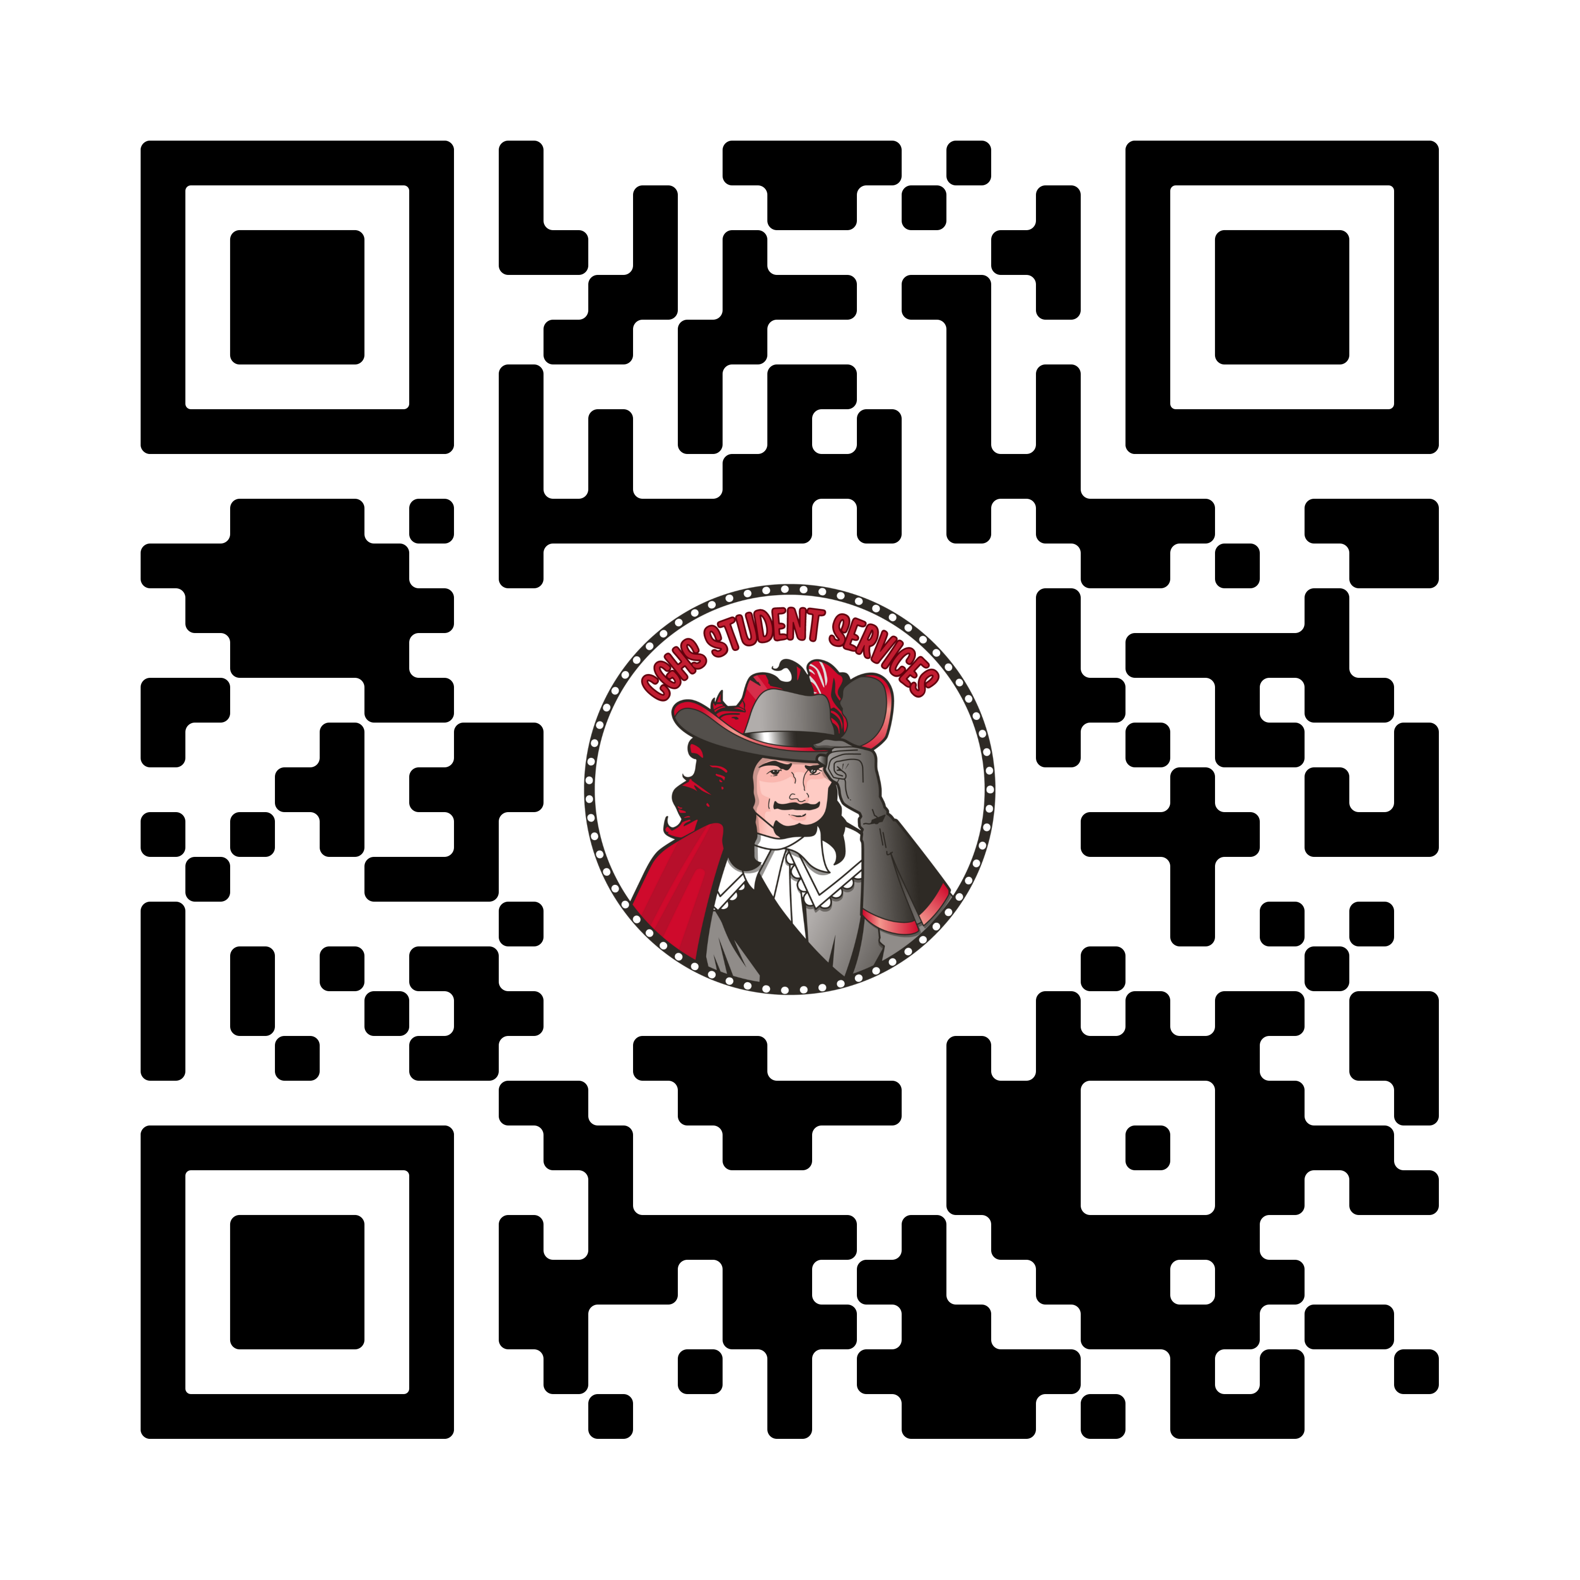
COUNSELOR ASSIGNMENTS
COUNSELOR | ASSIGNMENT | HOW TO MAKE AN APPOINTMENT | EMAIL
MR. SEPULVEDA | A-Dn |  | Ksepulveda@dadeschools.net
MS. COLLADO | Do - L |  | 339573@dadeschools.net
MS. PEDROSO | M - Ri |  | bpedroso@dadeschools.net
MS. BERGOUIGNAN | AOF/ Rj - Sam |  | mebergouignan@dadeschools.net
MS. SANZ | College Assistance | appointments /walk-ins welcome | ssanz@dadeschools.net
MR. FINORA | San - Z | email/ walk-ins welcome | dfinora@dadeschools.net
MS. LEZCANO | IB: A - K | email/ walk-ins welcome | nlezcano@dadeschools.net
MS. KURZNER | IB: L - Z | email/ walk-ins welcome | lkurzner@dadeschools.net
MS. COSGROVE | Graduation Assistance | email/ walk-ins welcome | francosgrove@dadeschools.net

Slide 3
GRAD TRACK

Slide 4
CAP COMMUNICATIONS
Email: ssanz@dadeschools.net
Instagram: @Gables_CAP
Schoology: Class of 2024, students only
Room 6111
CAVSCONNECT.COM
CAP CORNER- SENIORS

Slide 5
IMPORTANT DATES
BRIGHT FUTURES:
Application opens Sunday, October 1st
COLLEGE FAIR:
Monday, October 2nd
FAFSA
Application opens in December

Slide 6
WHAT ARE COLLEGES LOOKING AT?
IMPORTANT FACTORS:
Strength of curriculum (IB, AP, Honors)
Grade Point Average (GPA) and class rank (percentile)
College Entrance Examination Scores (ACT or SAT)
Activities student is involved in
IF THE COLLEGE REQUIRES THEM:
Essays
Recommendation Letters (teacher and counselor)
Resume (leadership, community service, extracurricular, talents, etc.)
Interviews

Slide 7
PICKING A COLLEGE OR UNIVERSITY
FACTORS TO CONSIDER:
Four-year, two-year, or vocational?
Location: close to home or far away? City life or college town?
Size: Under 3,000 students or over 30,000 students?
Coed or single sex?
Private or public institutions?
What programs are offered?
What sports or extracurricular activities are available?
Cost? Do not exclude any choices because of high cost (Expensive schools often offer more aid) ALWAYS CHECK THE NET PRICE CALCULATOR

Slide 8
THE COLLEGE LIST
AT LEAST 2 REACH SCHOOLS
AT LEAST 4 MATCH SCHOOLS
AT LEAST 2 REAL SAFETY SCHOOLS
RESEARCH THE COLLEGE’S ADMISSION DATA ON SCOIR OR LOOK AT THE COLLEGE’S WEBSITE FOR THE COMMON DATA SET:
most important facts and figures about a college that allows you to easily look up certain pieces of information, helps you compare colleges, and even provides demographic breakdowns of admissions and enrollment statistics

Slide 9
SELECTIVITY OF COLLEGES
OPEN ADMISSIONS: 100% acceptance rate
Community Colleges: application, high school degree- automatic acceptance
SELECTIVE: < 70% acceptance rate
Clemson, UCF, Syracuse, Penn State
VERY SELECTIVE: < 40% acceptance rate
UF, FSU, Villanova, Wake Forest, Smith College
MOST SELECTIVE: < 20% acceptance rate
Ivy League, Duke University, NYU, UChicago, UC Berkeley

Slide 10
2023 STATE UNIVERSITY SYSTEMS DATA
OPEN LINK!!!!

Slide 11
POST-SECONDARY EDUCATION
COLLEGE OR UNIVERSITY (FIU, Harvard, Pomona College)
COMMUNITY COLLEGE (Miami Dade College, Santa Fe)
VOCATIONAL/TECHNICAL (Robert Morgan, Lindsay Hopkins
MILITARY (Army, Navy, Marines)

Slide 12
POST SECONDARY EDUCATION
COMMUNITY COLLEGE: Better financially, MDC Honors
VOCATIONAL/TECHNICAL: quick path into the work force
MILITARY: scholarship opportunities

Slide 13
COMMUNITY COLLEGES AND STATE UNIVERISTIES
Programs of 6 months to full Bachelor’s degrees
OPEN ADMISSIONS: anyone with a high school diploma or GED is admitted.
Applications are simple, transcript is the only entry requirement.
Vast selection of programs including Graphic Design, Music Production & Management, Fire Science Technology, Nursing and much more.
Programs to consider:
MDC Honors
MDC Pathway Program

Slide 14
COLLEGE ENTRANCE EXAMS
ACT
ACT scores range from 1 to 36.
English
Math
Science
Reading
SAT
SAT scores range from 400 to 1600.
Reading/Writing
Math
SAT IS GOING DIGITAL

Slide 15
UPCOMING EXAM DATES
ACT
SAT
REGISTER AT MYACT.ORG
REGISTER AT SAT.SUITE.COLLEGEBOARD.ORG
REGISTER AT MYACT.ORG
EXAM DATE | REGISTRATION DEADLINE
October 7th | September 7th
November 4th | October 5th
December 2nd | November 2nd
March 9th | February 27th
May 4th | April 19th
May 4th | April 19th
June 1st | May 16th
EXAM DATE | REGISTRATION DEADLINE
October 28th | September 22nd
December 9th | November 3rd
February 10th | January 5th
April 13th | March 8th
June 8th | May 3rd

Slide 16
FEE WAIVERS
You must complete this form: incomesurvey.dadeschools.net
If you qualify for free or reduced lunch, you may qualify for testing and application fee waivers.
4 ACT Waivers (4 different codes)
2 SAT Waivers (1 code)
Unlimited Scoir Application Fee Waivers
TO REQUEST AN ACT/SAT FEE WAIVER: see me in room 6111 or send me an email at ssanz@dadeschools.net
Application fee waivers can be requested on Scoir under My Colleges- Application Documents

Slide 17
APPLYING FOR ADMISSION
APPLICATION: required everywhere
TRANSCRIPT OR SSAR
APPLICATION FEE: (fee waiver(s) can be used, see me for more info.)
SAT/ACT SCORES: required or test optional
LETTERS OF RECOMMENDATION: (if applicable)
ESSAY/PERSONAL STATEMENT: (if applicable…share your voice!)
COPY OF OTHER REQUIRED DOCUMENTATION: (if applicable)

Slide 18
TYPES OF APPLICATIONS
EARLY DECISION: binding, regardless of financial aid status. You can only apply to only one ED school and must sign a contract, along with your parents & myself.
EARLY ACTION: nonbinding. Students can apply to multiple schools as EA. Apply early (October-November) and receive notice by December.
REGULAR DECISION: varies per college/university. most deadlines are around January and decisions are made by mid-March-April.​
ROLLING ADMISSION: accepts students as applications come in, and until they run out of spots, so apply early!​

Slide 19
THE TIMELINE
Admissions Decisions from Universities
Early Action/Early Decision/Priority Applications Due
SAT/ACT Testing
Regular Decision Applications Due
Decision Day
August September October November December January February March April May
FFAA (Bright Futures) Application Opens
FAFSA Opens
Financial Aid Packages
Housing Applications

Slide 20
WHERE TO START
Sign up for the SAT/ACT if you still need to do so.
Finish researching colleges and make your list/excel spreadsheet. Organize it by deadline!
Mark those schools as applying on Scoir.
Involve family and look at the cost of attendance to these schools.
Go to the Undergraduate Admissions websites of each of your colleges. Create an account on their application site or Common App.
SAVE THE USERNAMES AND PASSWORDS IN A SAFE PLACE!

Slide 21
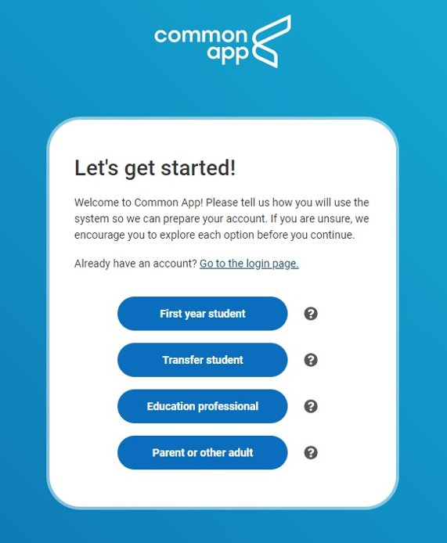
WHERE TO APPLY
INSTITUTIONAL APPLICATION: college admissions application provided by the specific school (or group of schools) that you are applying to. You can find this on the school’s admissions website.
COMMON APPLICATION: one of the most popular college admission applications. Appy to multiple schools using one application. ​
Create an account at commonapp.org

Slide 22
COMMON DEADLINES
EARLY DECISION:
UM’s Early Decision Deadline: November 1st
EARLY ACTION:
FSU Early Action Deadline: October 15th
UM’s Early Action Deadline: November 1st
FIU’s Scholarship Deadline: November 1st
REGULAR DECISION:
UF’s Deadline: November 1st
FSU’s Deadline: Dec. 1ST
ROLLING ADMISSION:
FIU: application closes March 25th

Slide 23
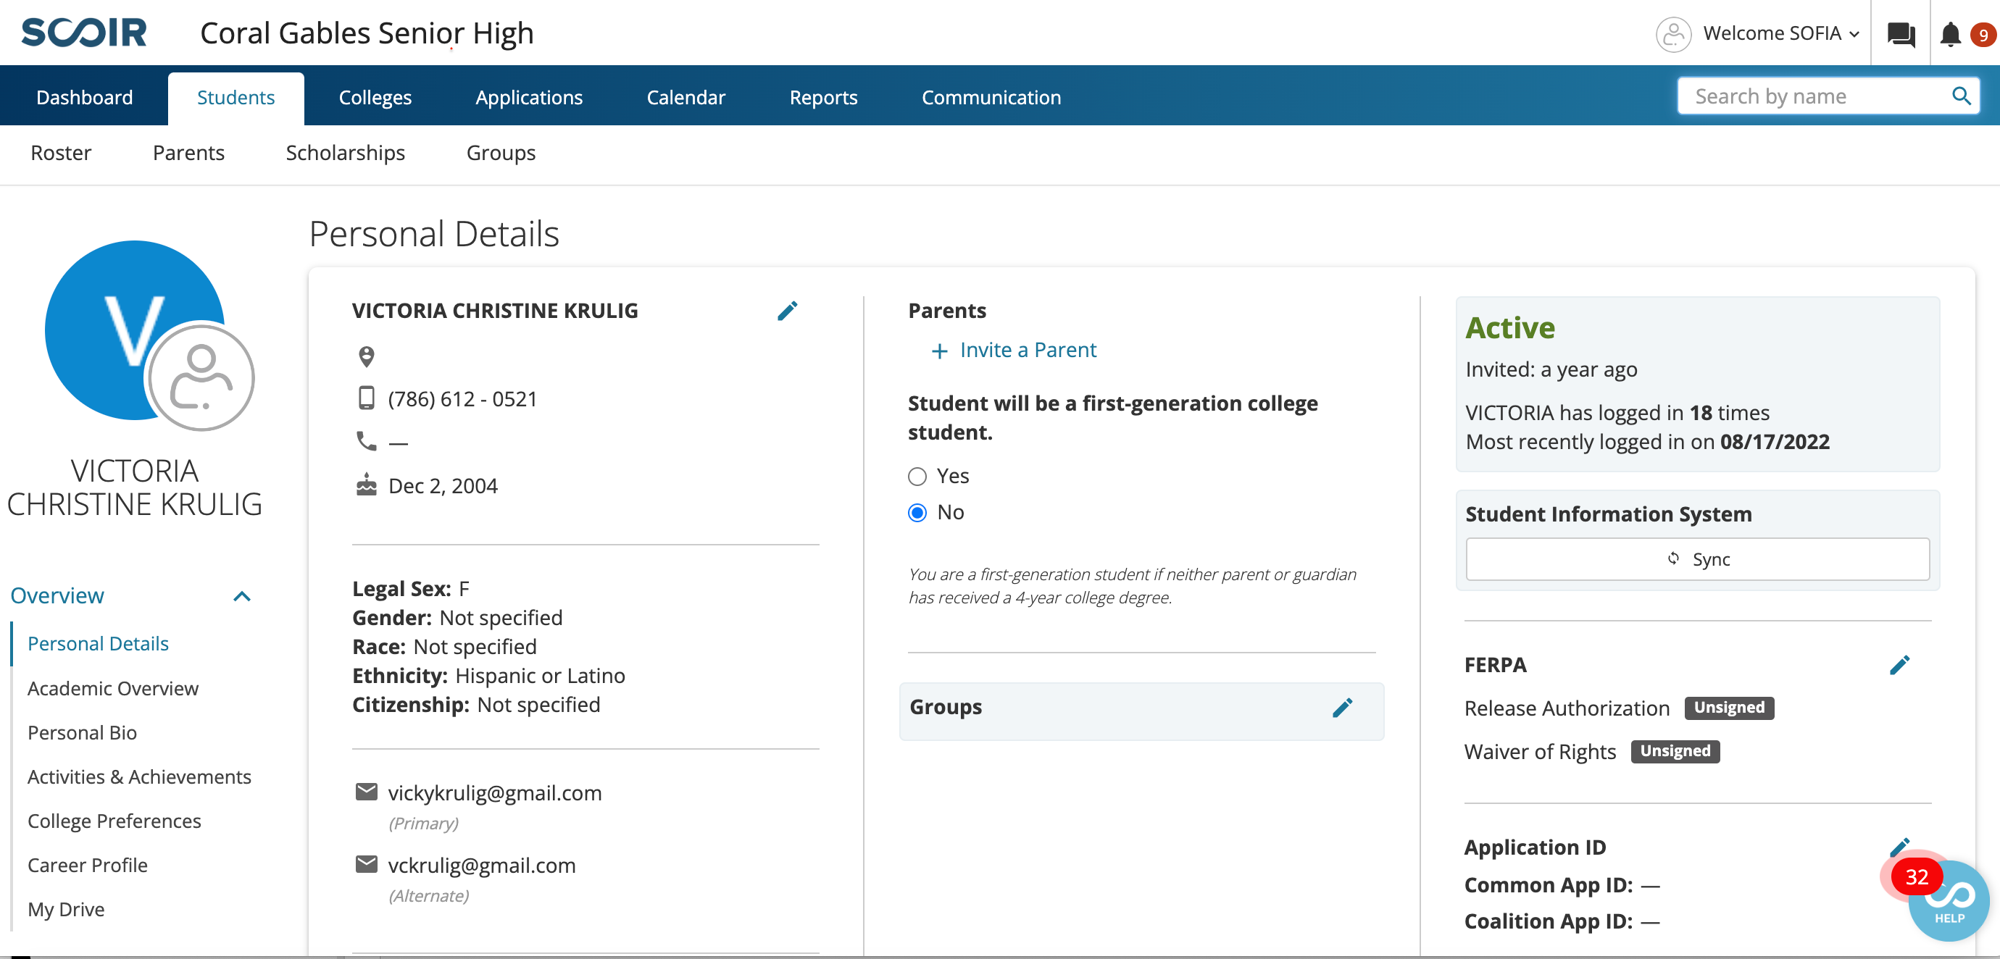
SCOIR
A college planning tool that assists parents and students in making informed decisions about college opportunities. All students must have a registered Scoir account. Only your student can invite you to join.

Slide 24
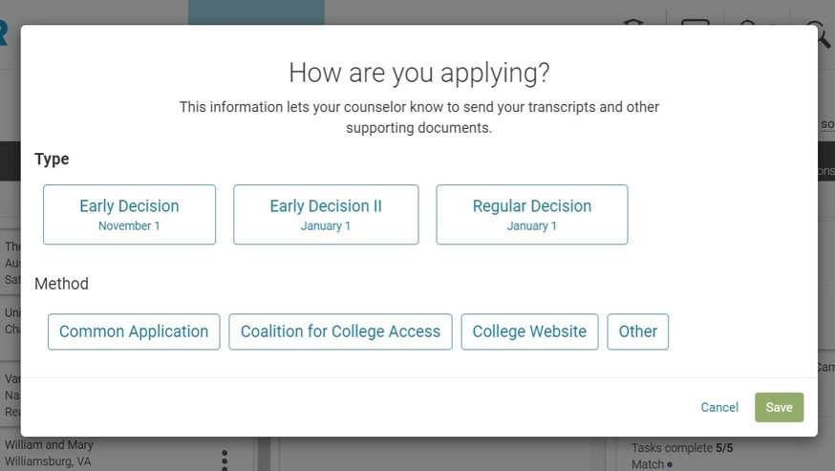
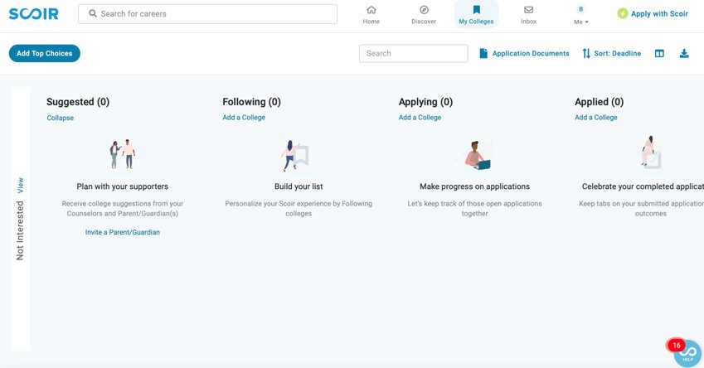
NEXT STEPS
UPDATE YOUR “APPLYING” COLUMN ON SCOIR. ADD ALL THE SCHOOLS YOU PLAN TO APPLY TO.

Slide 25
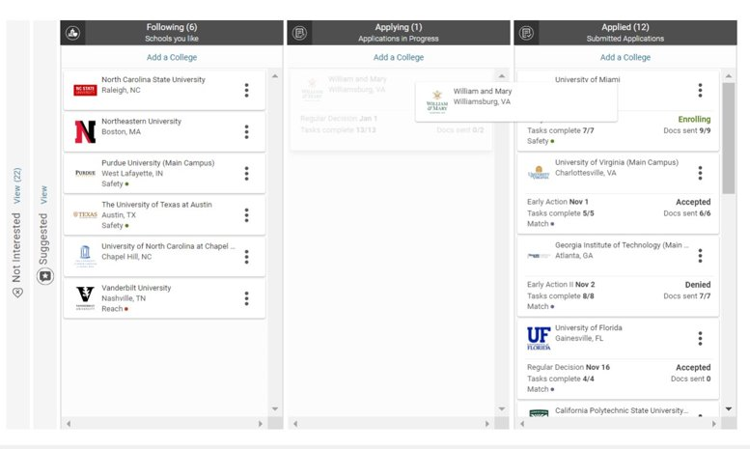
NEXT STEPS
MOVE THE COLLEGE FROM THE APPLYING TO APPLIED COLUMN. THIS ACTS AS YOUR NOTICE TO ME TO SEND YOUR DOCUMENTS. NO NEED TO SEE ME/EMAIL ME FOR THIS.

Slide 26
NEXT STEPS
KEEP TRACK OF YOUR APPLICATIONS AND ACTION ITEMS. ​ALWAYS CHECK YOUR EMAIL FOR NEXT STEPS. ​
Some things you may need to do after applying:​
Creating an account to see your outcome (myfiu portal, myfsu, cane id, etc.)​
Submitting Florida residency form​
Paying the application fee or submitting a fee waiver​
Financial aid or scholarship applications​
Submitting additional documents or forms

Slide 27
SCOIR DEADLINES
If applying to a school with a NOVEMBER 1ST DEADLINE OR EARLIER you MUST add that school to your “applying” column before FRIDAY, OCTOBER 6TH
If applying to a school with a deadline AFTER NOVEMBER 1ST you MUST add that school to your “applying” column before FRIDAY, OCTOBER 27TH
You should already be requesting recommendation letters from teachers. Give your recommenders AT LEAST 2 weeks before the application deadline to submit letters. Each recommender may have different preferences, so talk to them now.

Slide 28
TRANSCRIPTS
Transcripts are being updated will be ready for request/upload VIA SCOIR AROUND THE END OF SEPTEMBER OR EARLY OCTOBER
All the fabulousness you all did over the summer is being added on DISTRICT-WIDE…this takes time. Once they are updated, GPAs & rank will be calculated & available.
ORDERING TRANSCRIPTS:
CommonApp? SCOIR
Florida school’s online app? SCOIR
Out of state school or Florida private school not listed on electronic listing found on our website? SCOIR
UF, FSU, FAU, FGCU, UNF, NEW COLLEGE, & FL POLYTECH: COMPLETE THE SSAR, SELF REPORTED STUDENT ACADEMIC RECORD
https://ssar.selfreportedtranscript.com/Login.aspx (very easy to Google as well!)

Slide 29
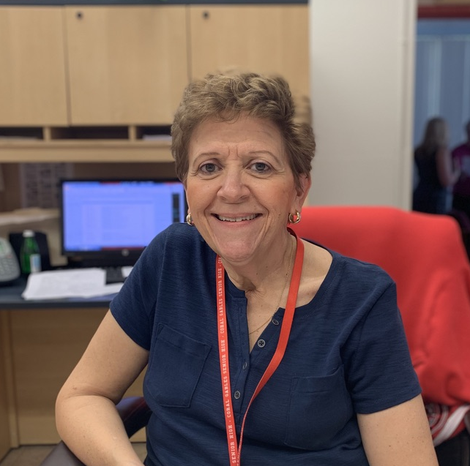
TRANSCRIPTS
Your initial transcripts will be uploaded into SCOIR
Questions about transcripts?
Email Ms. Garcia: solgarcia@dadeschools.net
STUDENTS DO NOT NEED TO REQUEST TRANSCRIPTS.
MS. GARCIA
TRANSCRIPT COORDINATOR
Registration office

Slide 30
FINANCIAL AID
FAFSA: Federal Student Aid
There are a lot of changes to the FAFSA this year. IT DOES NOT OPEN UNTIL DECEMBER. Stay tuned for Financial Aid Night coming soon.
FFAA: Florida Student Aid, also known as Bright Futures Application
Application opens Sunday, October 1st
SCHOLARSHIPS: Students need to put in the work to search and apply for scholarships.
Check CAP Corner and Schoology for Scholarships posted by the CAP Office

Slide 31
SCHOLARSHIPS
THREE MAIN TYPES OF SCHOLARSHIPS
INSTITUTIONAL: Usually are the most generous. Students can qualify by applying early and meeting the school’s requirements for their merit based scholarships. Each school has different requirements, check the scholarship page on their website.
Most cases, you are automatically considered for all of their scholarships, but sometimes there are additional requirements, such as:
Earlier deadlines
Additional essays
Nomination forms
Letters of recommendation

Slide 32
SCHOLARSHIPS
THREE MAIN TYPES OF SCHOLARSHIPS
PRIVATE: Can be very competitive and take a lot of work, but are often the deciding factor against student loans or can fill the financial need gap left over ater financial aid letters are awarded.
Can be awarded as many as possible (depending on the school)
Some take financial need into consideration, some do not
Have various application platforms and different requirements (essay, recommendation letters, service projects, etc)

Slide 33
BRIGHT FUTURES
Application opens October 1st
Should apply even if they don’t meet the requirements yet
Deadline: June 30th

Slide 34
FAFSA UPDATES
ALL students must fill out the FAFSA for any scholarship or grant consideration.
IMPORTANT UPDATES:
FAFSA now opens in December, exact date TBA
BOTH students and parents need to fill out the FAFSA
BOTH parents (even if divorced or separated or never married) need to provide tax information, if remarried, step parents as well.
Student Aid Index: a number that a college's or career school's financial aid office uses to determine how much federal student aid the student would receive if the student attended the school. (Similar to last year’s EFC) It can now be up to -1500.
No longer need to fill in tax information, but you need to grant permission to link with IRS.
https://www.youtube.com/watch?v=F3CxBRT7V8A

Slide 35
QUESTIONS?
CONTACT ME!
Q & A Google Doc
ssanz@dadeschools.net
CAP Office: 6111
Schedule a meeting:

