Slide 1
NAVIGATING

Slide 2
What is Scoir?
Scoir is a college platform aimed to assist students in the college research and application process.
It’s a one-stop-shop for all of your college needs and helps you make informed decisions about college and all the opportunities it has to offer.
Think of Scoir as the middle-man between colleges and your high school.

Slide 3
Log in to Scoir
Go to scoir.com
Log in using your email & password
OR
Log in with Clever and type in your dadeschools credentials (recommended!)
This will ensure that you are on the school account, not a personal account.

Slide 4
Step 1: Update your Profile

Slide 5
Step 1: Update your Profile
Add a photo of yourself
Invite your parent
Add personal details (address, phone number)
Answer first generation question
Add alternate email
Sign FERPA Waivers

Slide 6
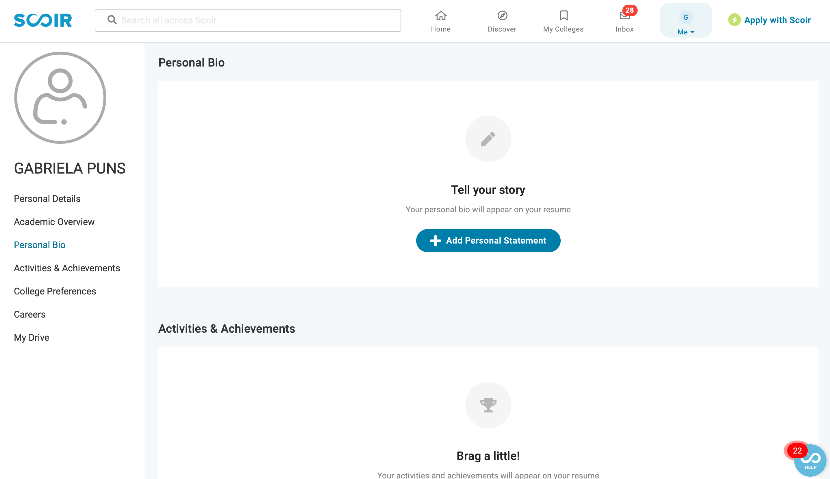
Step 2: Update your Personal Bio

Slide 7
Step 2: Update your Personal Bio
Add a 3-4 snippet about yourself. Include your passions, hobbies, how you spend your time, and your college interests.
For example:
Growing up in a tri-lingual household - and in Miami - has contributed to the immense appreciation I have for diverse peoples and cultures. As a result, my biggest passions include protecting and traveling the world around me. I strive to be kind, driven, and passionate in my work and life, and am infinitely grateful for the people and school environment that have allowed me to practice and uphold such values.

Slide 8
Step 3: Add Your Activities & Achievements

Slide 9
Step 3: Add your Activities & Achievements
Explain all of your activities & achievements:
Work experience
Athletics
Community service
Clubs and activities
For example:

Slide 10
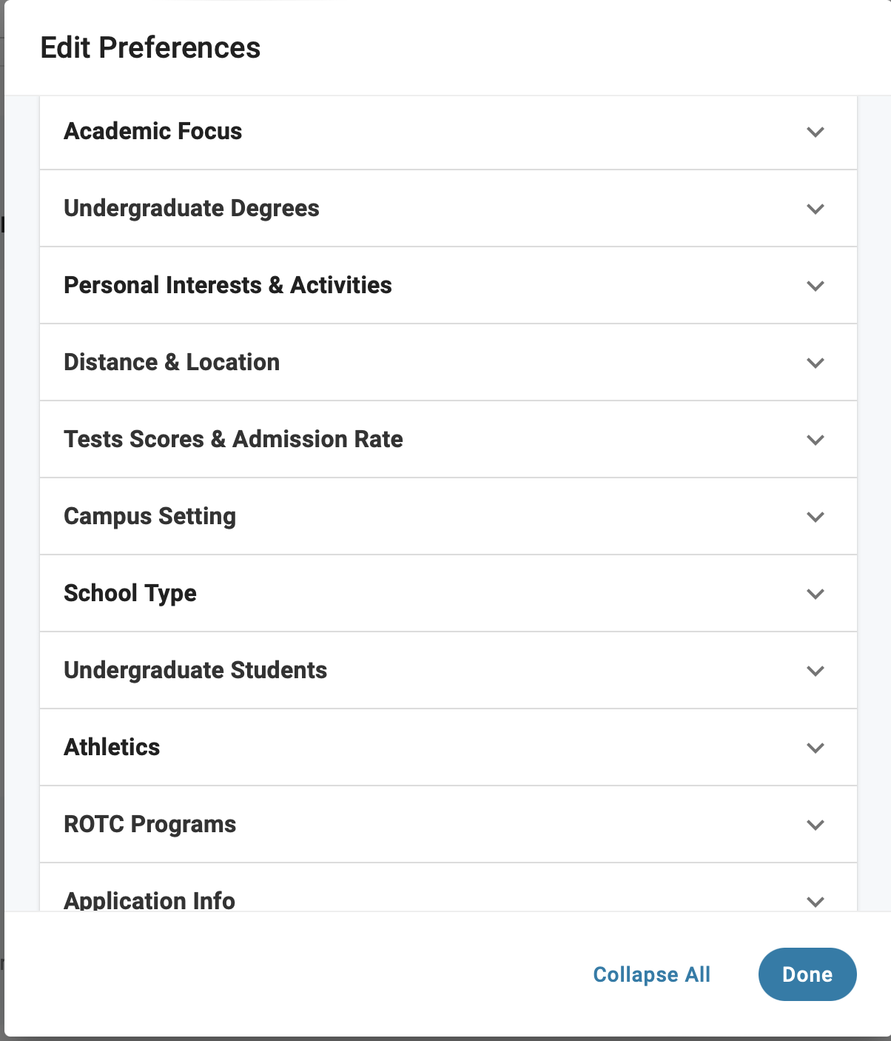
Step 4: College Preferences
Updating your college preferences will help Scoir better understand your needs & will recommend schools based on your preferences.

Slide 11
Colleges

Slide 12
Colleges
Information available on Scoir:
Admission statistics
Student life
Application requirements
Location
Academic programs
Athletics/ clubs available
Cost & aid
If interested, add it to your following list
Click here

Slide 13
My Colleges

Slide 14
Requesting Recommendation Letters

Slide 15
Requesting Recommendation Letters
Speak to your teacher before requesting the letter through Scoir.
Scoir will send the letters automatically, so if you want a specific teacher’s letter to go to a specific school, you must let me know AHEAD OF TIME (but not yet). I will give more instructions next year.
Who needs recommendation letters? How many? You need to check with the schools you are applying to.

Slide 16
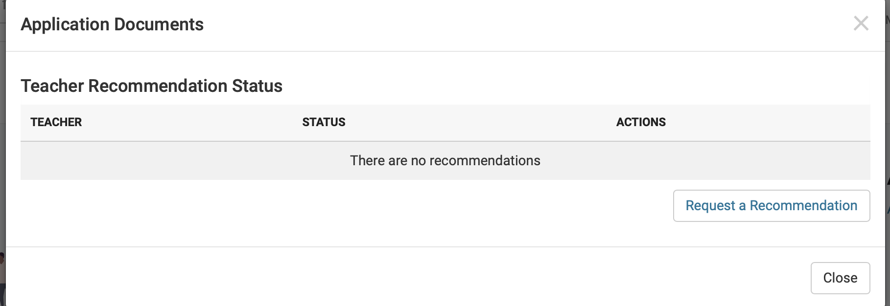
Recommendation Letters when applying with Common App
Recommendation letters will still be sent through Scoir.
https://www.cavsconnect.com/wp-content/uploads/2022/09/SCOIR-Guide-to-Completing-Recommenders-Section-of-CommonApp.pdf

Slide 17
Requesting Recommendation Letters
If you are receiving a recommendation letter from someone who does not work at the school:
They need to email me the letter as a PDF, with your full name and student ID, as well as their full name, and their position (ex: internship supervisor).
I will upload the letter on their behalf and send it to the colleges.

Slide 18
Requesting Fee Waivers for free College Applications

Slide 19
Requesting Fee Waivers for free College Applications
Only students who have free or reduced lunch or took the SAT/ACT with a waiver are eligible to receive application waivers.
If you have a special circumstance, you may also be eligible for a waiver.
Once the waiver is signed by me, you are responsible for emailing that waiver to each university’s admissions office.

Slide 20
Transcripts
You do not need to request transcripts on Scoir, they will be automatically sent to the schools that require them, as long as the school is in your applied column.
If you need your transcript for a scholarship application, you can ask your me or your counselor to place it in your Scoir MyDrive.

Slide 21
Sending Documents
I will send all required documents to the colleges. To ensure they will be delivered check the following are the same on scoir and your application:
First, middle, and last name
Email address
Date of birth
Home address
Add your Common App ID to Scoir

