Slide 1
RESUME WORKSHOP
Coral Gables Senior High
Notes:
Introduce myself

Slide 2
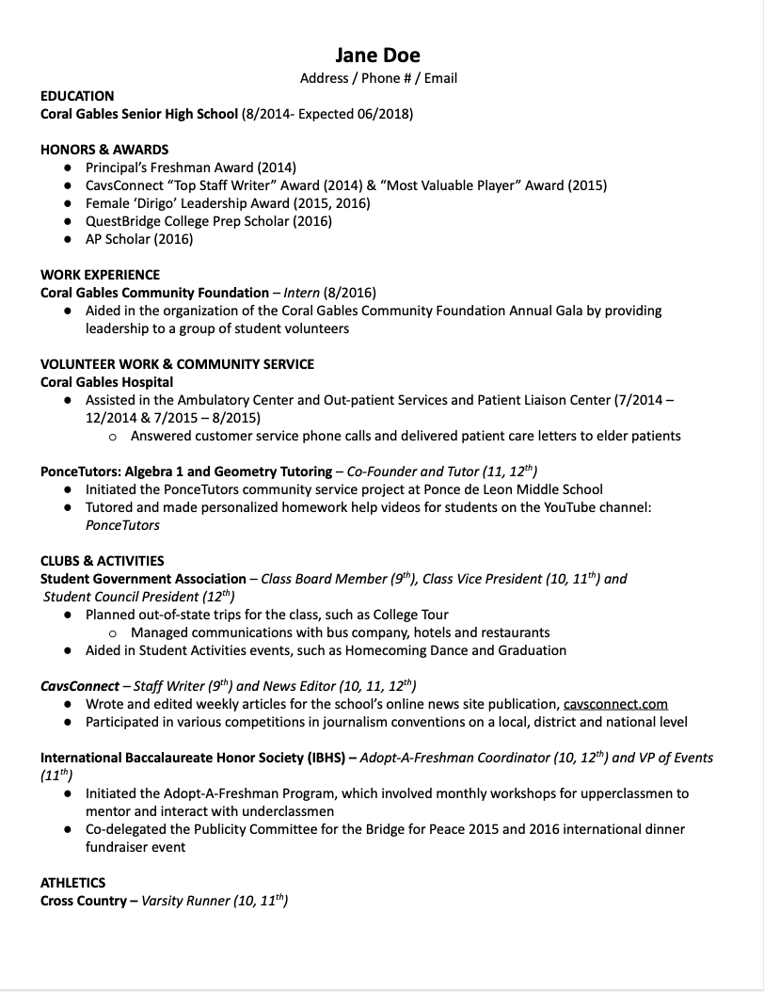
BASIC RESUME 101
Length:
1 page for high school students
Mostly Single-spaced
Double-space after headings
Margins:
Use 1 inch margins, ½ in if necessary
All margins should be consistent
Digital Format:
Convert document to PDF to ensure that your fomat stays the same
Notes:
Fix format

Slide 3
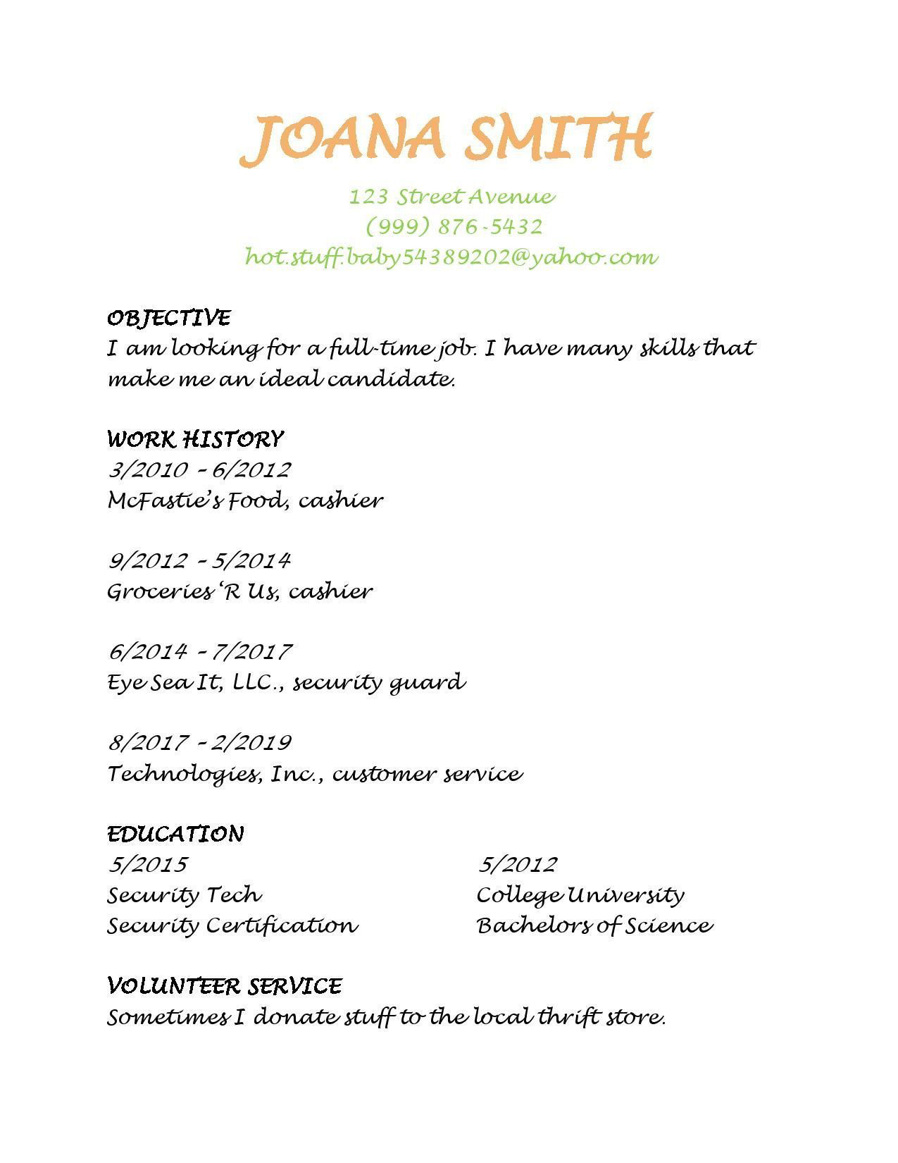
GOOD
&
BAD
FORMAT

Slide 4
FORMAT FOR DESCRIPTIVE SENTENCES
[ACTION VERB] + WHAT I DID + SKILLS I USED = SPECIFIC RESULTS I ACHIEVED
What I Did: Describe the tasks at hand and the role you played in that experience.
Skills I Used: Examples include oral/written communication, customer service, and proficiency with computer programs.
Results I Got: An effective result is concrete, measurable, and describes the goal of your actions. (e.g., an increase in sales percentage, improved customer service, etc)
EXAMPLE:
Strengthened relationships with customers utilizing outstanding communication skills, exceeding sales objectives by 5%

Slide 5
Action words to use:
MANAGEMENT
• Anticipated • Consolidated • Decided Coordinated • Oversaw • Motivated • Managed • Led • Launched • • Implemented • Headed • Executed • Established • Directed • Determined • Delegated • Strengthened • Supervised • Trained
COMMUNICATION
Addressed • Advertised • Authored • Answered • Briefed • Collaborated • Communicated • Composed • Corresponded • Consulted Expressed • Informed • Interpreted • Marketed • Interviewed • Narrated • Participated • Persuaded • Promoted • Translated • Verified • Wrote
RESEARCH
Applied • Collected • Compared • Conducted • Compiled • Critiqued Correlated • Defined • Diagnosed • Discovered • Estimated • Evaluated Experimented
TECHNICAL
Assembled • Built • Constructed • Engineered • Formed • Inspected Maintained • Monitored • Operated • Navigated • Programmed • Restored • Solved • Supplied • Upgraded
CREATIVE
• Conceptualized • Created • Customized • Designed • Developed • Drafted • • Illustrated • Imagined • Integrated • • Practiced • Produced • Proposed • Published • Revamped

Slide 6
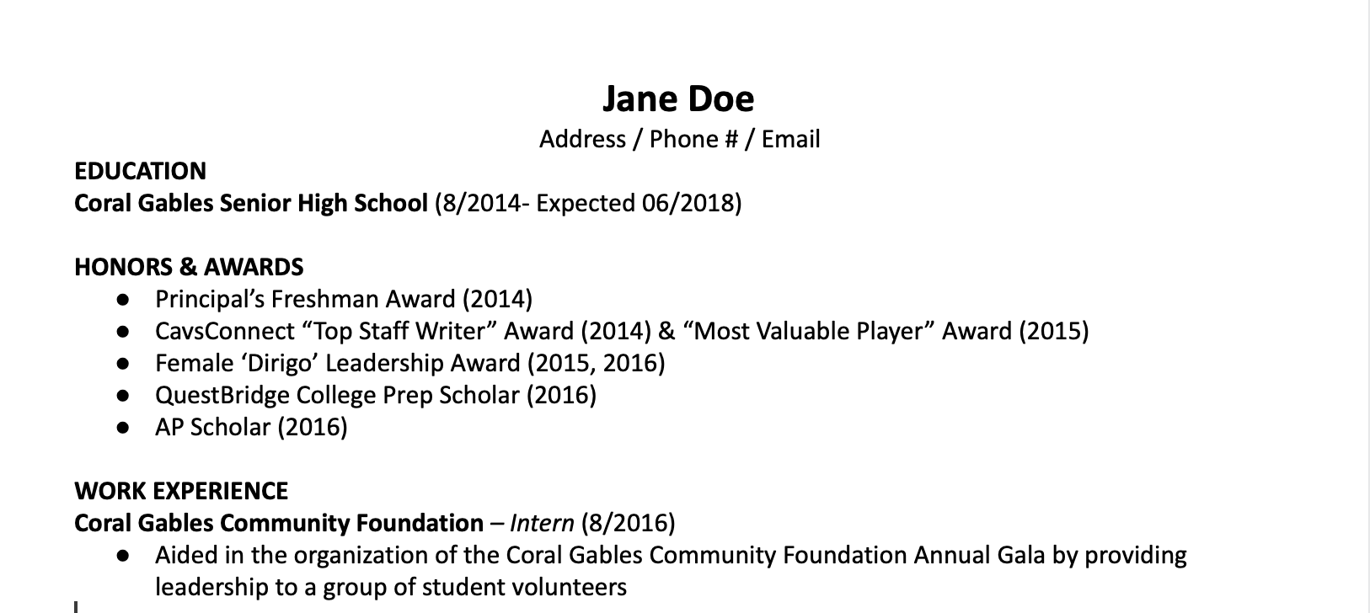
Basic Information + Work Experience
Include any additional education, such as Summer Programs or Dual Enrollment
GPA is optional
Elaborate on any skills learned + valuable experience
Notes:
Google Doc- write down any work experience
WORK EXPERIENCE:
Internship
Job
Getting paid

Slide 7
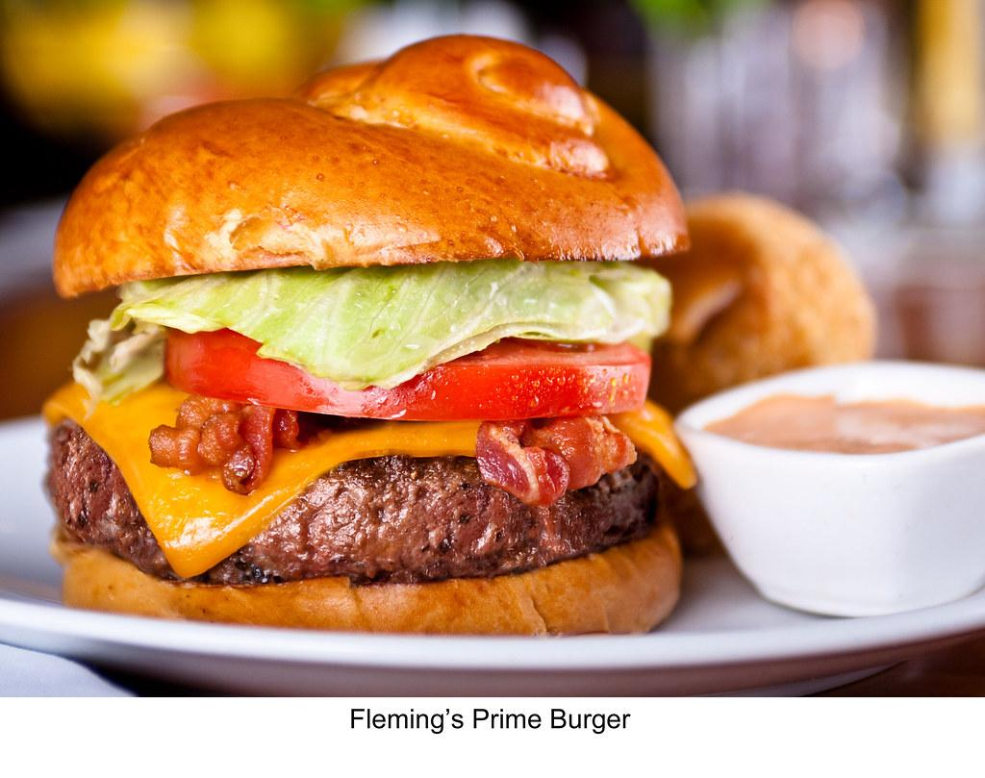
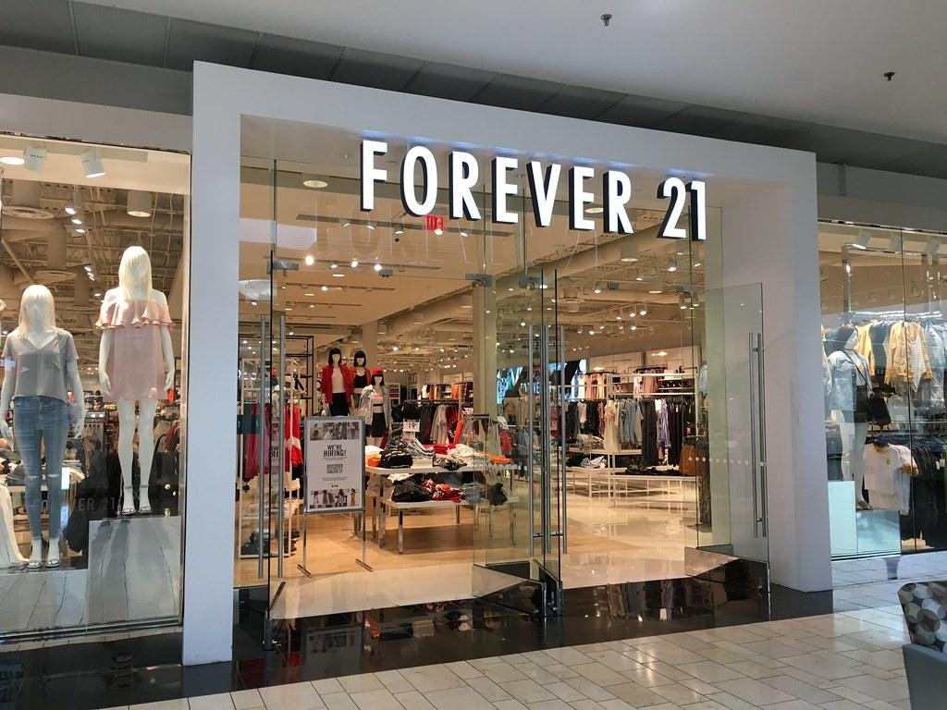
Have you worked as a server or in retail?
Restaurant servers:
Don’t say “I told customers about the menu”
Instead: “Memorized over 30 menu items and rotating specials in order to give customized recommendations to customers”
Retail jobs:
Folded clothes?
Try something like: “Maintained a clean, organized and curated displays of clothing and accessories”
Examples from @erinmcgoff TikTok! Check her out for more

Slide 8
Next Section: Volunteer Work and Community Service
Remember: keep this concise yet accurately reveal your experiences
Make sure to include locations
= Indirect way of including a reference place

Slide 9
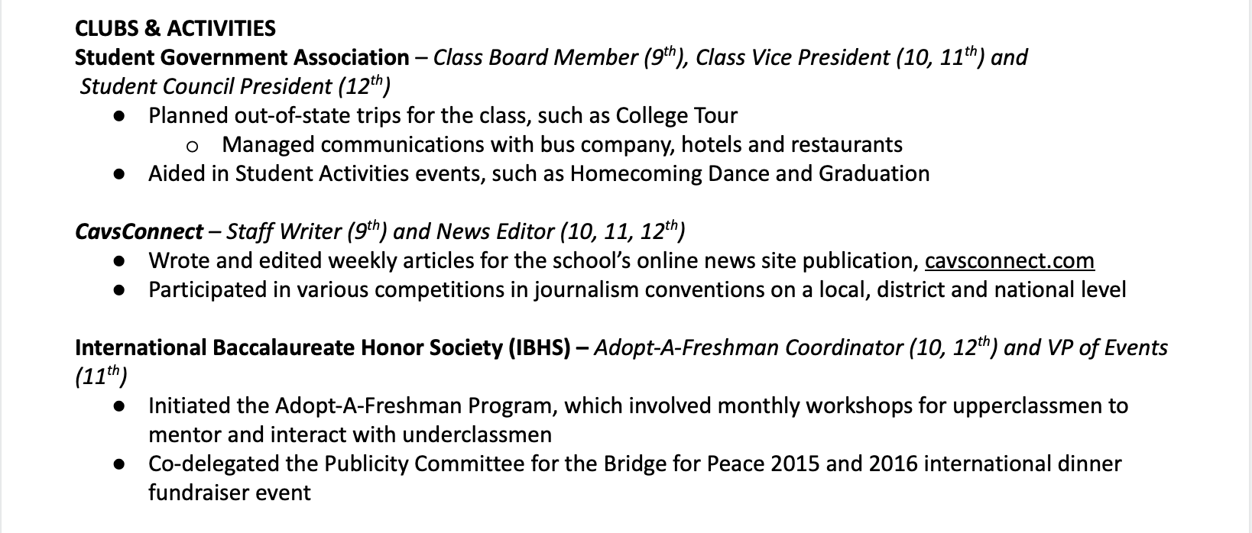
AT-SCHOOL ACTIVITIES
Include position then grade level
= Provides a quick to the reader
Add a bullet point to explain further

Slide 10
Last Section:
Add any role to your experience with the sport
= Captain, Treasurer, etc
Include languages, even if beginner
Include any social media experience!
= High in demand
= Instagram, Twitter
Include any software skills
= Adobe Cloud
= Microsoft

