Slide 1
Getting Organized with a College List
CARS 2023

Slide 2
Table of Contents
01
02
03
Searching
Creating
Organizing
04
05
06
Functionality
A Step Further
Other Tips
Searching for the colleges which you’d like to be on your list is the first step!
Create the list while noting the factors that are important in your sheet.
Feel free to use colors, keys, and different fonts to organize and separate.
Using your list while and post applying to make the process easier to follow.
A list is not the only thing that can be done, having folders is a good idea too!
Staying organized can come in simple tips that can save time as you’re applying.

Slide 3
Searching for Colleges
Part of starting your college search is introspection!
Start by thinking of what you want in a college: Is there a specific major/subject you’re interested in? a program? Do you prefer a smaller classroom setting or a bigger one? What about location?
Research schools based on the things you have now realized you want. Search for schools that offer opportunities tailored to your likes and do not be afraid to also research schools you’ve heard of often (i.e. Top 30 schools, UM, UF, etc.) out of curiosity!
Think money!!! Talk to your parents or guardians about affordability and how it can impact your plans for college. Keep your financial situation in the back of your head while searching for schools.
Go to college fairs, attend informational sessions, and explore a college’s website if you’re considering it. It could be a place you attend for 4 years; being informed is important!
Categorize the colleges you have settles on as a safety, match, or reach depending on their average statistics available online. A good college search is composed of a fair and even amount of each, with more safeties than not.

Slide 4
Important Terms to Know
When researching colleges, here are some terms to know and keep in mind:
Demonstrated Interest: showing that you have a desire to learn more about or potentially attend a school through clicking their emails, visiting their website, visiting their campus, or attending info sessions. Some colleges track this as part of their admissions process!
Liberal Arts College: a school that focuses more on an even-structured education rather than a pre-professional or angular one. Encourages students to strengthen their skills in both, STEM and the humanities.
Early decision vs Early action: Early decision is binding, meaning if you are accepted you MUST attend. Early action is non-binding and allows you to get your decision earlier than most while giving you the opportunity to reject or accept your enrollment later on.
Restrictive Early Action: Non-binding application under the condition that you do not apply early action to another private institution. You can apply REA to a private school and still apply EA to a public school!
Need-Blind: The reviewing of a student’s application without consideration of their financial situation.

Slide 5
Websites to Facilitate the College Search
https://www.niche.com/colleges/college-quiz/?utm_source=google&utm_medium=cpc&gclid=CjwKCAjwv-GUBhAzEiwASUMm4vAIF5emu1rS6jOk8XsJHmxKB5PB1yj3PNV7D5H0WkKUlFnBa6_66hoCsJ0QAvD_BwE
https://www.princetonreview.com/college-search
https://www.collegevine.com/

Slide 6
Creating your College List
Your list will help you keep track of schools and applications, as well as deadlines.
Open a google or excel sheet and start by listing the names of the schools that you are interested in applying to.
Next to the name, make sections with other factors that you previously researched and found important.
Possible Sections to Include:
Location
Deadline for application and financial aid
Cost of attendance
Acceptance rate
Categorize: safety, match, reach
Majors interested in
Opportunities
Class size/overall size
Requirements: credits, past classes, interviews etc.

Slide 7
Organizing Your College List
Keys
Font & Size
Colors
Acronyms
***Extra step that may be helpful: add the financial aid and admissions office emails at the end of your list for each school.
Keys allow you to facilitate the color coding system
Play around with font and sizing to personalize your list.
Add colors to separate sections from each other
If you feel it helps or simplifies your list, create acronyms

Slide 8
Why the College List is Useful
A well-organized college list will allow you to:
Remember admissions deadlines and make sure you are on track
Be reminded of when financial aid documents are due
Keep track of any interviews you may have scheduled if you choose to include a section for it
Quickly see the places you have applied to, and later on accepted, rejected, or waitlisted/deferred to.
Go back and decline admissions offers to every school you applied and got accepted to faster and easier.
Create flexibility: as schools ask for extra documents, you can highlight them on your list to remind yourself of their request.

Slide 9
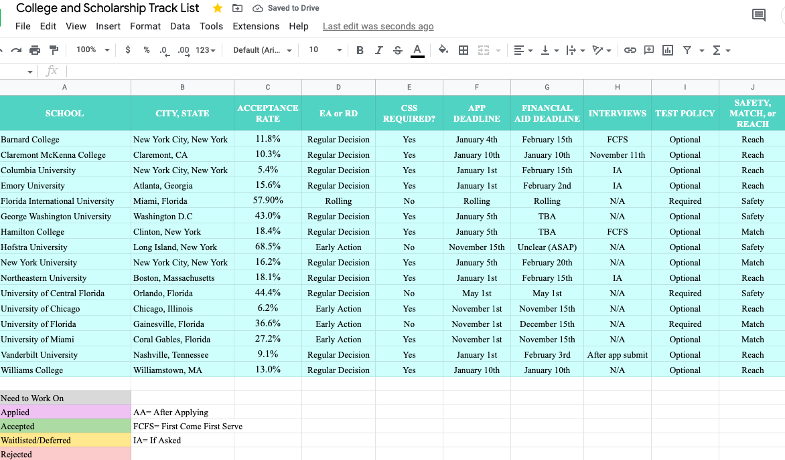

Slide 10
How to Use Your List While and After Applying

Slide 11
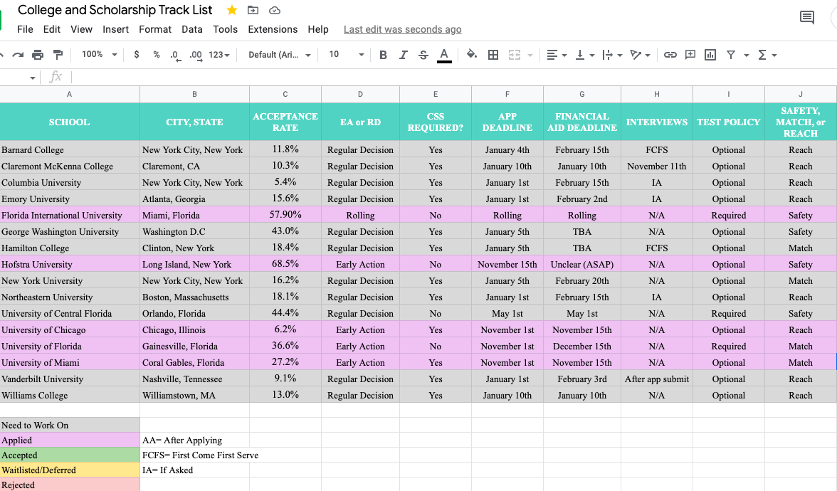

Slide 12
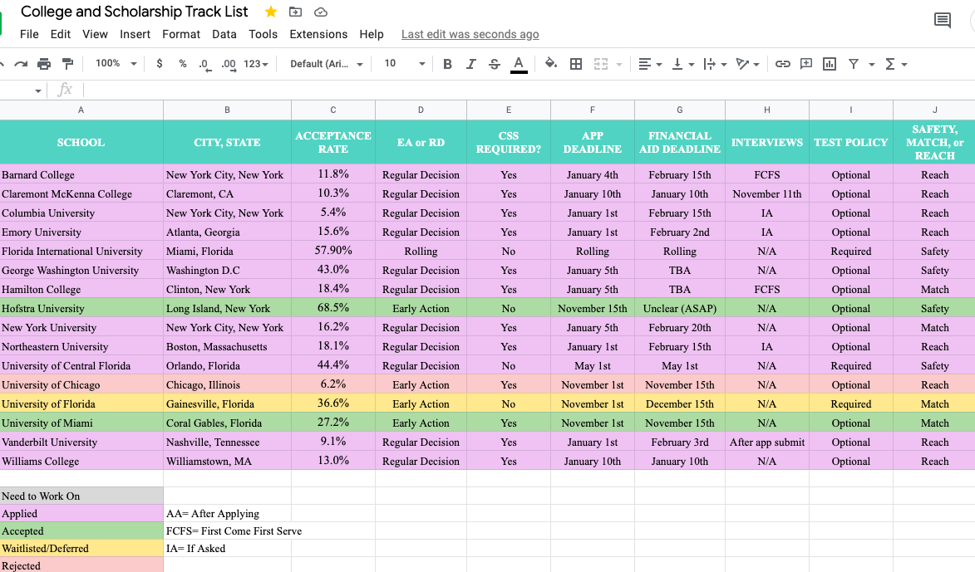

Slide 13
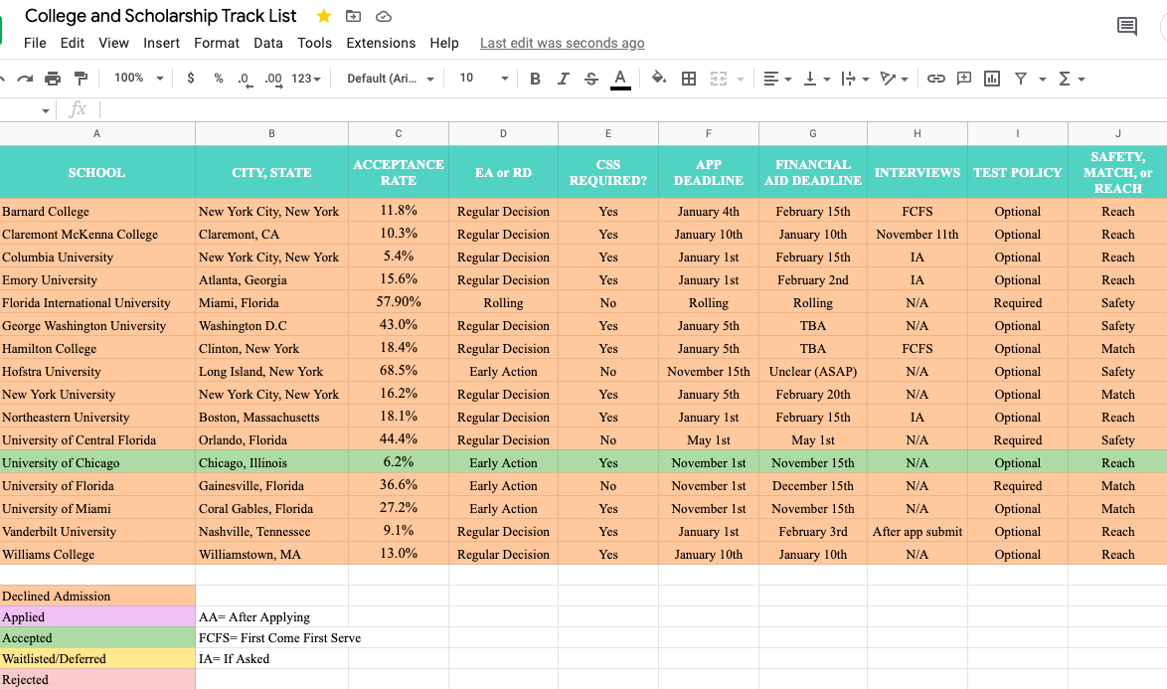

Slide 14
Other Ways of Organizing Yourself
You can take organization to the next level by dedicating a folder on your laptop to your applications.
Start a folder on your desktop or google drive
Dedicate separate folders within the main one to each college respectively.
Keep supplements in each school’s folder for easy access (Some people prefer to just have one document divided by sections for each school. Do what works best for you!)
Keep your personal statement, resume, college list, and scholarship list in the main folder.

Slide 15
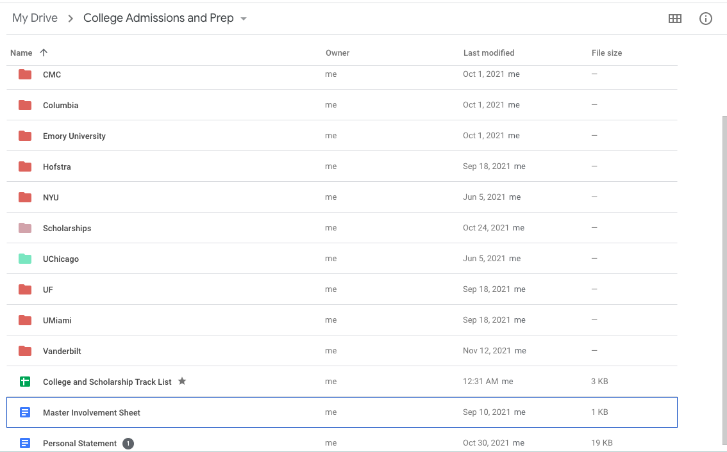

Slide 16
Inside Each Folder

Slide 17
Final Tips for Organization
Bookmark login pages
Save passwords
Save award / scholarship letters
When you create an applicant portal, bookmark the login pages to be able to access them quicker.
Because you have to be making accounts for every school you apply to, writing passwords down is a good idea.
Save a PDF or physical copy of your aid package and scholarship letters for the end of year CAP survey!

