Slide 1
ALL ABOUT GPA

Slide 2
There Are Three Types of GPA:
Unweighted GPA
Weighted GPA
Core GPA

Slide 3
Unweighted and Weighted
Unweighted GPA - Grade point average without bonus points; maximum is 4.0
Weighted GPA - Grade point average with bonus points; maximum is 6.0

Slide 4
Grade Point Average
Grade point average (GPA) may be required for any of the following:
The required GPA for high school graduation is a 2.0.
Rank in class uses a weighted GPA.
Eligibility to participate in interscholastic extracurricular activities
Academic recognition programs
Placement on the honor roll and/or memberships in honor societies
College admission and scholarships

Slide 5
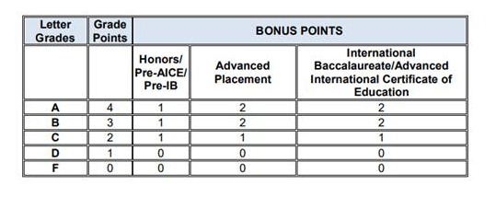
Grade Point Average
Weighting of Assigned Grade

Slide 6
Unweighted GPA
Grade Point Average Without Bonus Points

Slide 7
GPA Is a Graduation Requirement
24 credit option minimum GPA is a 2.0.
18 Credit ACCEL option minimum GPA is a 2.0.

Slide 8
Weighted GPA
Grade Point Average With Bonus Points

Slide 9
Weighted GPA Is Used for:
Rank in class:
The grade point average used for determining the rank in class for students includes grades from all courses in which credits have been earned for high school graduation and the first semester of the students’ final year. Bonus points are applied to grades earned in individual courses prior to the calculation of the weighted GPA.
Academic Recognition of High School Graduates: The following honor designations are used by Miami-Dade County Public Schools for academic recognition of high school graduates. The criteria for academic recognition are based on a weighted GPA.
Cum Laude: the upper 15% of the graduating class, excluding the Summa and
Magna Cum Laude students, using a weighted GPA or students who have a 4.0 GPA
or higher.
Magna Cum Laude: the upper 10% of the graduating class, excluding the Summa
Cum Laude students, using a weighted GPA.
Summa Cum Laude: the upper 5% of the graduating class using a weighted GPA.

Slide 10
Weighted GPA Is Used for:
Superintendent’s Diploma of Distinction: In addition to the State’s high school diploma options, M-DCPS offers students the opportunity to obtain the Superintendent’s Diploma of Distinction. This diploma is awarded to students who meet the requirements of the standard diploma and:
Complete an academically rigorous program of study, including at least four honors, Advanced Placement (AP), International Baccalaureate (IB), Advanced International Certificate of Education (AICE), International Studies (IS), and/or dual Enrollment courses;
Complete a 75-hour community service project or work hours; and
Earn a 3.5 weighted GPA by the end of the first semester of the senior year with no final grades reflected on the transcript less than a “C.”

Slide 11
Core GPA
A Core GPA is based on the grades earned in a particular group of core academic courses. Usually these courses include English, Mathematics, Science, Social Studies, and Foreign Language courses.
Core GPAs are recalculated for:
Bright Futures Scholarship
State University System (SUS)
National Collegiate Athletic Association (NCAA)

Slide 12
Bright Futures
Evaluation for Bright Futures includes an unrounded, weighted high school GPA in the 16 college-preparatory credits.
4 – English (three must include substantial writing)
4 – Mathematics (at or above Algebra 1 level)
3 – Natural Sciences (two must have substantial laboratory)
3 – Social Sciences
2 – World Languages (sequential, in the same language)
Bright Futures Student Handbook 2021-22
https://www.floridastudentfinancialaidsg.org/PDF/BFHandbookChapter1.pdf

Slide 13
Bright Futures Calculates a Weighted GPA as Follows:
Evaluation for Bright Futures includes an unrounded, weighted high school GPA in the 16 college-preparatory credits. The following courses are weighted .25 per semester course or .50 per year course in the calculation of the GPA:
Advanced Placement (AP)
Pre-International Baccalaureate (Pre-IB)
International Baccalaureate (IB)
Honors
Pre-Advanced International Certificate of Education (Pre-AICE)
Advanced International Certificate Education (AICE) or
Academic Dual Enrollment
Ex: “A” = 4 points for an un-weighted course – an “A” would equal 4.5 quality points for a weighted course.
Bright Futures Student Handbook 2021-22
https://www.floridastudentfinancialaidsg.org/PDF/BFHandbookChapter1.pdf

Slide 14
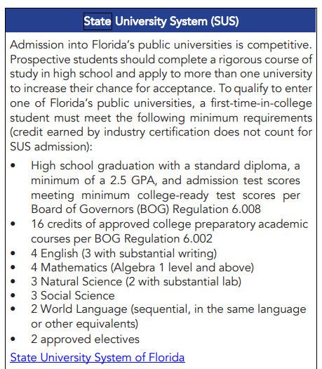
State University System (SUS)

