Slide 1
How to Input Activities
Common Application

Slide 2
Activities Section?
When applying to college it’s really important to put your best foot forward and give them a sense of who you are with every aspect of your application.
The activities section of any application is extremely important because:
Your involvement tells them what is important to you
It shows that you do what is required of you and more
Helps them determine if you would be a good fit for their university

Slide 3
What would be considered important?
Make sure to include all leadership positions you’ve held in the order of relevance.
All volunteering activity is important (especially if it’s related to your major)
Jobs
Paid and unpaid internships
Make sure to know the exact dates and time you spend (approximately) in these activities.

Slide 4
What the Activities Section of your resume should look like
Having this section perfected in your resume will make it easier for you when it’s time to input your activities in any application type.
You need the title of the activity, how long you have been involved, and a small description of what you do.
Example: National Honor Society (NHS) member since sophomore year, and Board Member junior and senior year. Here we would do community service projects in order to beautify and impact the community in a positive way. Some organizations we partnered with were “Paws 4 You” and “White Coat Waste Project”. As a secretary, I was in charge of making sure all the members got their community service hours in on time, and dealt with tasks like registration and event organization.

Slide 5
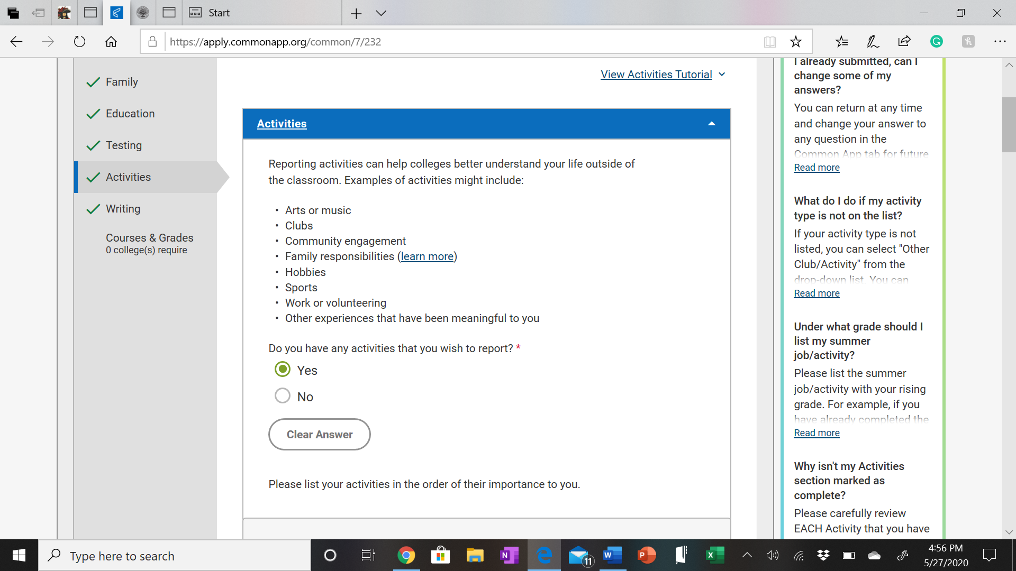
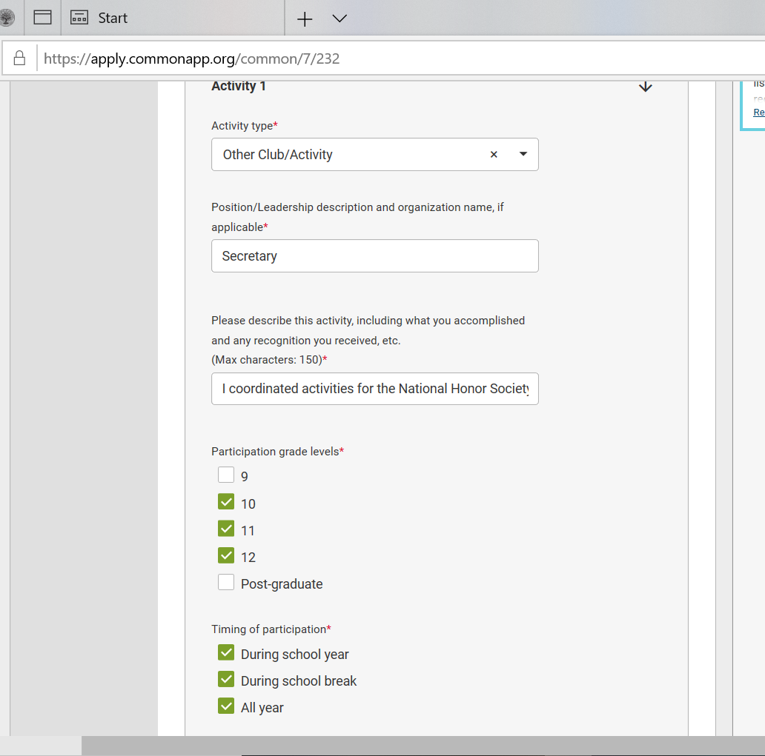
What the Activities Section looks like in Common App
Notes:
Talk about how they need to make the best out of the 150 characters

Slide 6
Other things to take into account:
Quality is more important than quantity. (while being involved in every club for one year can look good, it looks better when you show commitment).
Leadership roles are extremely important because they show you were committed and escalated within the organization.
It’s harder to obtain a leadership role in large clubs, which also makes it more impressive if you do.
If your clubs, volunteering and major are related; this creates a theme in your application which can help you stand out.
Other students can have the same activities as you, so make sure that your activities have a component that make you stand out (ex: commitment, leadership, funding, etc)

