Slide 1
COLLEGE APPLICATIONS: THE ESSENTIALS

Slide 2
Application: required everywhere
Transcript or SSAR
Essay/Personal Statement: (if applicable…share your voice!)
Application fee: (fee waiver(s) can be used, see me for more info.)
SAT/ACT Scores: required or test optional
Letters of Recommendation: (if applicable)
Copy of other Required Documentation: (if applicable)
GENERAL APPLICATION CHECKLIST

Slide 3
TYPES OF APPLICATIONS
Rolling Admission: accepts students as applications come in, and until they run out of spots, so apply early!
Early Action: NON-BINDING! Students can apply to multiple schools as EA. Apply early (October-November) and receive notice by December.
Early Decision: If the student is accepted, this is a BINDING decision, regardless of any financial aid packages. You can only apply to one ED school and must sign a contract, along with your parents & myself.
Regular Decision: most deadlines are around January and decisions are made by mid-March-April.

Slide 4
Meet your deadlines
Rolling Admission: normally open in August and end in April
Early Action: October-November
Early Decision: October-November
Regular Decision: January-March
SCHOLARSHIP DEADLINES MAY BE MUCH EARLIER!

Slide 5
The big three
Common Application: one of the most popular college admission applications. Appy to multiple schools using one application.
Coalition Application: less popular college admission application
Institutional Application: college admissions application provided by the specific school (or group of schools) that you are applying to.

Slide 6
The big three: differences
Common Application: typically, more user friendly, and has over 800 schools in its network. Students are limited to applying to 20 universities on common app.
Coalition Application: no limit on how many schools you can apply to, has a connection to Scoir.
Institutional Application: these schools are typically not on common app or on the coalition app. You apply directly on their website.

Slide 7
What should I use?
Recommended: Common App
Most schools you are applying to are on Common App! This includes Florida schools (UF, FSU, UCF, etc.), private schools (UM, BU, USC, and the Ivy Leagues), and public out-of-state schools (UVA, UNC, Michigan).
Institutional Applications:
If you plan to apply to California schools, you’ll have to apply via the UC website or CSU website. The FIU application also tends to be easier through their website than through common app.

Slide 8
LET’S GET A HEAD START!
COMMONAPP.ORG

Slide 9
The common application

Slide 10
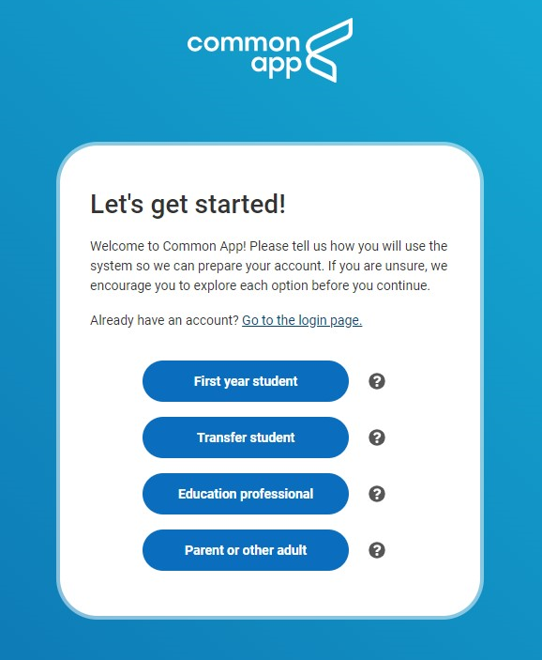
Create an account

Slide 11
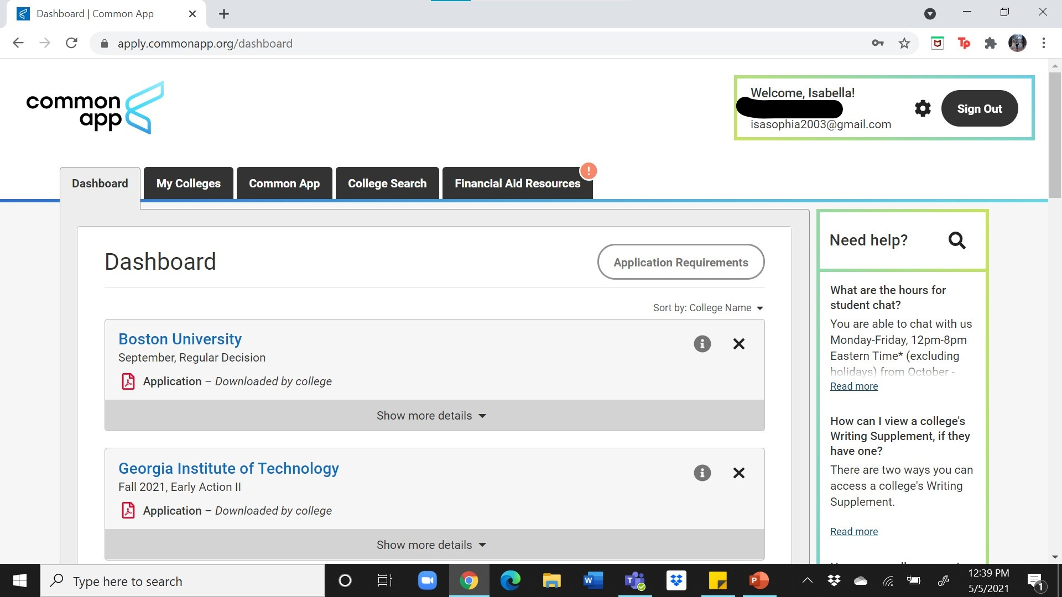
The common app dashboard

Slide 12
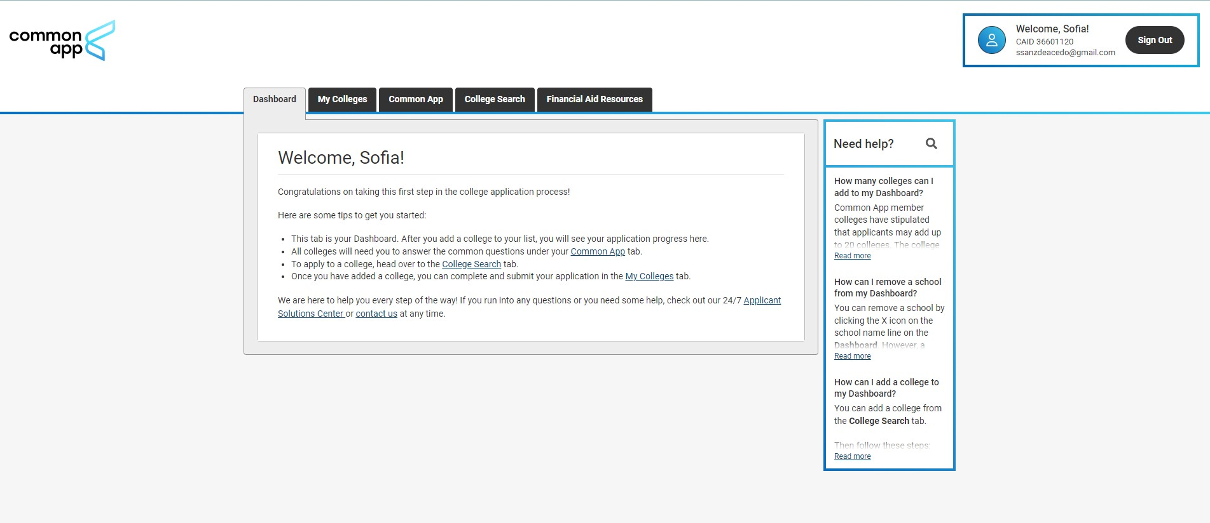
The common app dashboard

Slide 13
Parts of common app
Dashboard: summary of your applications
My Colleges: your college applications. Every school may have different questions, supplements, or other requirements. This is where you will find that. You can submit different colleges at different times.
Common App: general information that is used for every school will require.

Slide 14
common app sections

Slide 15
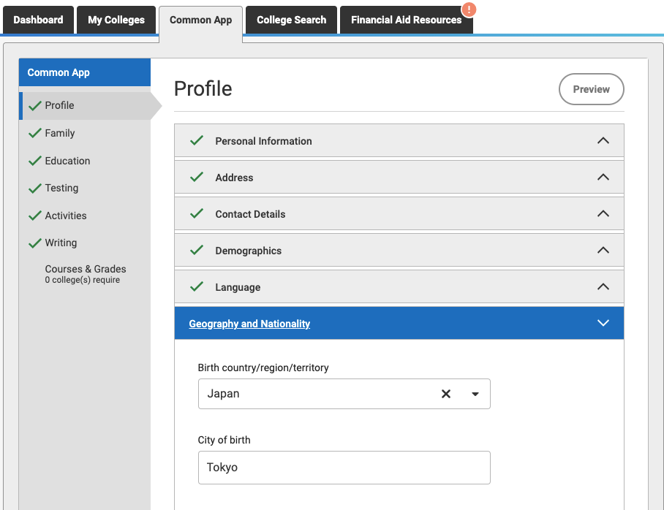
PROFILE SECTION: Each part of the common app profile is up-front and easy. Not all of it is required as you will see by the red asterisk. If you feel uncomfortable answering something that is optional, you may omit it.

Slide 16
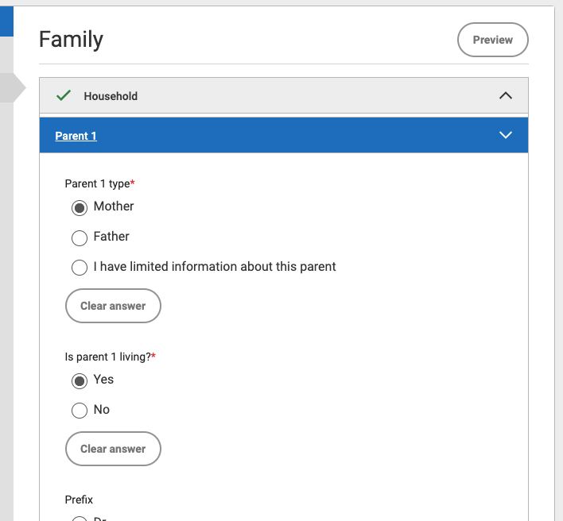
FAMILY SECTION: Asks for information about your parents’ and (if applicable) any siblings level of education and occupation.

Slide 17
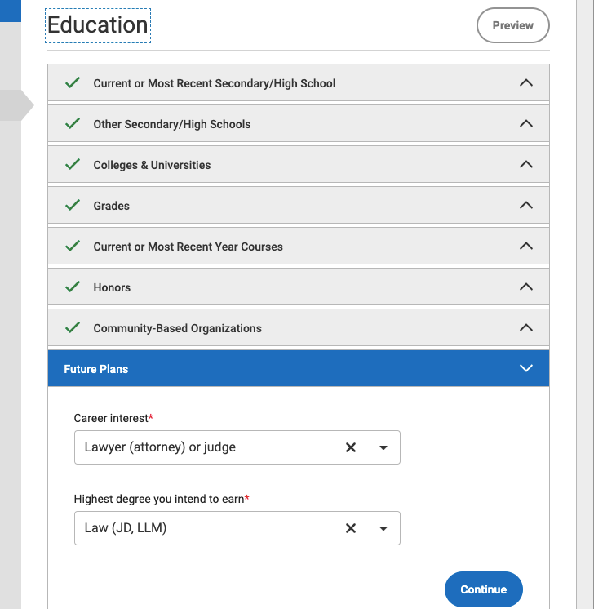
EDUCATION SECTION: Answer questions about the school you are in currently (Gables), any other schools you may have attended including colleges (dual enrollment), senior year courses, any honors you may have received, and your career or education plans.

Slide 18
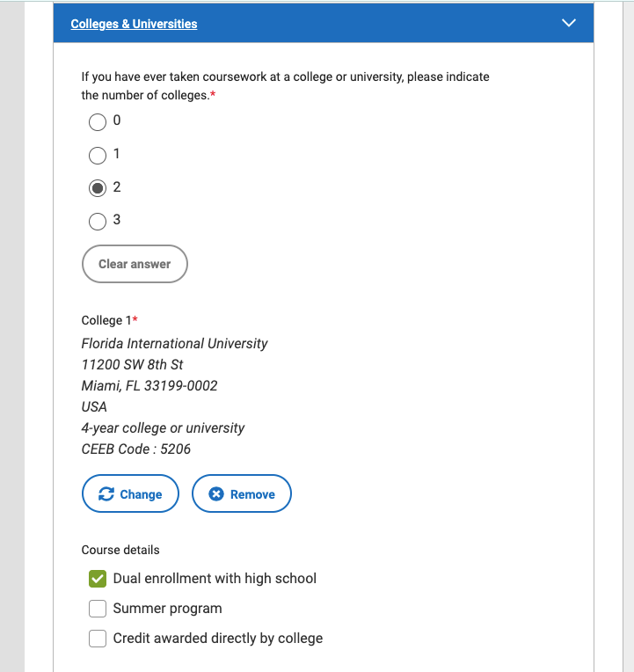
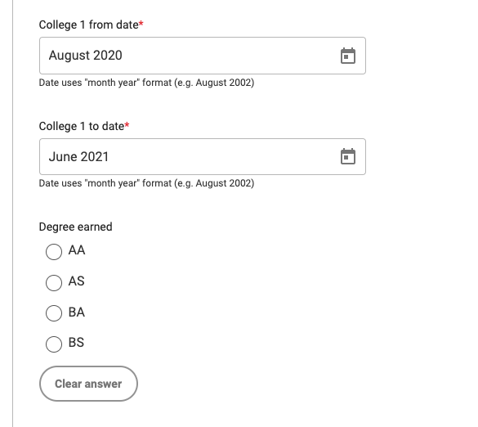
DUAL ENROLLMENT

Slide 19
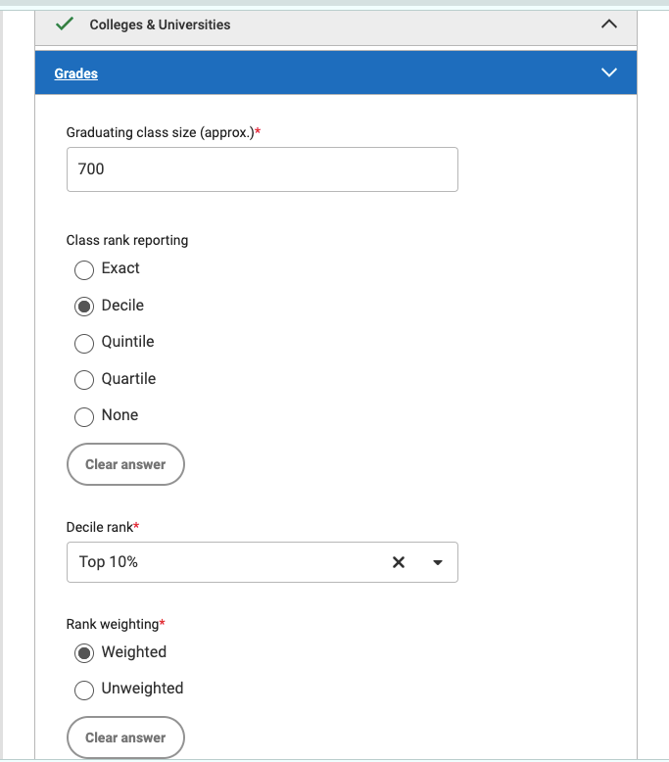
CLASS STATS: Class size will be announced in August. Gables does not rank students, we only haver percentile ranking, so you’ll select DECILE. Percentages will be announced around mid-September.

Slide 20
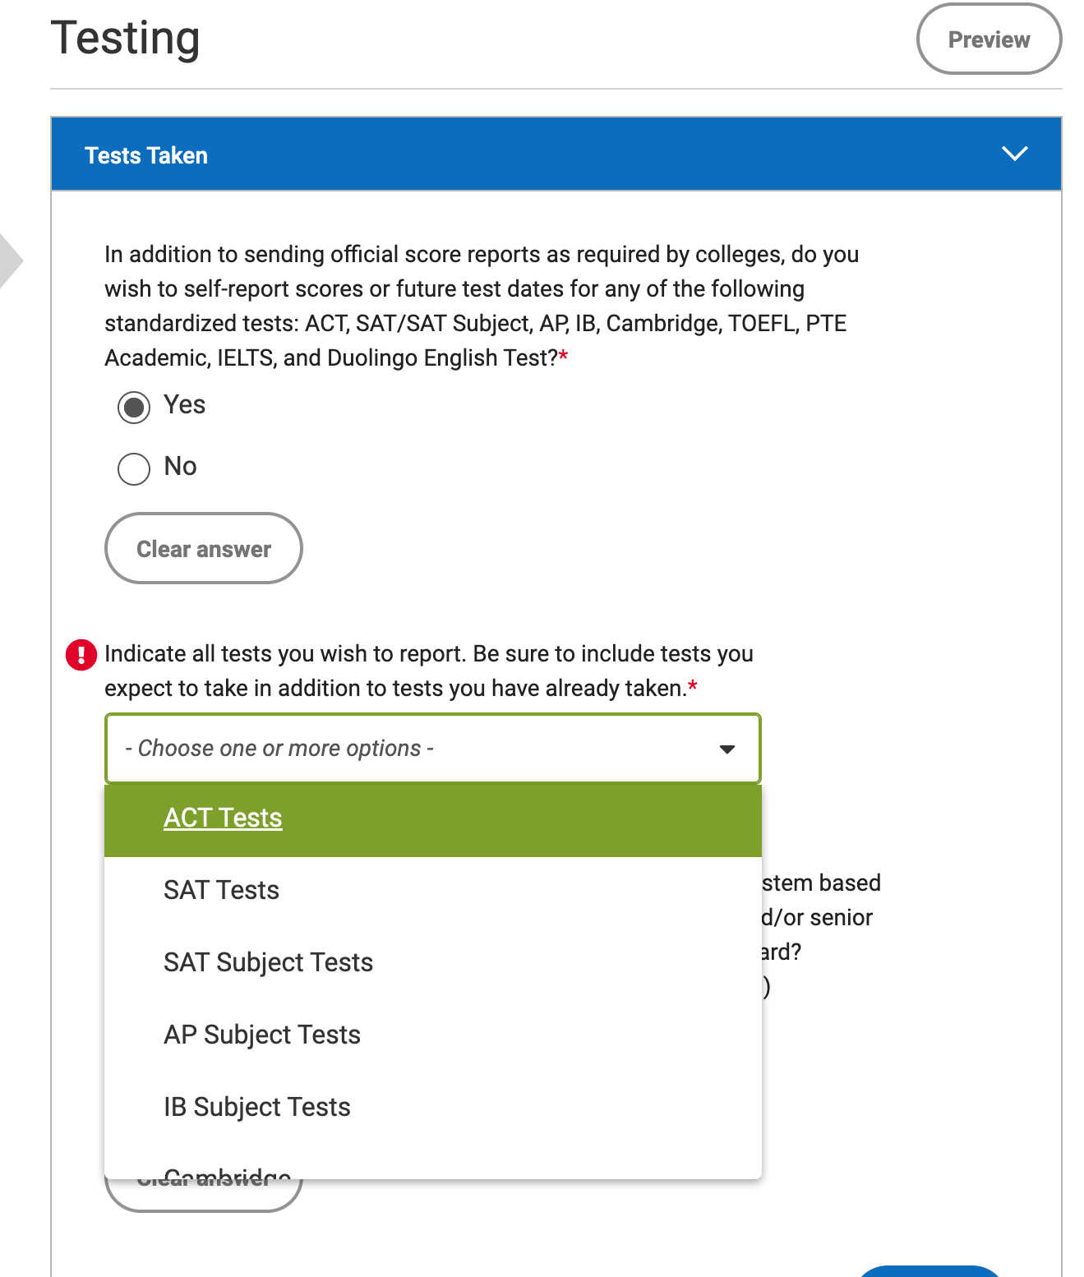
TESTING SECTION: Some of your schools may be test optional, while others may require them. Before submitting your application, make sure you edit this section.

Slide 21
MORE ON ACTIVITIES SECTION & WRITING SECTIONS LATER…

Slide 22
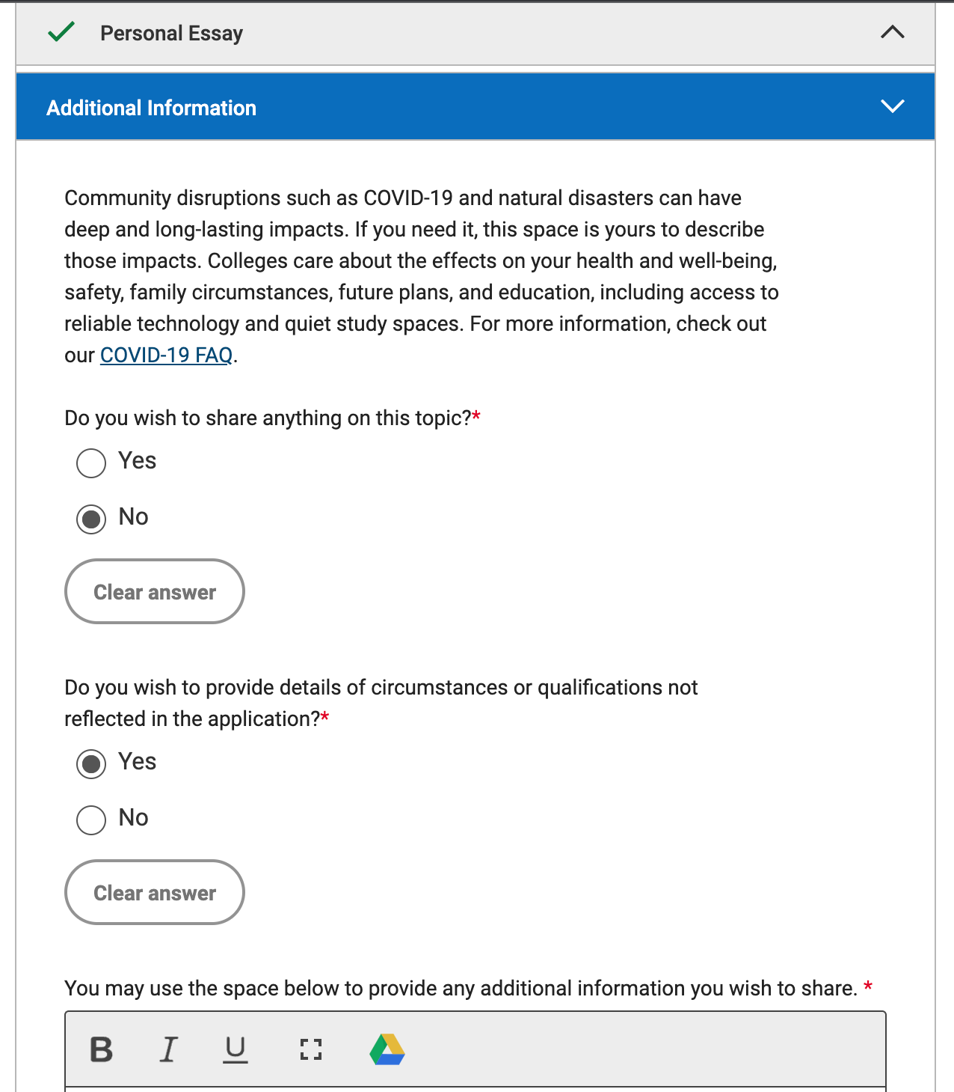
ADDITIONAL INFO: The section is separated in 2: the long-lasting effects covid-19 may have had on your life for 250 words, and the second allowing you to expand on other circumstances or qualifications. Avoid repeating anything from your essay. Only use this space if you feel like you need to.

Slide 23
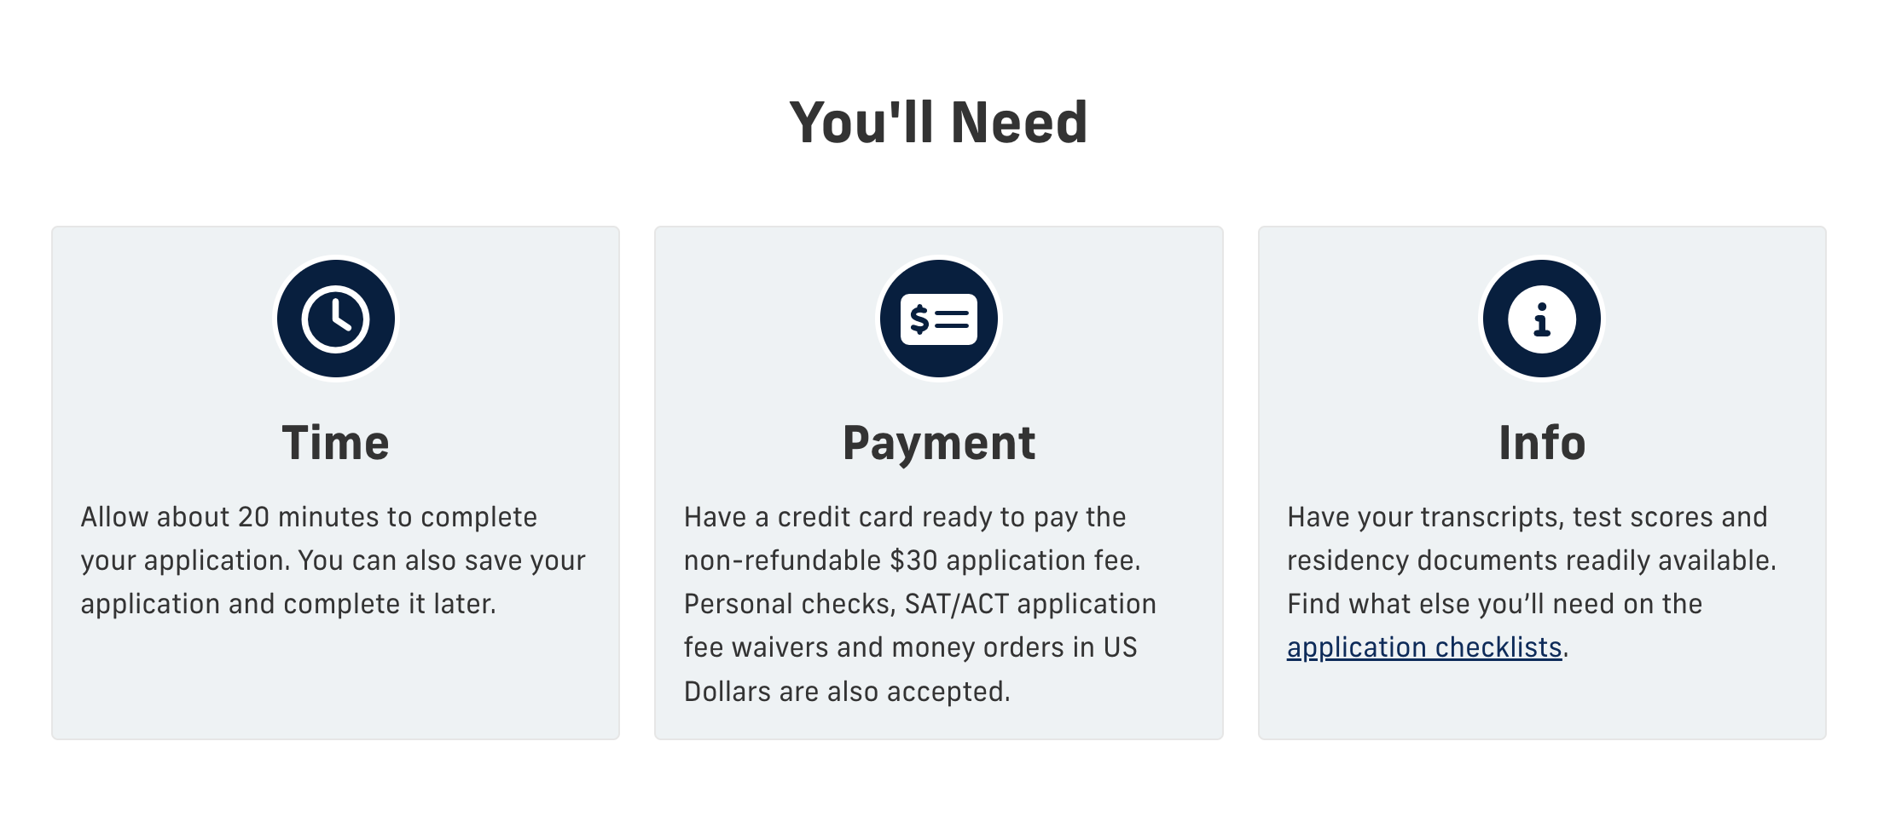
Institutional APPLICATION
Apply on the school's website.
For example: fiu.edu. Typically found under the admissions tab---> apply https://www.fiu.edu/

Slide 24
Institutional APPLICATION
Type of application: ALWAYS 1st year, undergraduate. Even if you are graduating with an AA or have taken Dual Enrollment courses.

Slide 25
AFTER SUBMITTING AN APPLICATION
WHAT NOW?

Slide 26
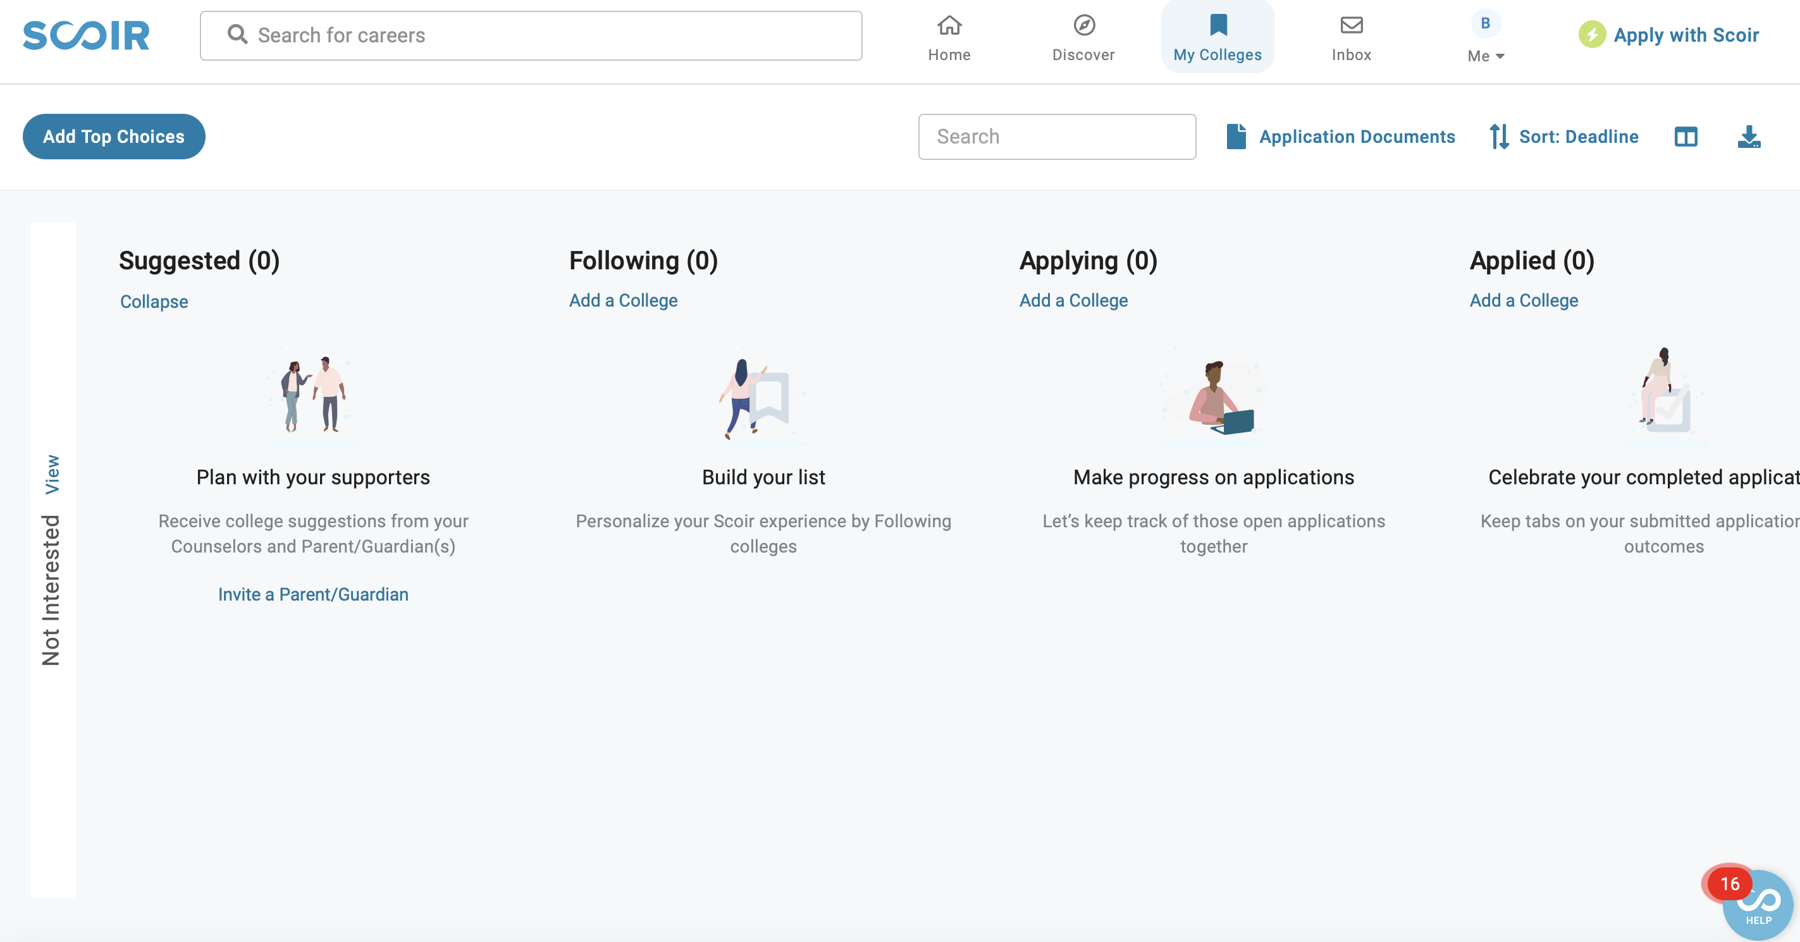
NEXT STEPS
Step 1:
Make sure your “applying” column is accurate.
Add all the schools you plan to apply to.

Slide 27
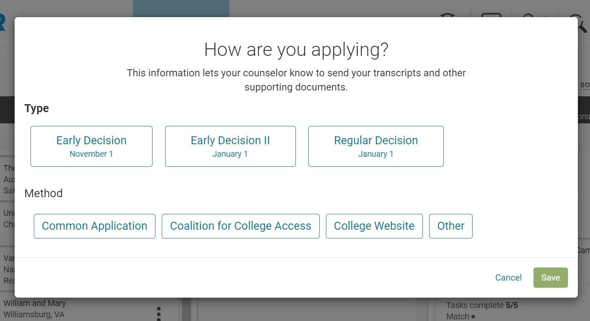
NEXT STEPS

Slide 28
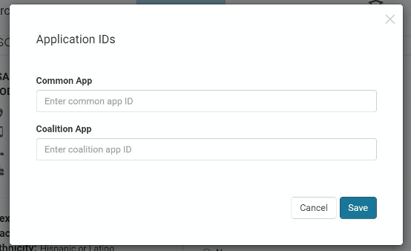
NEXT STEPS

Slide 29
NEXT STEPS
Step 2:
Move the college from the applying to applied column. This acts as your notice to me to send your documents. No need to see me/email me for this.

Slide 30
NEXT STEPS
Step 3:
Keep track of your applications and action items.
ALWAYS check your email for next steps.
Some things you may need to do after applying:
Creating an account to see your outcome (myfiu portal, myfsu, cane id, etc.)
Submitting Florida residency form
Paying the application fee or submitting a fee waiver
Financial aid applications
Keeping track of your documents

