Slide 1
BRIGHT FUTURES SCHOLARSHIP
Requirements
Award amounts
How to apply

Slide 2
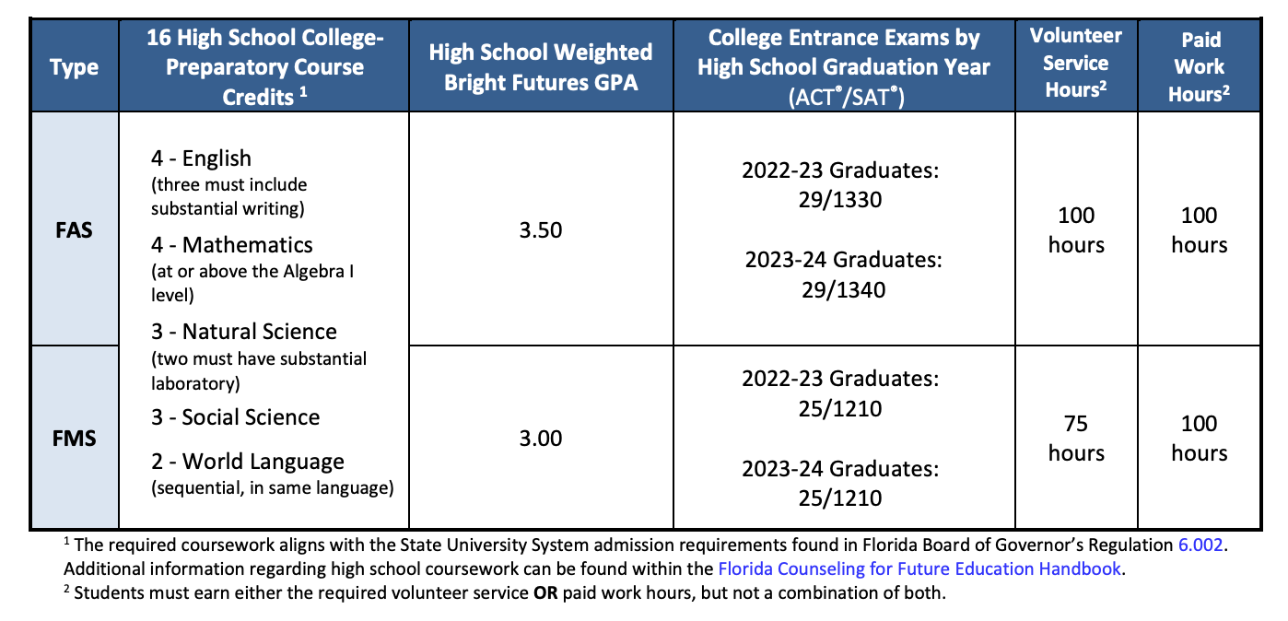
REQUIREMENTS

Slide 3
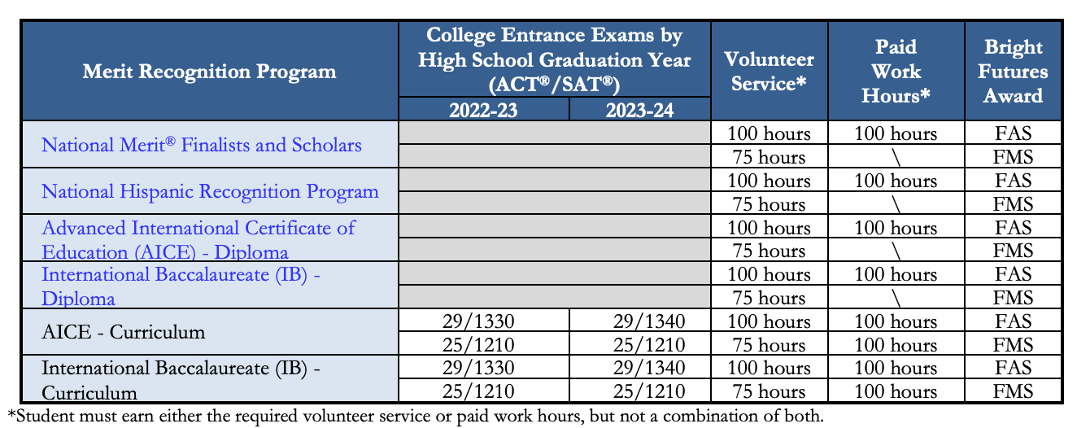
OTHER WAYS TO QUALIFY

Slide 4
AWARD AMOUNTS
Florida Academic Scholars (FAS) aka “100%” Bright Futures
100% of TUITION at any public Florida University- around $6,500 a year. Goes directly to your financial account at the school you enroll in.
Florida Medallion Scholars (FMS) aka “75%” Bright Futures
75% of TUITION at any public Florida University –around $5,000 a year. Goes directly to your financial account at the school you enroll in.
Private Schools
You receive about $200 per credit hour. Typical course load per semester is 12 hours, so total is about $5,000 a year.
Out of State:
Nada!

Slide 5
HOW/ WHEN TO APPLY
You can apply as early as October 1st, 2023 until August 31, 2024
Test score eligibility: until June 30th 2024
Two-Step process:
Create a student account
Submit the FFAA

Slide 6
EVALUATION PERIOD AND AWARD NOTIFICATION
Early Evaluation
Required coursework and GPA through 7th semester
Coursework in progress for 8th semester
Service hours earned through January 31
Test scores for tests taken through January 31
Final Evaluation
All required coursework and GPA completed by high school graduation
Service hours completed by a date established by the public school district/nonpublic school administrator
Test scores for all tests taken through June 30 of high school graduation year
High school graduation date associated with earning a standard high school diploma

Slide 7
STEP BY STEP INSTRUCTIONS
Click here!

