Slide 1
INTEREST MEETING
DATE APPLICATION OPENS AND DEADLINE TBD!

Slide 2
ABOUT QUESTBRIDGE COLLEGE PREP SCHOLARS
Questbridge helps high achieving, low-income students navigate college admissions, access the nations top colleges and have additional opportunities after graduation.
Over 80,000 students are served by Questbridge
30,000 students admitted to a Questbridge college partner
Mini college application: Special awards and resources to prepare Juniors to apply to the nation’s best colleges
Great bridge to the National College Match: college admissions and scholarship process that connects seniors to full scholarships at college partners

Slide 3
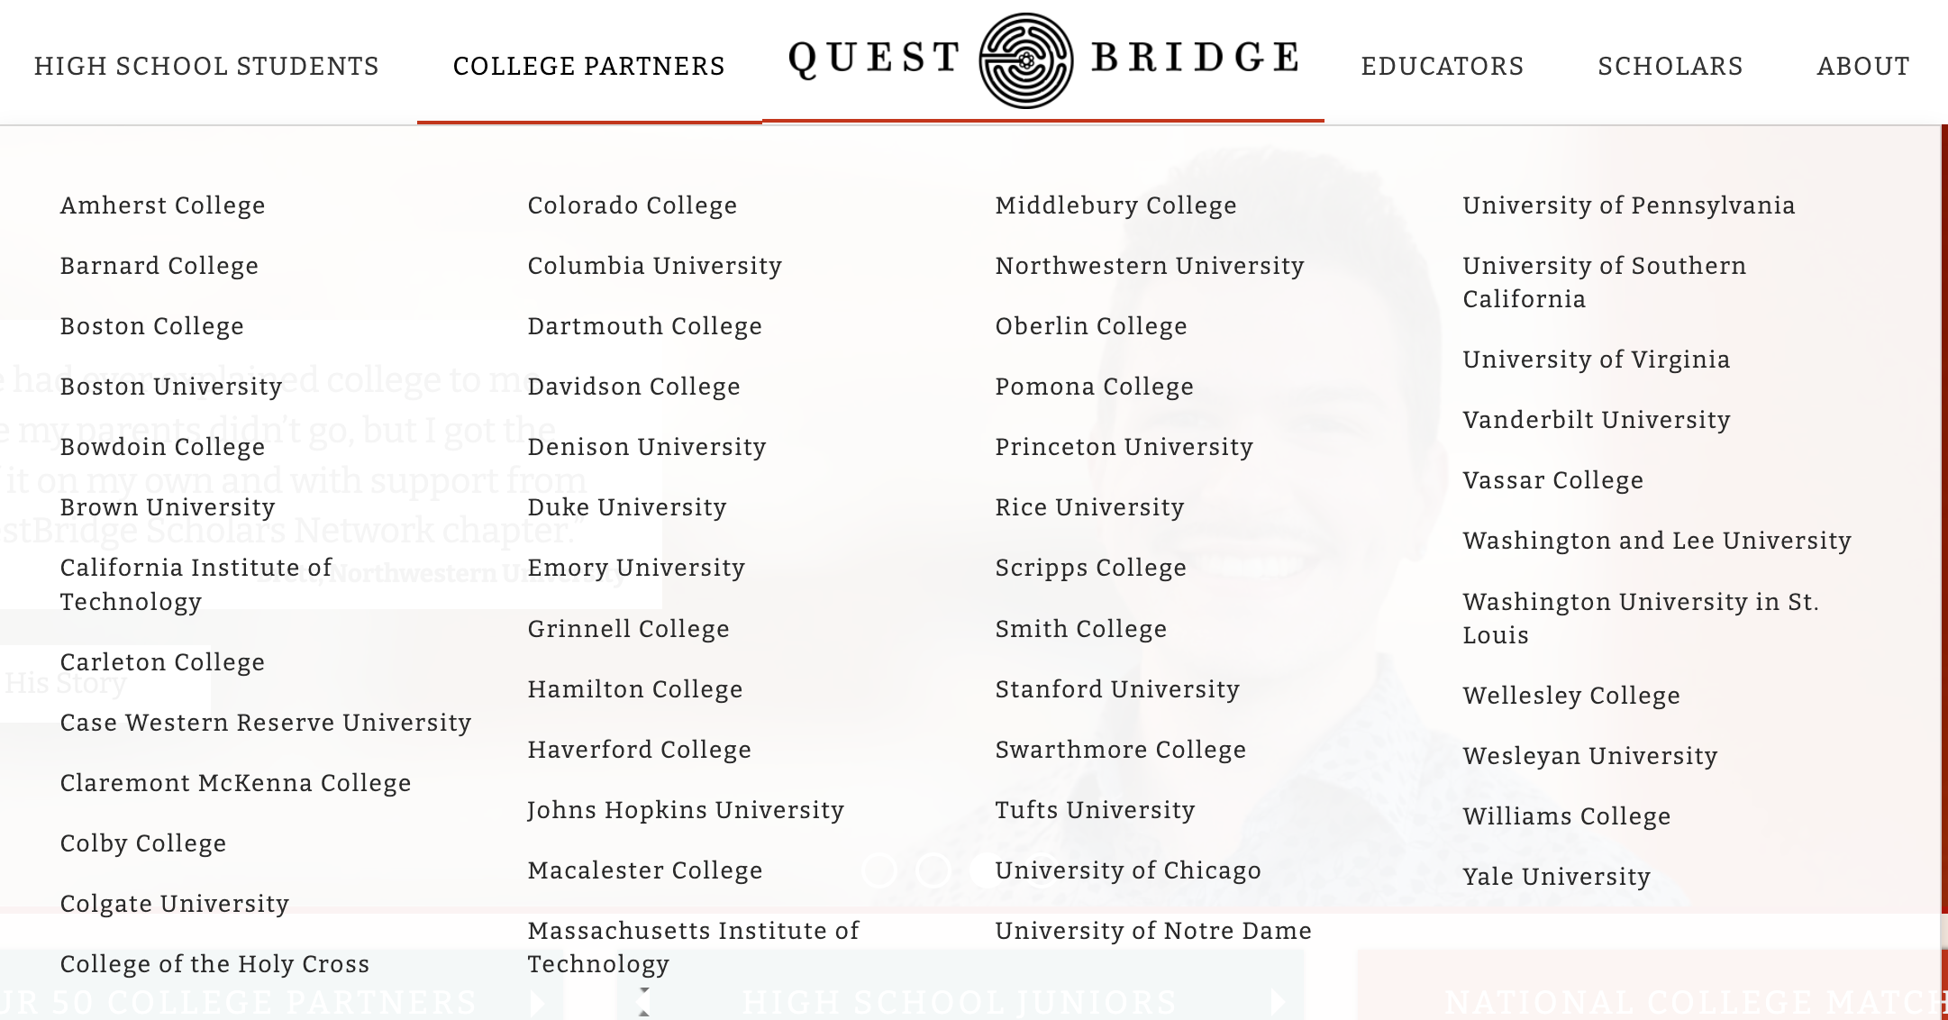

Slide 4
WHO SHOULD APPLY?
US citizens, permanent residents, or attend high school in the US (regardless of citizenship status. Yes, undocumented students are eligible)
ACADEMIC ACHIEVEMENT:
Ranked in the top 10% of their class
Earn mostly A’s, high GPA
Most challenging coursework offered in school
Demonstrate strong writing skills and intellectual curiosity
Test scores are not mandatory but can be submitted

Slide 5
WHO SHOULD APPLY?
FINANCIAL QUALIFICATIONS:
Typically households earning less than $65,000 annually with minimal assets (for a family of 4)
May have extenuating circumstances impacted finances, $65,0000 is not a strict cut off
PERSONAL CIRCUMSTANCES:
Demonstrate strength in character and resilience
Involved in or hold leadership roles in extracurricular activities
Often (but not mandatory) first-generation college students

Slide 6
QUESTBRIDGE TIMELINE
FEBRUARY
Application opens (date TBD)
MARCH
Application due (date TBD)
APRIL
College Prep Scholars selected and awarded summer opportunities
LATE SUMMER
Application carries over to the National College Match
FALL 2023
Apply to the National College Match

Slide 7
WHAT DO YOU NEED TO APPLY?
HOUSEHOLD AND FINANCIAL SITUATION: number of household members, income and assets
ACADEMIC: transcript, high school information, and coursework
TESTING AND HONORS: test scores, any awards or honors
RECOMMENDATION: 1 letter from a core subject teacher
WRITING: personal essay, short answers, additional information
ACTIVITIES: clubs, volunteer hours, athletics, family responsibilities, work

Slide 8
INTERESTED? SIGN UP FOR MORE INFORMATION

