Slide 1
SCHOLARSHIP INTEREST MEETING
APPLICATIONS DUE SUNDAY, FEBRUARY 12TH BEFORE 11:59 PM VIA EMAIL TO SSANZ@DADESCHOOLS.NET

Slide 2
ABOUT POSSE
Each Posse Scholar receives a four-year, full-tuition leadership scholarship to one of the Posse partner schools.
Posse Scholars go into college with a group of 10 students, who meet weekly.
Posse is a merit based scholarship. Not a minority, low-income, or need-based scholarship.
Posse looks for students who:
Demonstrate leadership ability, communication, and team building skills
Do well academically, but are not considering (or might be missed by) some top universities
Are positive contributors to their school and communities
Are interested in teamwork and diversity

Slide 3
POSSE COMPONENTS
Pre-Collegiate Training Program (PCT): From January to August of their senior year in high school, they meet weekly with Posse peers and staff for two-hour workshops that address four areas:
Academic excellence, team building and group support, cross-cultural communication, leadership and becoming an active agent of change.
The Campus Program: Four year on campus program. During a Posse’s first two years on campus, Scholars meet with their mentor weekly as a group and individually every two weeks.
Career Program: Connects Posse Scholars and alumni to highly coveted professional development opportunities. The Career Program gives Scholars tools to secure competitive internships and leadership-track jobs in a wide range of fields.

Slide 4
POSSE SCHOOLS
DAVIDSON COLLEGE
Davidson, North Carolina
FRANKLIN & MARSHALL
Lancaster, Pennsylvania
HAMILTON COLLEGE
Clinton, New York
MOUNT HOLYOKE COLLEGE (Women’s College)
South Hadley, Massacusetts
POMONA COLLEGE
Claremont, California
SYRACUSE UNIVERSITY
Syracuse, New York

Slide 5
APPLICATION PROCESS
Submit the Posse Nomination Application (on cavsconnect.com), resume, and short response by11:59 pm on Sunday, February 12th via email to ssanz@dadeschools.net
Interview with a small group of selected Gables faculty on Friday, February 17th
Be nominated by Ms. Sanz
Submit official Posse application
Go through the Dynamic Assessment Process

Slide 6
THE DYNAMIC ASSESSMENT PROCESS (DAP)
DAP 1 (August-September): large group interview with about 100 students led by Posse staff. Consists of a series of interactive small-group workshops.
DAP 2 (October-November): A 20-minute, one-on-one interview with Posse staff.
Finalists will be notified by early November.
If finalists accept the last-round interview, they agree to submit an Early Decision application for the college they are matched with.
DAP 3 (December-January): A final, small group interview, with 20–25 students.

Slide 7
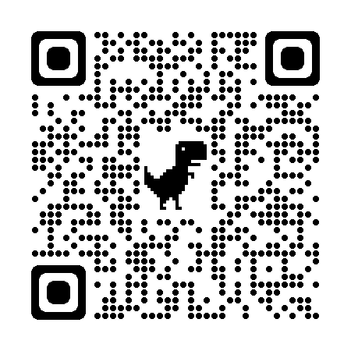
POSSE NOMINATION APPLICATION

