Slide 1
Parent college night Class of 2024

Slide 2
CAP COMMUNICATIONS
EMAIL: ssanz@dadeschools.net
Instagram: @Gables_CAP
MS Teams: Juniors Class of 2024 (students only)
CAVS CONNECT:
CAP CORNER- Juniors

Slide 3
SCOIR
your place for all your information & needs for college.
EVERY STUDENT NEEDS TO REGISTER THEIR SCOIR ACCOUNT!

Slide 4
Students will log in with clever OR sign up with the invitation in their STUDENT EMAIL

Slide 5
SCOIR profile
Add as much information as possible & get invited to SCOIR by your child

Slide 6
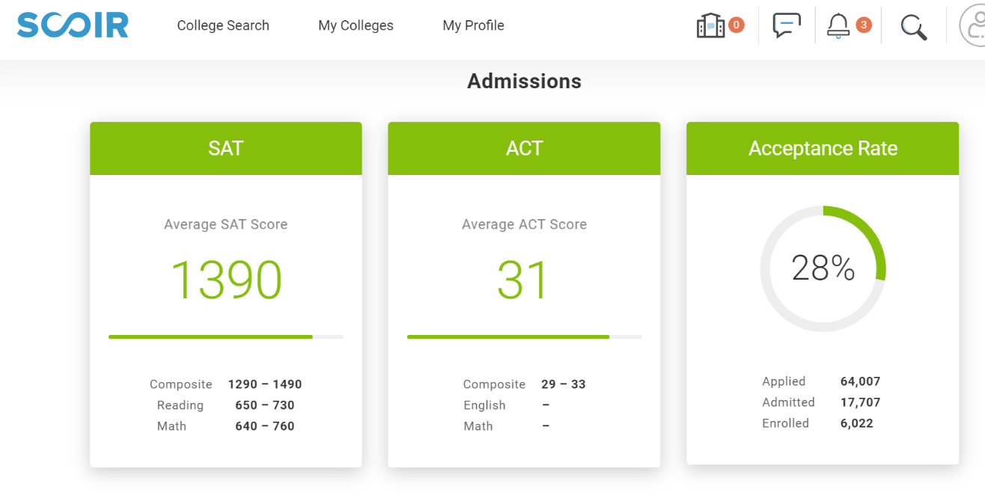
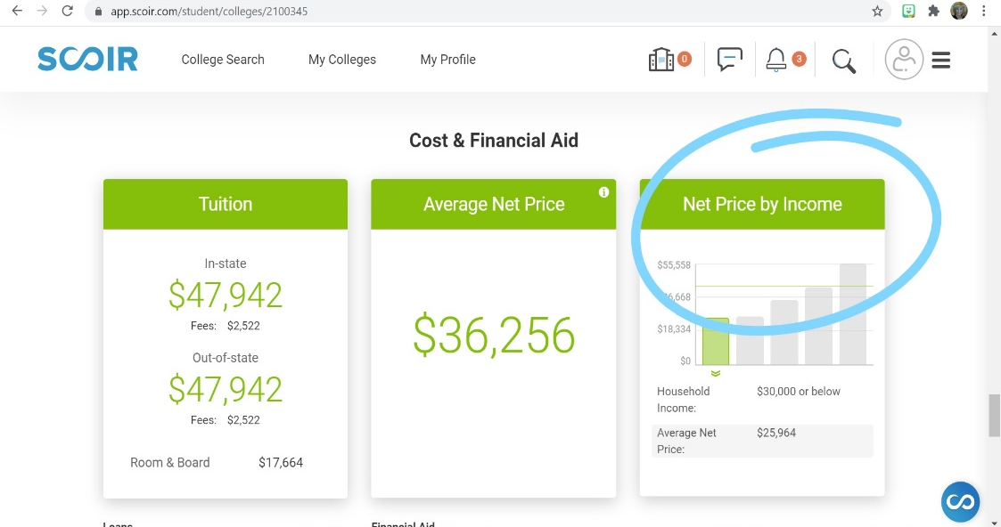
Research colleges on scoir
Search schools by preferences
Look at the cost of attendance and financial aid calculator

Slide 7
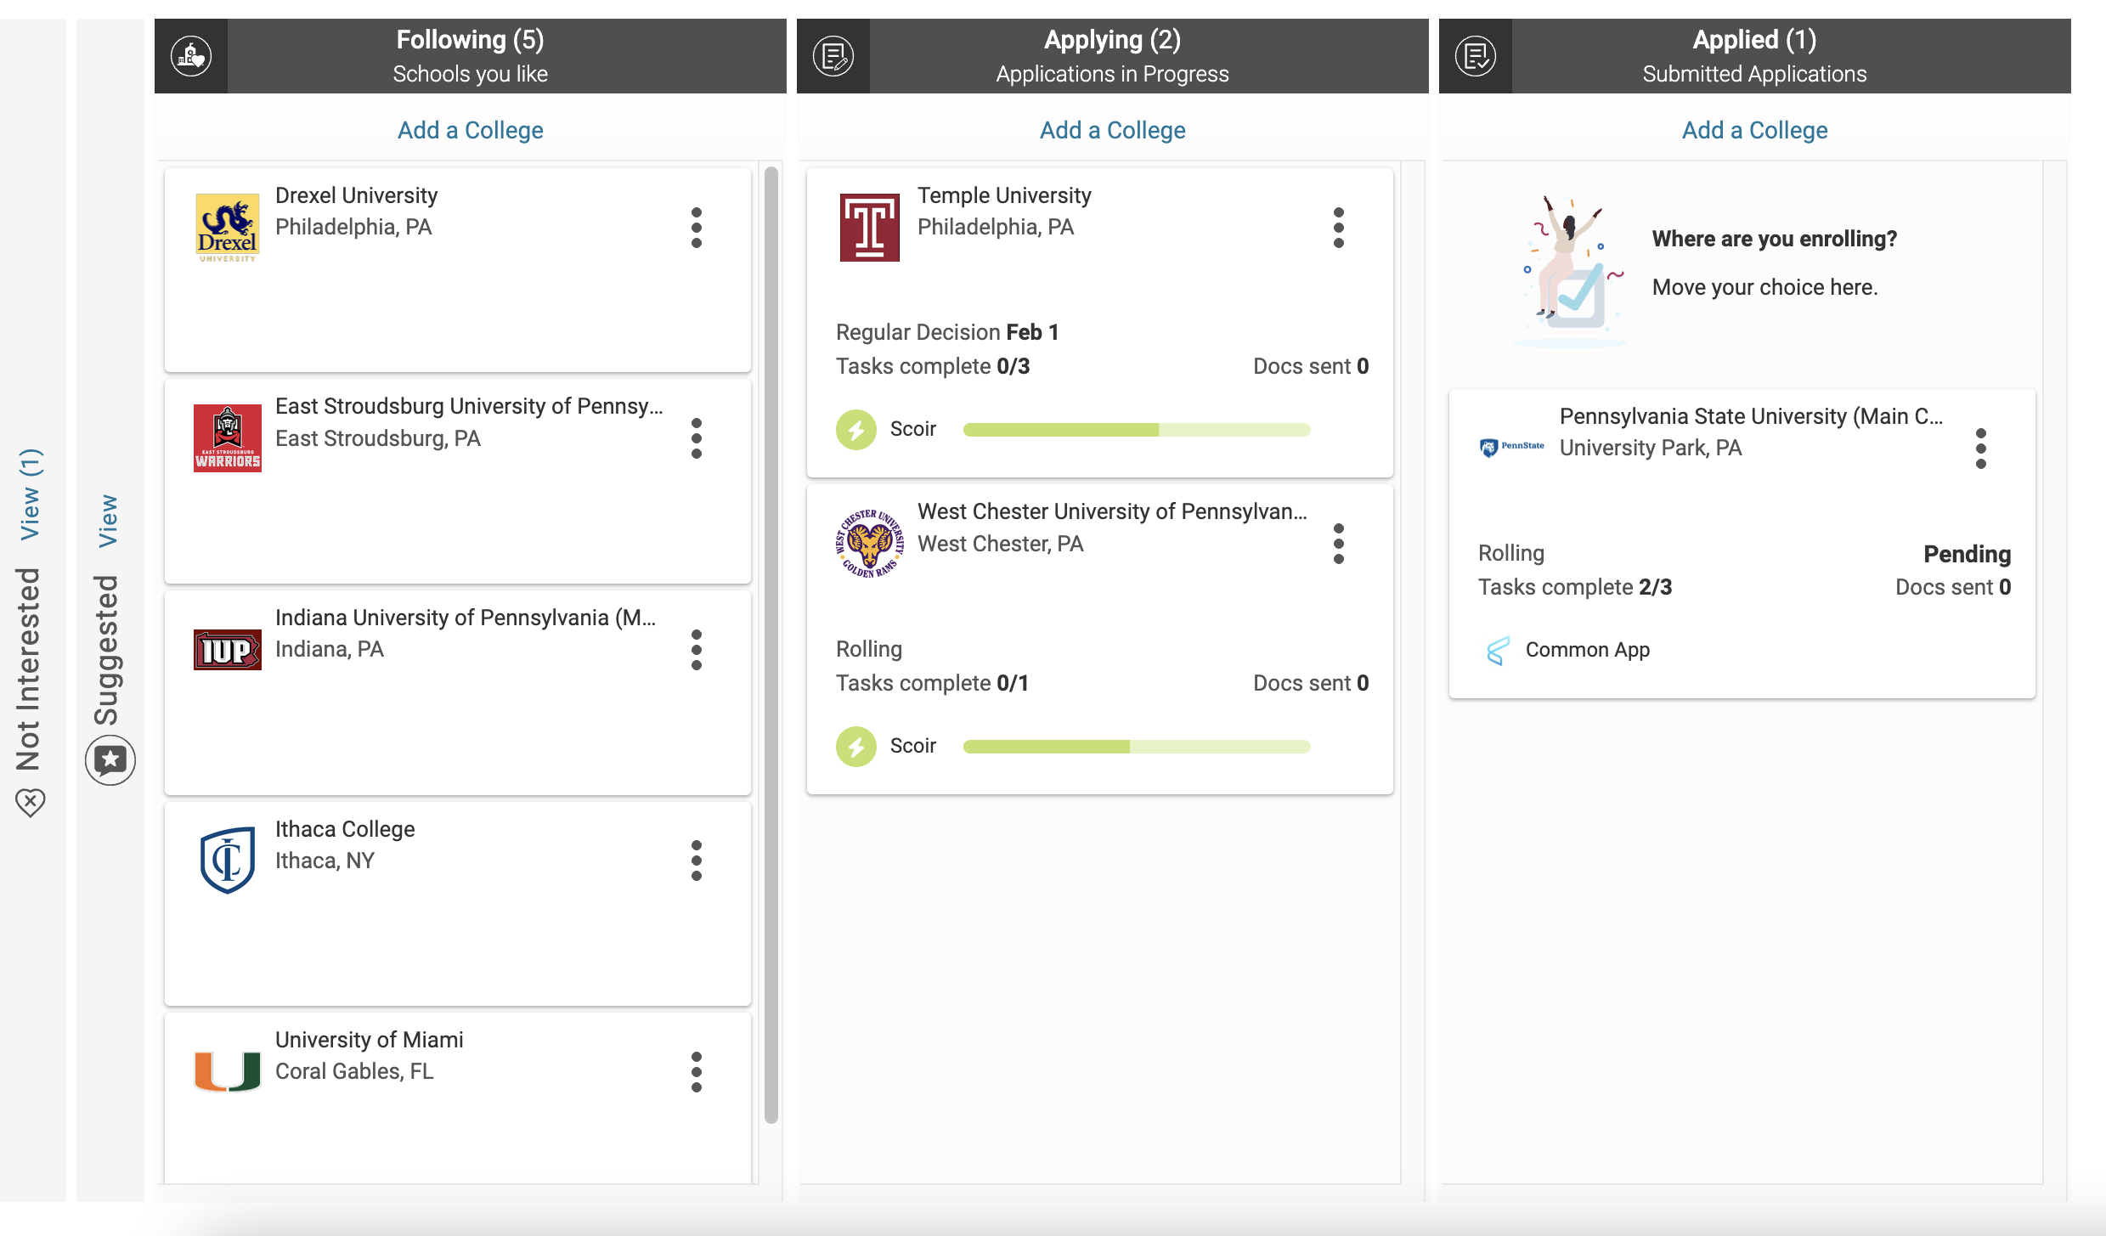
ADD COLLEGES TO YOUR FOLLOWING LIST

Slide 8
What are colleges looking at?
Important Factors:
Strength of curriculum (IB, AP, Honors)
Grade Point Average (GPA) and percentile rank
College Entrance Examination Scores (ACT or SAT)
Activities student is involved in
If the College Requires them:
Essays
Recommendation Letters (teacher and counselor)
Resume (leadership, community service, extracurricular, talents, etc.)
Interviews

Slide 9
HOLISTIC REVIEW OF APPLICATIONS
Academic Record
Difficulty of Course Load/RIGOR
SAT/ACT Scores
Letters of Recommendation
College Essay
Extra-Curricular Activities
Personal Interview
Neatness of the College Application
Community Service
Special Talents
Demonstrated Interest

Slide 10
TYPES OF APPLICATIONS
REGULAR DECISION: most deadlines are around January and decisions are made by mid-March-April
ROLLING ADMISSION: accept students as applications come in, and until they run out of spots
ALWAYS DOUBLE CHECK DEADLINES AND TYPE OF APPLICATION!

Slide 11
TYPES OF APPLICATIONS
EARLY DECISION
Early decision (ED) plans allow you to apply early (October-November) and get admissions decisions early on (around December-January).
This is a BINDING contract. Meaning, if you apply as ED, you agree to attend the college if it accepts you, most times, regardless of financial aid packages.
You can only apply to one college as ED. But, you can apply to other colleges through their regular admissions process or through Early Action.
If you are accepted through ED, you must withdraw all your other applications.
ED applicants usually have higher chances of getting accepted.
Must speak with Ms. Sanz & sign an early decision contract before applying ED.

Slide 12
TYPES OF APPLICATIONS
EARLY ACTION
Early Action (EA) plans are similar to ED plans, where they allow you to apply early (October-November) and get admissions decisions early on (around December-January).
This process is NOT BINDING. Meaning, you do NOT have to attend if you get accepted.
You can apply to multiple schools as EA, unless the school is marked as Restrictive Early Action.
EA applicants also usually have higher chances of getting accepted.

Slide 13
Selectivity of admission
SAFETY:
Admission to this college is HIGHLY likely and probable due to the strength of your application. Odds of affording and attending this university are also very high.
University of Florida and Florida State University are NOT safety schools!
TARGET/MATCH:
The majority of previously admitted students had scores, grades, and other activities slightly better or equal to your own.
REACH:
To be admitted at this school may be possible, but it is not a definite occurrence. These schools have low acceptance rates.

Slide 14
WHAT THE college LIST SHOULD LOOK LIKE
About 2 reach schools
About 4 match schools
At least 2 REAL safety schools
Research the college’s admission data on SCOIR or look at the college’s website for the Common Data Set:
The most important facts and figures about a college that allows you to easily look up certain pieces of information, helps you compare colleges, and even provides demographic breakdowns of admissions and enrollment statistics.

Slide 15
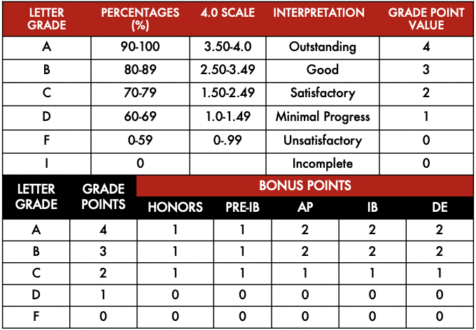
WHY IS JUNIOR YEAR SO IMPORTANT?
Grade point average (gpa)
Weighted & unweighted
They apply to college with grades and GPA from freshman year to the end of Junior year.
Some schools will ask for 1st semester grades and mid-year report from senior year, but their GPA will not be updated again until mid-March of their senior year.

Slide 16
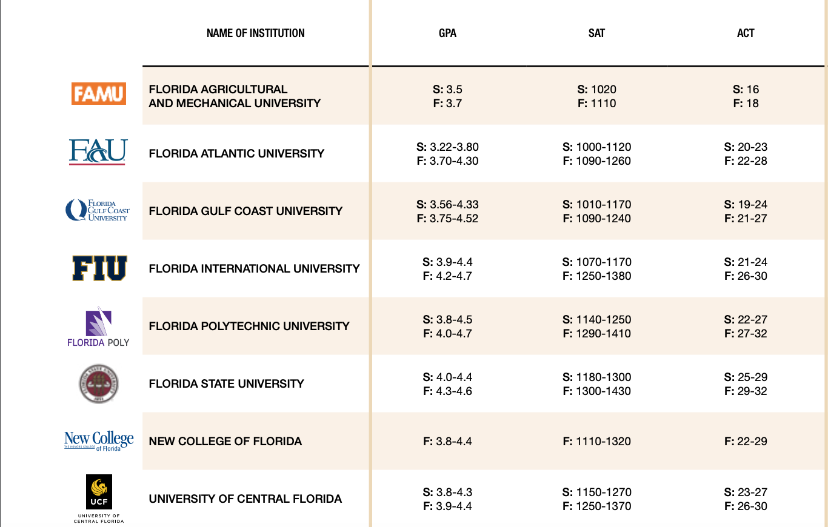
DO YOU HAVE WHAT IT TAKES?

Slide 17
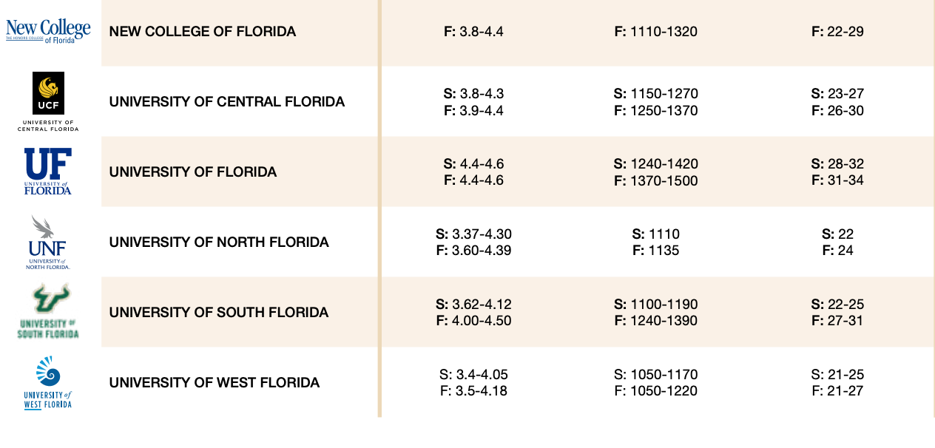
DO YOU HAVE WHAT IT TAKES?

Slide 18
HOW TO IMPROVE YOUR CHANCES FOR STATE SCHOOLS:
Focus your study efforts on your core academic classes
Challenge yourself with Honors, AP, and Dual Enrollment classes
Study and prepare for the entrance exams (SAT OR ACT)
Build your activities and community service list

Slide 19
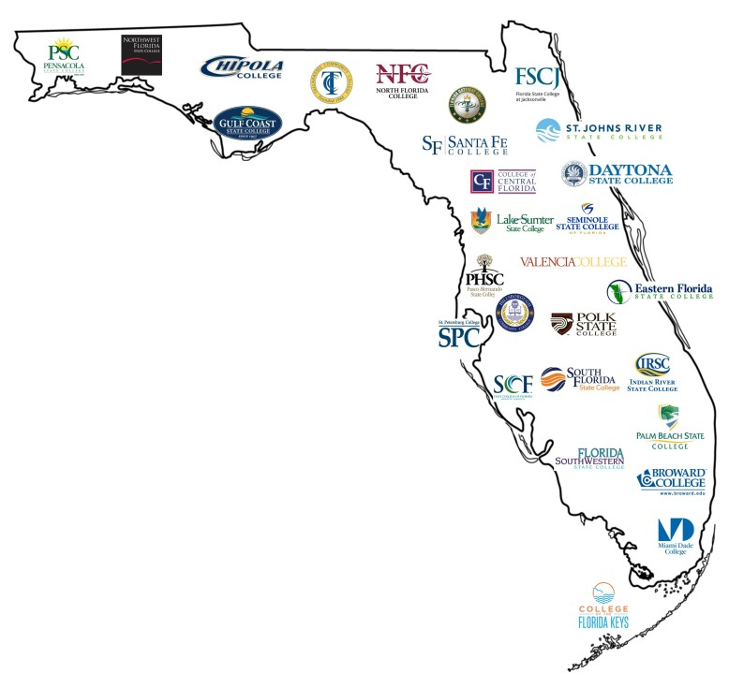
Programs of 6 months to full Bachelor’s degrees
Open admissions: anyone with a high school diploma or GED is admitted.
Vast selection of programs including Graphic Design, Music Production & Management, Fire Science Technology, Nursing and much more.
Programs to look into:
MDC Honors (3.7 GPA)
MDC Pathway Program
Community colleges in Florida

Slide 20
1. Application: required everywhere
2. Transcript or SSAR
3. Application fee: (fee waiver(s) can be used, see me for more info.)
4. SAT/ACT Scores: required or test optional
5. Letters of Recommendation: (if applicable)
6. Essay/Personal Statement: (if applicable…share your voice!)
7. Copy of other Required Documentation: (if applicable)
APPLYING FOR ADMISSION
In no particular order
DOUBLE CHECK WHAT EACH INSTITUTION REQUIRES OR REQUESTS!

Slide 21
THE college app TIMELINE
JUNIOR YEAR
Keep grades up, especially in core classes
Stay involved, gain leadership roles, build your resume
STUDY and take the SAT or ACT
Should be taking these exams more than once
Research colleges and build your college list
Show demonstrated interest: subscribe to email lists, go to events in your area, tour schools if possible
Research scholarship programs: Questbridge and Posse

Slide 22
THE college app TIMELINE
SENIOR YEAR
August-January: typical applications due (check deadlines)
August-June: SAT-ACT testing
November: Last chance testing for most admissions' decisions.
Can keep testing until June 30th for Bright Futures eligibility
October: Financial Aid
FAFSA, FFAA, CSS (if needed)
December-April: Admission decisions from universities
February-April: Housing applications/Financial Aid packages
May 1st: Decision Day

Slide 23
COLLEGE ENTRANCE EXAMS
ACT
ACT scores range from 1 to 36.
English
Math
Science
Reading
SAT
SAT scores range from 400 to 1600.
Reading/Writing
Math
Will be electronic starting August 2023!

Slide 24
COLLEGE ENTRANCE EXAMS
More and more schools are becoming test optional: Truly test optional!
ALL STATE SCHOOLS REQUIRE EXAMS
SAT or ACT: There is no difference in judgement
Don’t hide your scores…SEND THEM TO SCHOOLS WHEN YOU REGSITER! Saves $$, shows demonstrated interest, gets you on mailing lists for Open Houses, scholarship deadlines & more!
Khan Academy in Student/Parent portals
If you have a fee waiver, ACT includes free test prep

Slide 25
UPCOMING EXAM DATES
ACT |  |  | SAT
Register at MyACT.org |  |  | Register at SATsuite.collegeboard.org
Test Date | Registration Deadline | Scores Available | Test Date | Registration Deadline | Scores Available
February 11th | January 6th | TBD | March 11th | February 10th | March 24th
April 15th | March 10 | TBD | May 6th | April 25th | May 19th
June 10th | May 15th | TBD | June 3rd | May 23rd | TBD
July 15th | June 16th | TBD | August 26^{th*} | July 28^{th*} | TBD

Slide 26
FEE WAIVERS
Students must complete the MDCPS income survey: incomesurvey.dadeschools.net
If they are on free or reduced lunch or meet other eligibility requirements, they qualify for the following:
4 ACT test waivers
2 SAT test fee waivers
4 College Board - College Application Fee Waivers…access these via College Board account
4 ACT College Application Fee Waivers
Scoir Application fee waivers
Testing waivers used during junior year count

Slide 27
Typical application checklist
Application (College Website or Common App)
Transcript or SSAR
Application fee or fee waiver
SAT/ACT scores (some colleges are test optional or test flexible)
Letters of recommendation from teachers/counselors
Essay/supplemental essay(s) and short answers
Copy of other required documentation (ex. FL residency)

Slide 28
FINANCIAL AID
APPLICATIONS
FAFSA (federal aid): opens October of SENIOR YEAR
EVERYONE MUST APPLY! Even if you think you won’t receive aid.
This is the first step to receiving ANY kind of scholarship
FFAA (state aid): opens October of SENIOR YEAR
Bright Futures Application
CSS Profile: only some schools require it

Slide 29
Students must SEARCH and APPLY for scholarships
Check CAP Corner on Cavs Connect FREQUENTLY
Check each university’s website for scholarships
Look at specific qualifications, deadlines, and requirements
SCHOLARSHIPS
1. Institutional 2. State 3. Private

Slide 30
Qualify early by testing early, applying early and meeting the institution’s requirements for their merit based scholarships.
In most cases these institutional scholarship offers are an automatic part of the application process…there are exceptions & requirements (i.e. deadlines, supplemental info, etc…) so always double check and research for each university!
INSTITUTIONAL SCHOLARSHIPS
Usually the most generous!

Slide 31
DISCOVER COLLEGES: Learn more about which colleges could be a great fit for you, see the micro-scholarships they’re offering, and share that you’re interested.
ADD YOUR ACHIEVEMENTS: Complete your RaiseMe Portfolio by adding each of your course grades, club involvement, sports, volunteer activities, and more.
EARN MONEY: For each achievement, you'll earn a micro-scholarships from colleges you’re following, the sum of which you'll be awarded when you attend that college.
INSTITUTIONAL SCHOLARSHIPS
Raise.Me

Slide 32
QUESTBRIDGE
Scholarship opportunity for students with outstanding academic ability and considerable financial challenges.
QUALIFYING CRITERIA
Academics | Primarily A's in the most challenging courses available (usually including Honors, AP, and/or IB level courses.)
Class Rank | Top 5-10% of your graduating class.
Test scores | SAT or PSAT scores > 1310 ACT composite score > 28 We also recommend submitting any AP, IB, or SAT Subject Test scores. Review the standardized testing requirements for each college.
Financial Need | Households typically earning less than $65,000 annually. Looks at ALL sources of income and both biological parents.
Additional Criteria | Looks for evidence of strong writing ability, intellectual spark, and determination through essays and teacher/counselor recommendations.

Slide 33
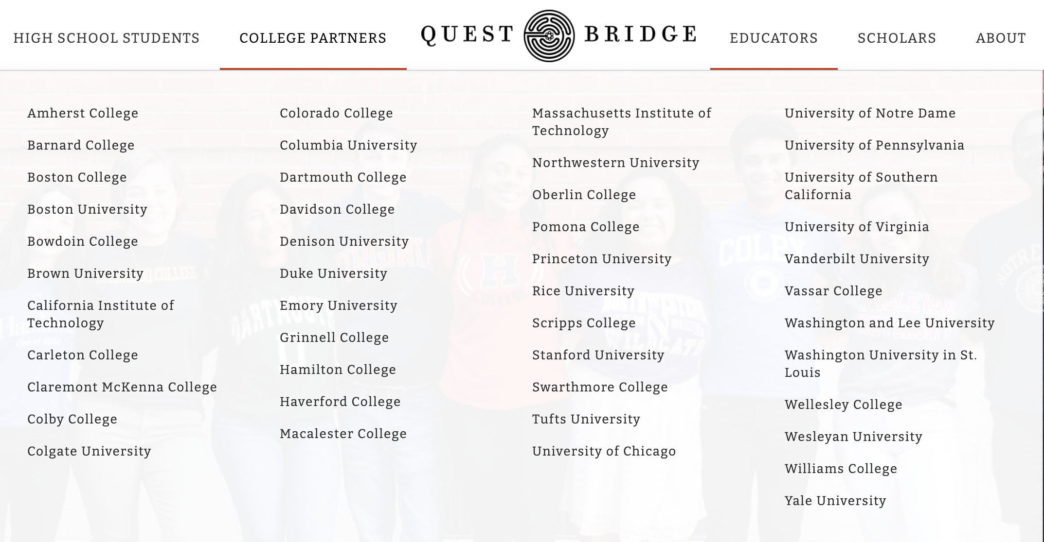
QUESTBRIDGE COLLEGE PARTNERS

Slide 34
POSSE SCHOLARSHIP
A partner full-tuition scholarship based on nominations (nominated towards the end of Junior Year: NOT NEED BASED!
Miami Posse Foundation Partner schools:
Davidson College
Franklin & Marshall
Hamilton College
Mount Holyoke College
Pomona College
Syracuse University

Slide 35
Guaranteed scholarship if you meet all 3 requirements by graduation
GPA
College Entrance Exams
Community Service Hours/Work Hours
OR
IB Diploma
Qualify by filling out the FFAA senior year prior to graduation, application opens October 1st of senior year
Can access the scholarship money up to 5 years after graduation
STATE SCHOLARSHIPS
Bright Futures

Slide 36
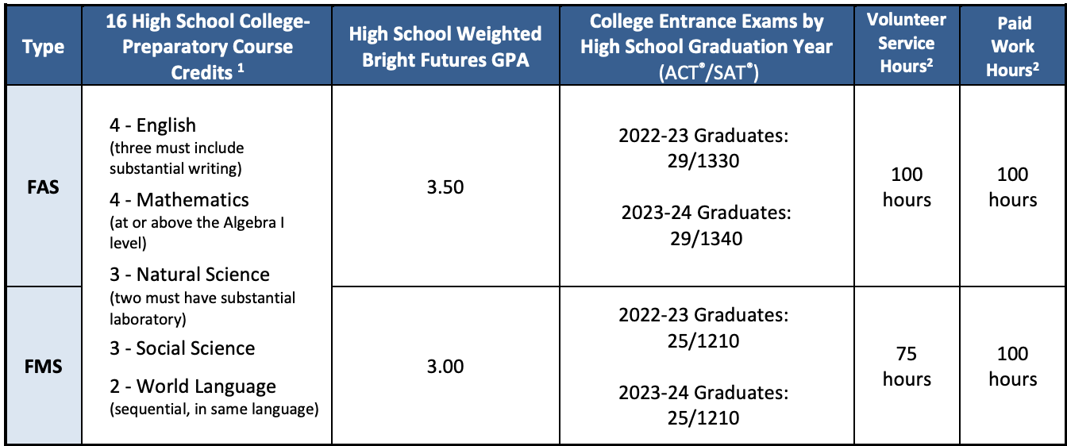
BRIGHT FUTURES REQUIREMENTS

Slide 37
Private scholarships take a lot of work but are often are the deciding factor against student loans or can fill the financial need gap left over after all federal, state & institutional aid is awarded.
Can be awarded as many as possible
Some do take financial need into consideration, some do not
PRIVATE SCHOLARSHIPS
Put in the work to get the money

Slide 38
https://www.scholarsnapp.org/
https://studentscholarships.org/
https://www.goingmerry.com/
https://www.myscholly.com/
http://peerlift.org/
http://www.scholarships.com/
AND MUCH MORE!
PRIVATE SCHOLARSHIPS
Websites that can help

Slide 39
THE COLLEGE VISIT
Virtual or in-person options. Some tips:
Make appointments/schedule your visit two weeks in advance, if possible…most can be done online
Go while school is in session
Notice the students on campus
No more than two a day
Eat in the dining hall if possible
See a FRESHMAN dorm
Ask about programs you are interested in
Look for anything else that will be important to you

Slide 40
College Application Readiness Symposium (cars)
Dates: last week of school, exact dates TBA
More information to come in February
Great way for Juniors to get a head start on college applications, writing their personal statements, etc.
Must sign up to attend. There will be GPA requirements

Slide 41
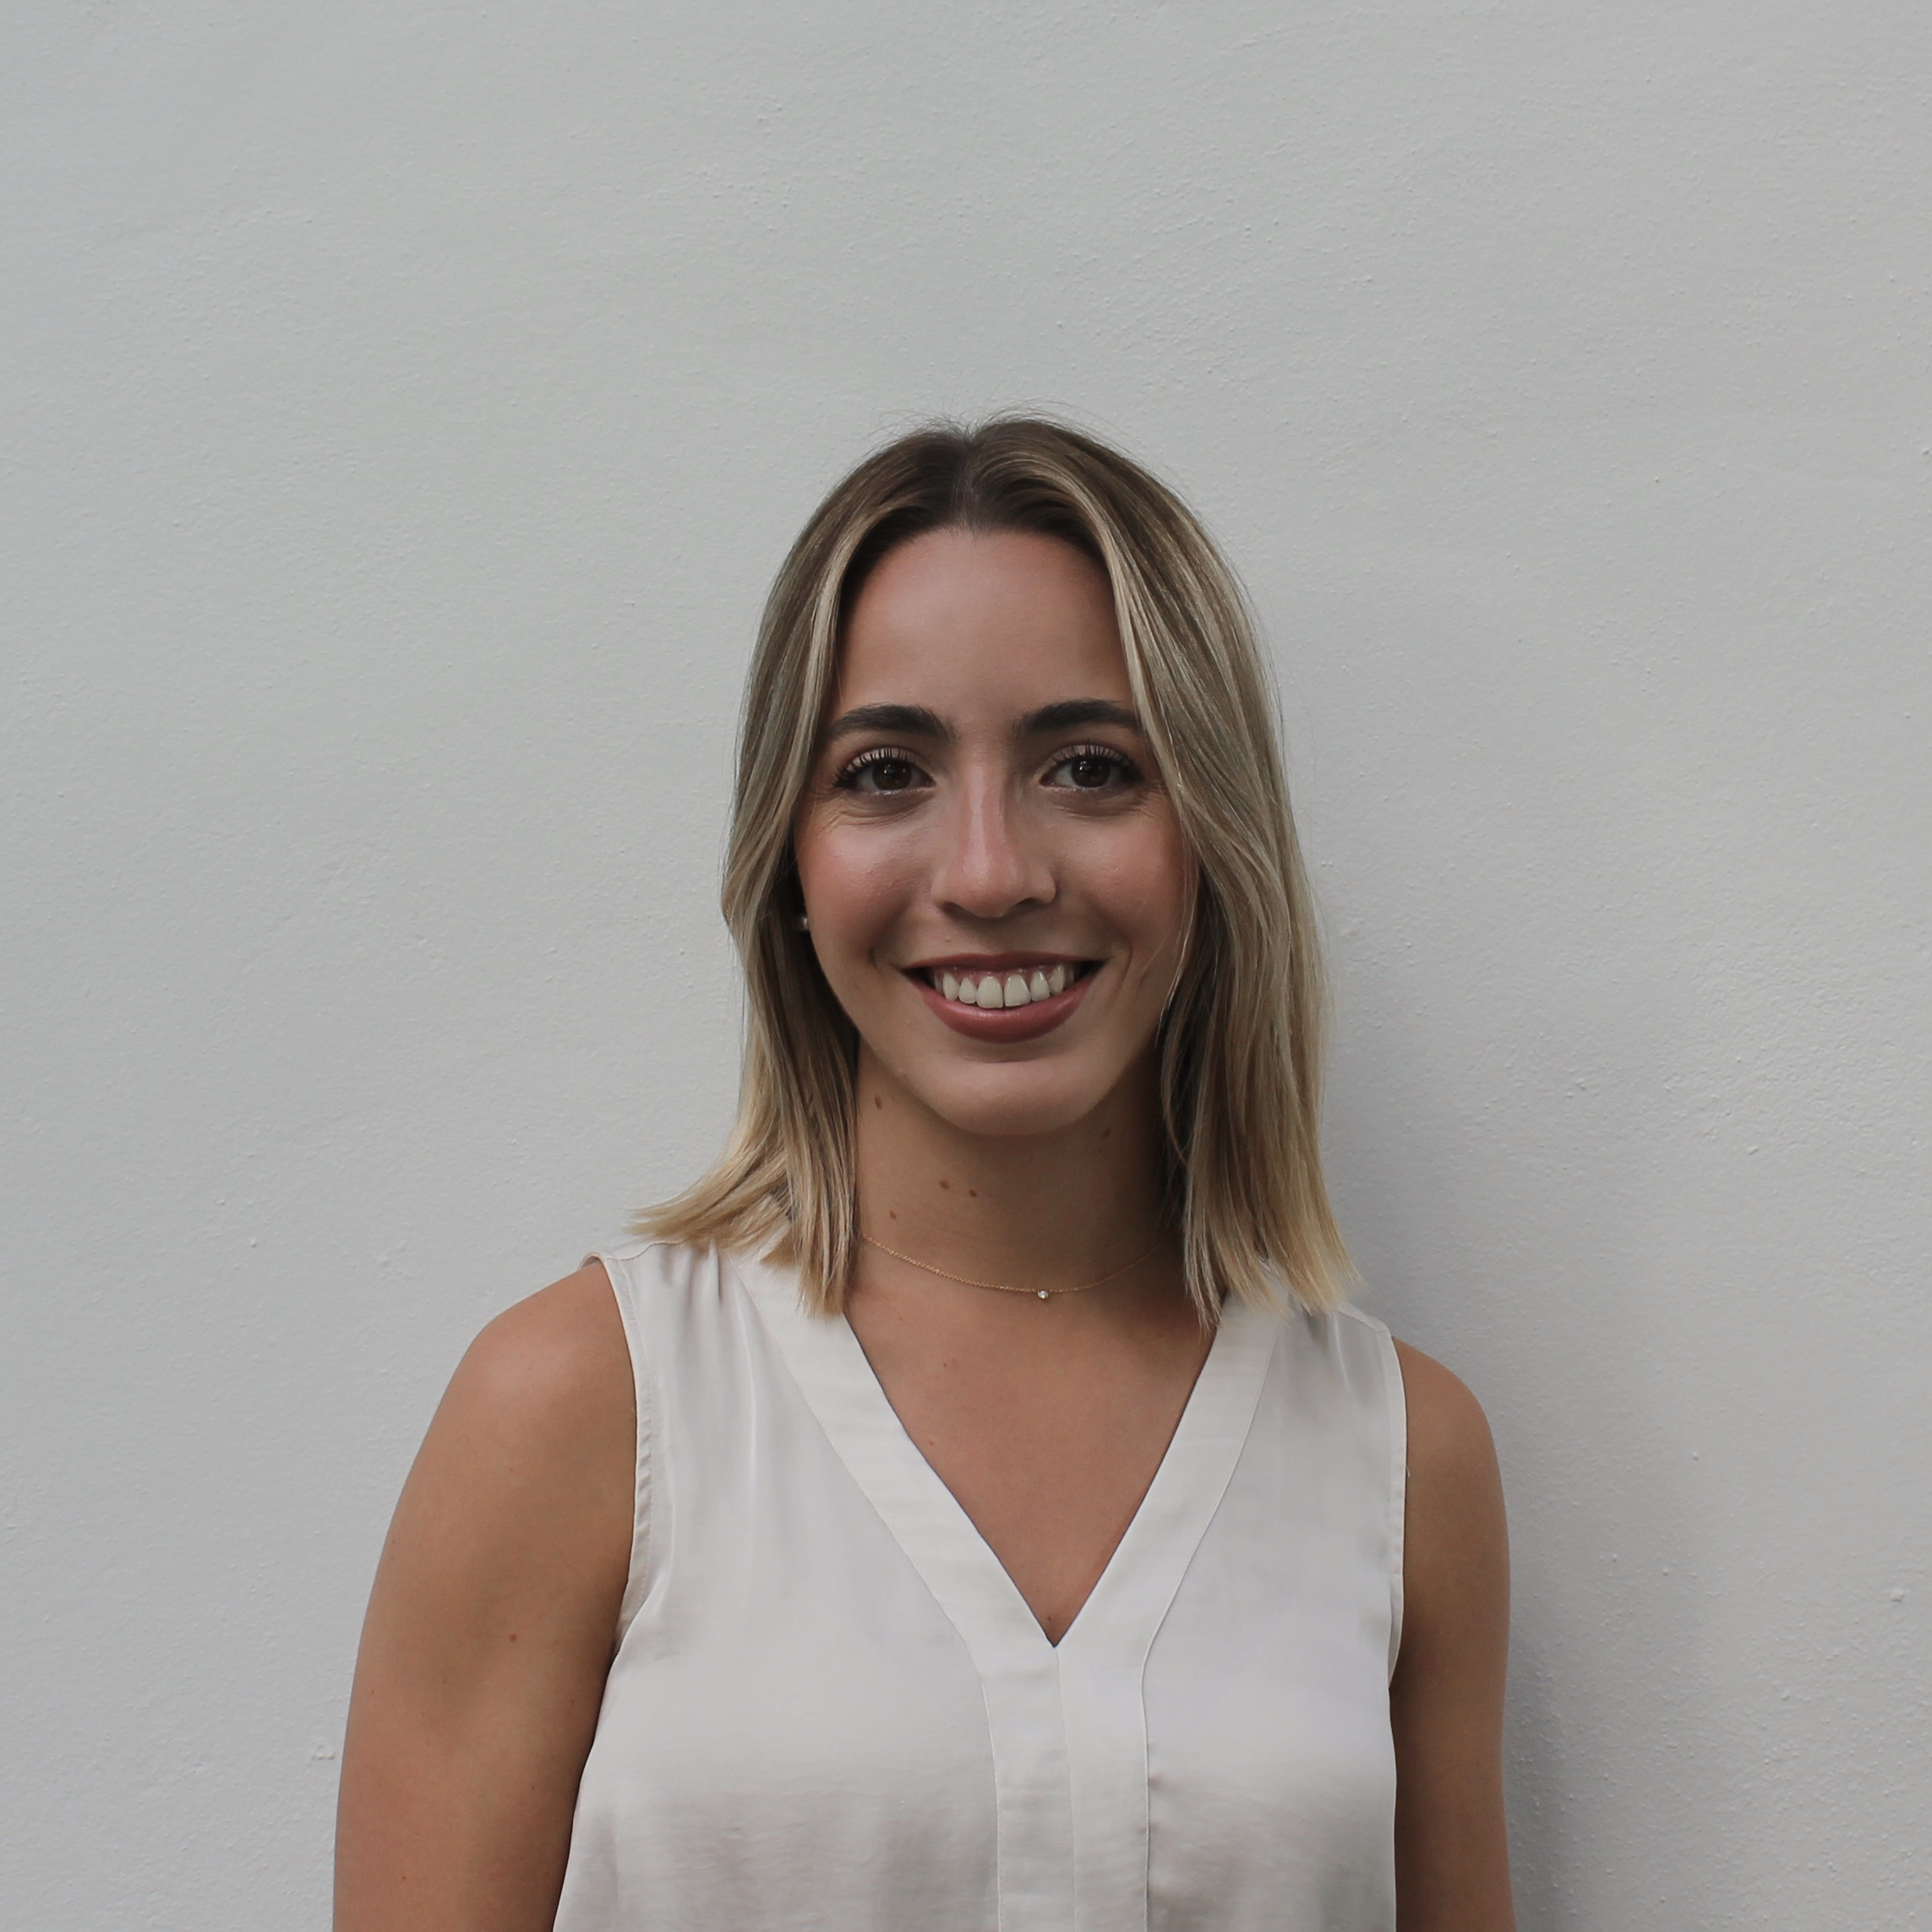
QUESTIONS? Contact your CAP Advisor
Ms. Sanz
ssanz@dadeschools.net
Please email to request a parent meeting
CAP Office: room 6111
Open office hours for students
cavsconnect.com
Cap Corner
Juniors

