Slide 1
Required documents VIA

Slide 2
CLARIFYING CONFUSION
Scoir is the middle man between Gables, and whatever platform you are applying on
Common App
University’s website
You are NOT applying to schools on Scoir, BUT you do have to update your college list on Scoir so that Gables knows where to send your documents.

Slide 3
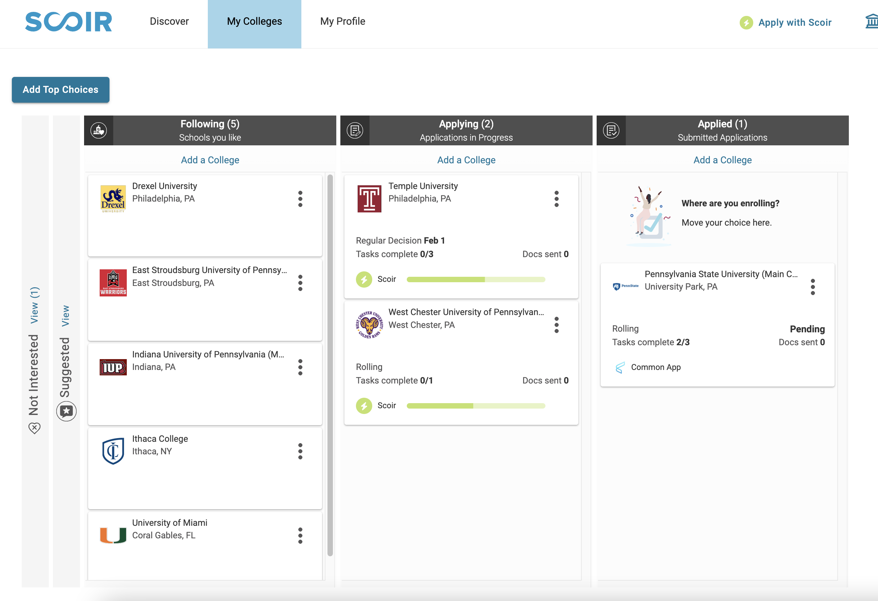
BEFORE REQUESTING RECOMMENDATIONS…
Update your college lists on scoir
Make sure you are connected to your school Scoir account, not your personal one

Slide 4
STUDENT LETTER OF RECOMMENDATION PROCESS
Scoir support instructions

Slide 5
LETTER OF RECOMMENDATION PROCESS with common app
Step by step guide

Slide 6
WHAT IF…?
What if I’m not applying through the Common App?
Doesn’t matter, you still need to request the teacher recommendations through Scoir.
What if I’m requesting a recommendation letter from someone who does not work at the school?
They must EMAIL the recommendation letter to Ms. Sanz and she will upload it to your Scoir documents
Make sure to include the student’s name and ID number
If it is going to a specific university, specify which one you want it sent to

Slide 7
THE SCOIR GUIDE TO THE COMMON APPLICATION
CLICK HERE FOR VIDEO INSTRUCTIONS

Slide 8
WHAT ABOUT TRANSCRIPTS?
In Scoir, you do NOT need to request a transcript!
Moving a college to the Applying or Applied column of your My Colleges list is what will alert your counselor that a transcript is required.
Your counselor will be notified of what documents are required for this college and will be able to send forward your transcript if required.

Slide 9
STUDENT CHECKLIST FOR ENSURING DOCUMENT DELIVERY
My first name and last name in Scoir match my first name and last name in my application
My email address in Scoir matches the email used in my application
My date of birth in Scoir matches the date of birth used in my application
My home address in Scoir matches the home address used in my application
I entered my Common App ID into Scoir when adding schools to the Applying List. This does not apply when Applying with Scoir.

