Slide 1
Summer Youth Internship Program

Slide 2
Dates/Length
July 1 - August 2, 2019 (five consecutive weeks)
Application deadline TBA
A total of 150 work hours must be completed prior to the end of the SYIP Program (August 2, 2019)
30 hours part time weekly (five weeks)

Slide 3
Targeted Student Population
Rising 11-12 grade high school students between the ages of 15-18 who are enrolled in a Miami-Dade County Public High School are eligible to apply.

Slide 4
Eligibility
In order to qualify for this program students must:
Be eligible to work and have a Social Security Number
Provide self-transportation
Reside in Miami-Dade County
Open an account with the South Florida Educational Federal Credit Union
Complete the online pre-internship course
Notes:
Ask about transportation on slide 4

Slide 5
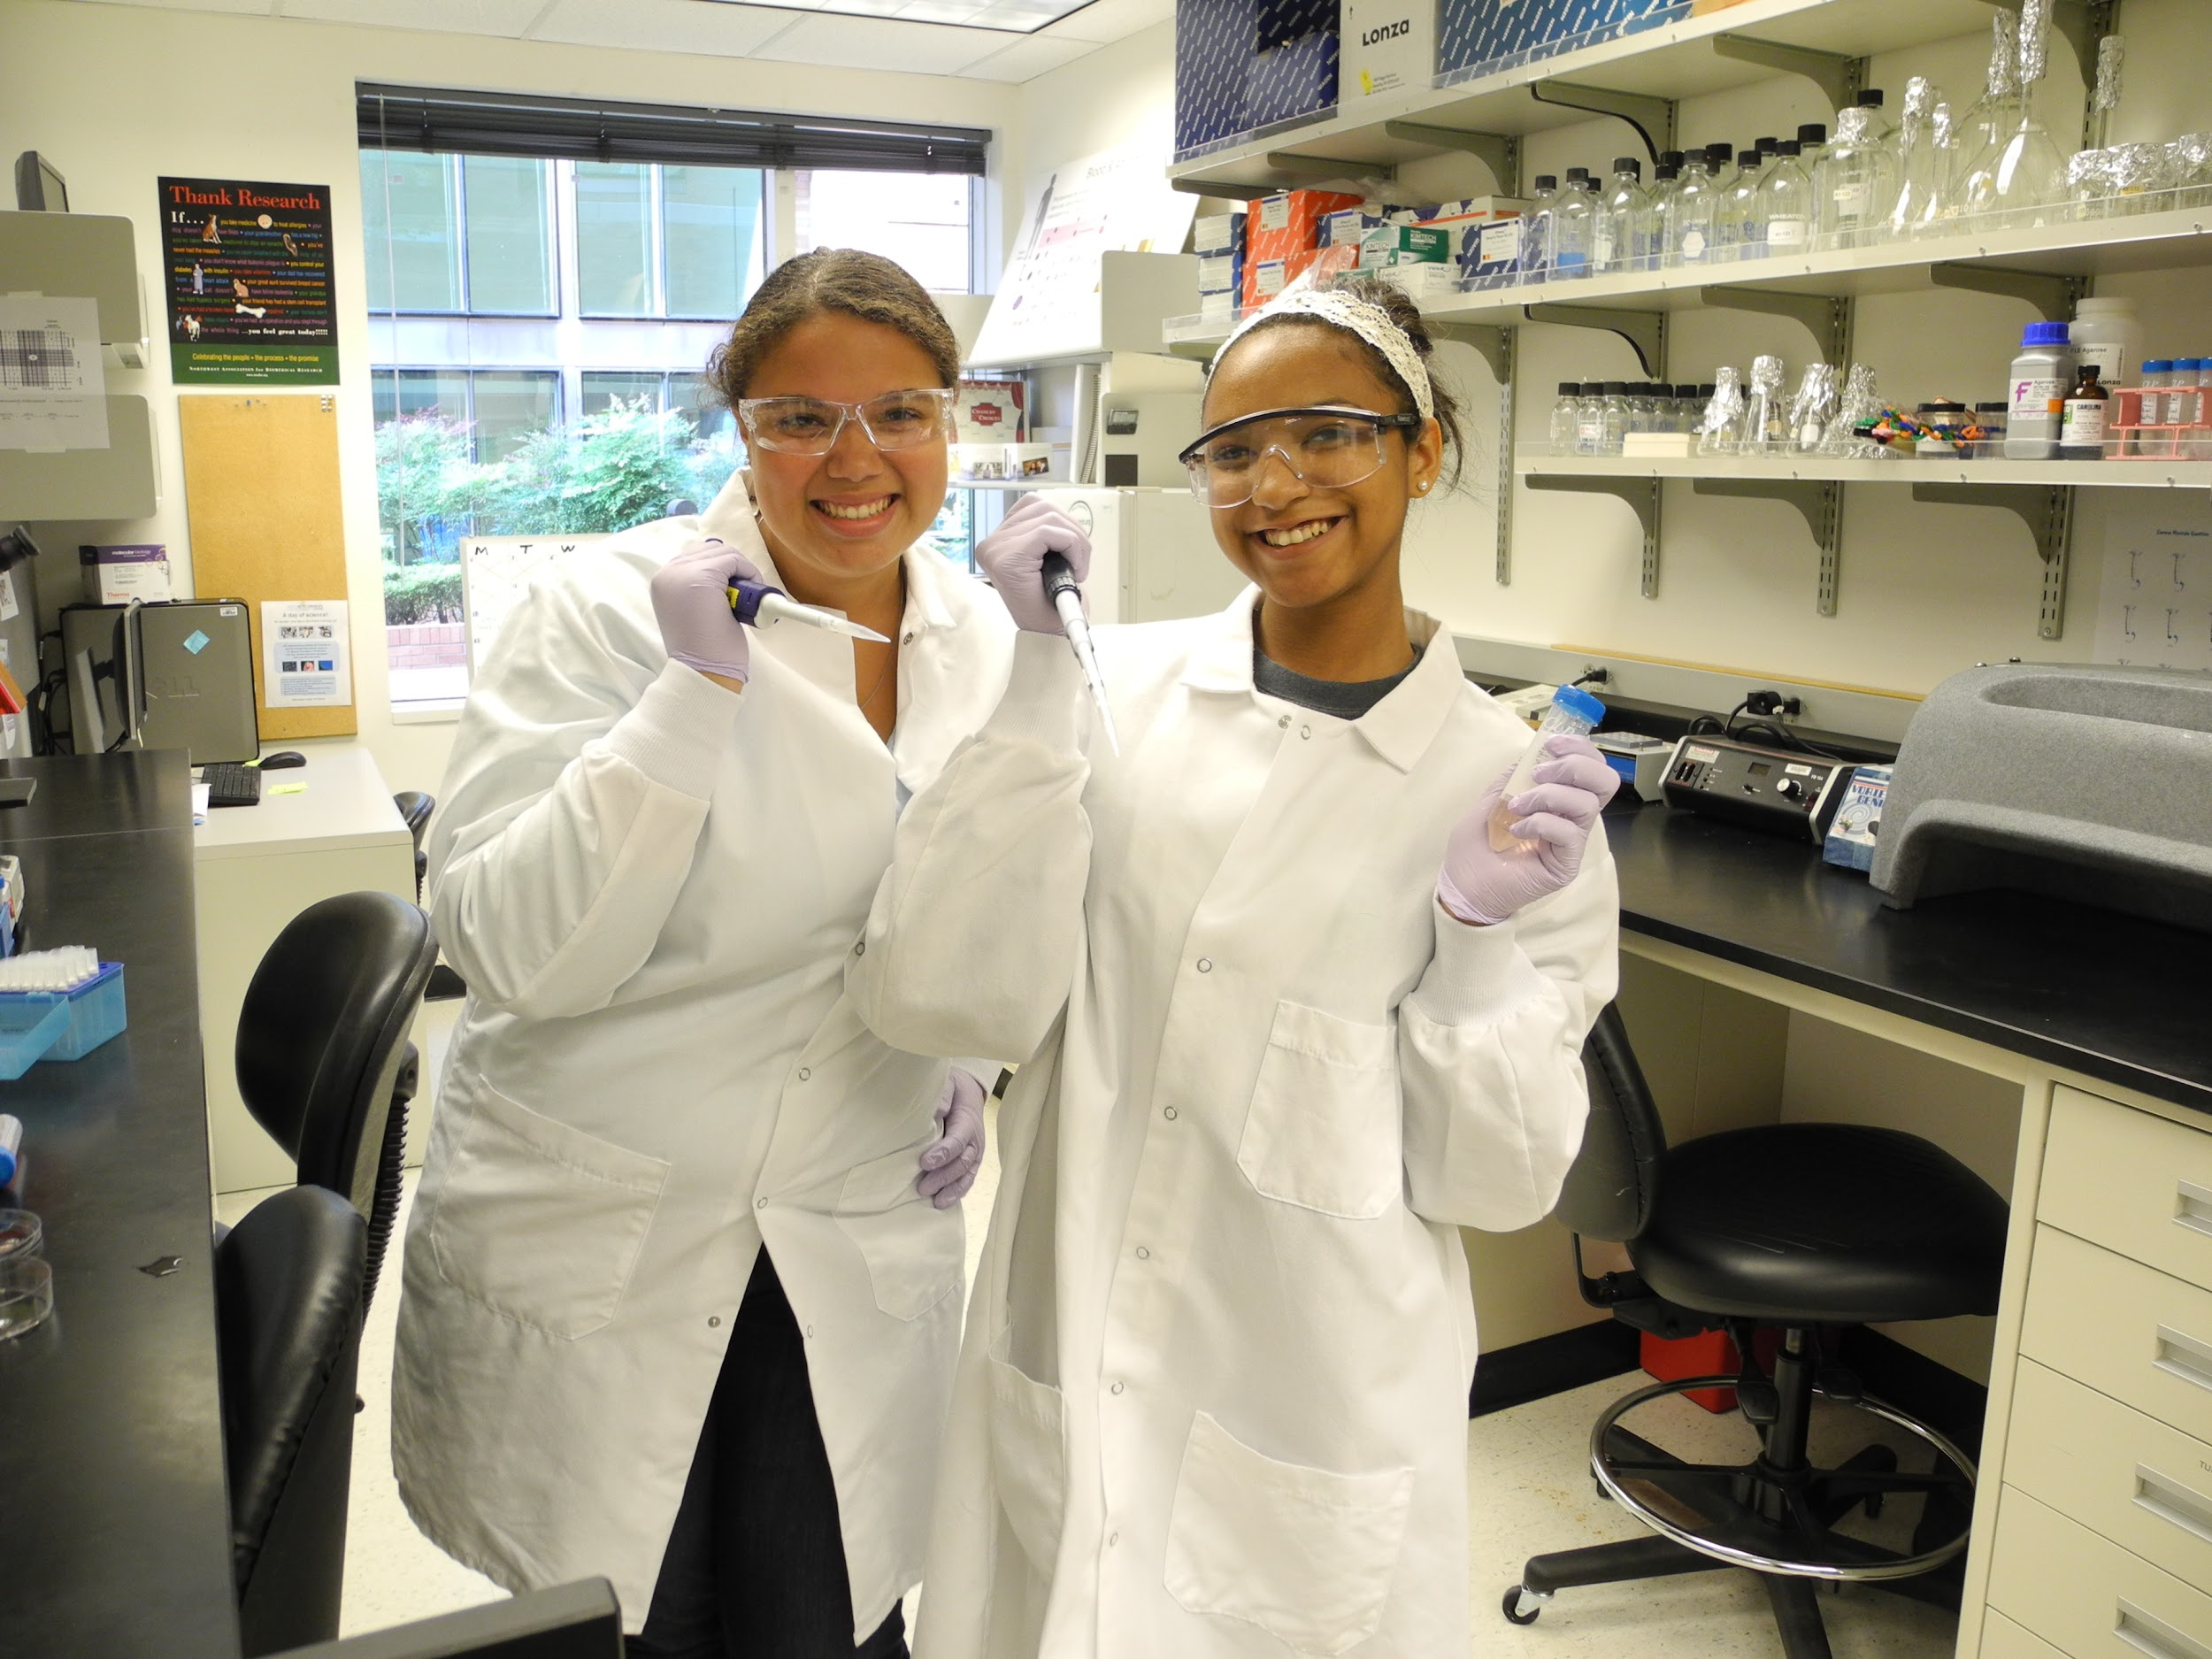
Student Requirements
Students will be required to:
Attend a interview
Prepare a resume
Resume building workshop will occur prior to application deadline
Notes:
Must have resume and be prepared for interview

Slide 6
Method of Payment
Students will receive three payments
1st week: $100.00 to cover incidentals and transportation
2nd payment Week 3: $618.75
3rd payment Week 5: $618.75 after all assignments and timesheets are submitted to a teacher
*Students must open a credit union account ($5.00) for direct deposit

Slide 7
Supervision
A workplace supervisor from the employing organization will evaluate the intern twice during the internship.
A M-DCPS teacher supervisor will also be assigned to the intern and will communicate and visit workplace supervisor and intern.

Slide 8
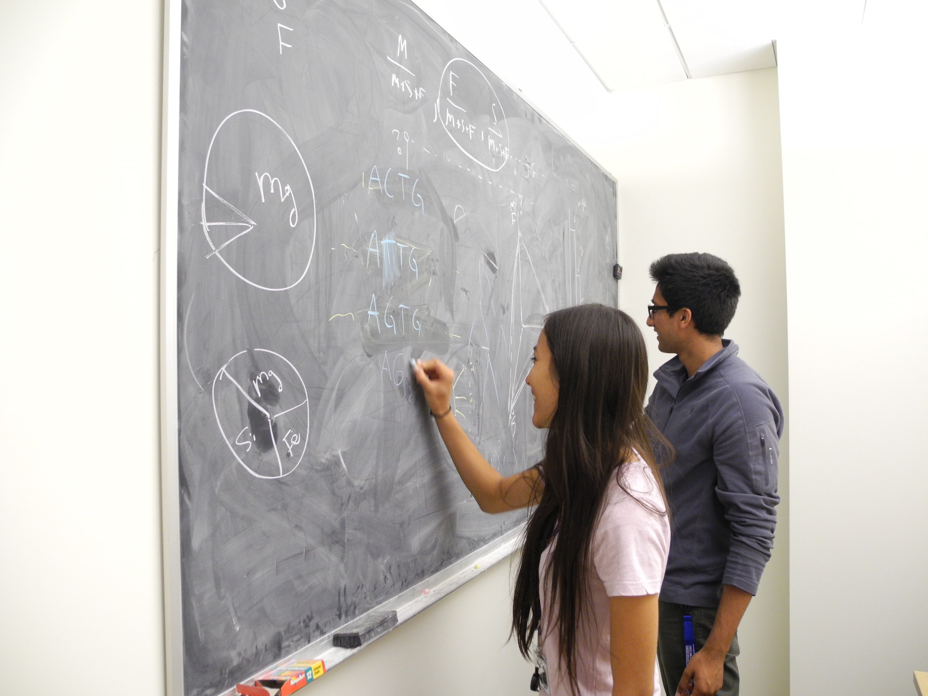
Insurance
The employers hold no liability for the interns as all interns are required to obtain student accident insurance.
Insurance cost: $18.00

Slide 9
Consent Form Deadline
To be considered for this program you must submit this completed form to the mailbox in front of Ms. Landsea’s room (9320) on or before December 7, 2018 by 2:20 p.m.

